Slide 1
The Benefits of Hosting a Regional Undergraduate Mathematics Conference
Moderator: Doug Faires, Youngstown State University
Panelists: Alissa S. Crans, Loyola Marymount University
Laura Taalman, James Madison University
Nathan Gibson, Oregon State University

Slide 2
History of the NSF-MAA Program
Philosophy of the program
First year 2003-2004
  15 Conferences, 433 speakers, 1193 students
Recent year 2008-2009
  37 Conferences, 907 speakers, 3179 students
Average 2003-2008
  $27.31 ($82.96) per student attendee (speaker)

Slide 3
Distribution of Grants for 2010-2011

Slide 4
Regions With NSF-MAA Conferences

Slide 5
Regions Without NSF-MAA Conferences

Slide 6
“Subway’’ Conferences

Slide 7

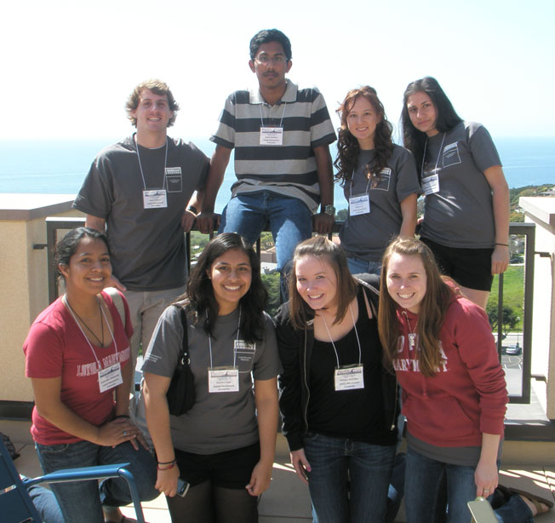
Co-sponsored by Lewis & Clark
College, Loyola Marymount
University, Pepperdine University
Co-organized by Naiomi Cameron,
Alissa S. Crans & Kendra Killpatrick
Held at rotating institutions in
greater Los Angeles area since 2006
Funded by MAA-RUMC grants, NSA Conference/Workshop grants, and Raytheon Company

Slide 8
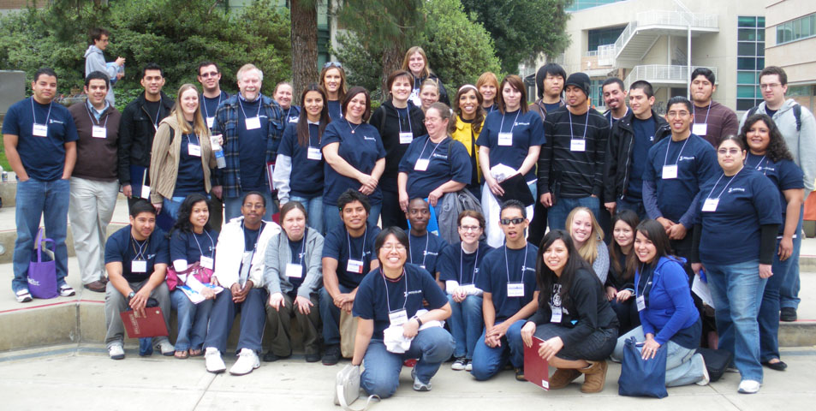
Year | Talks | Schools | Attendance | Women | Minorities
2006 | 22 | 18 | 86 | 41% | 8%
2007 | 28 | 26 | 170 | 48% | 29%
2008* | 37 | 57 | 188 | 38% | 33%
2009 | 37 | 37 | 274 | 46% | 41%
2010 | 61 | 48 | 335 | 47% | 39%

Slide 9
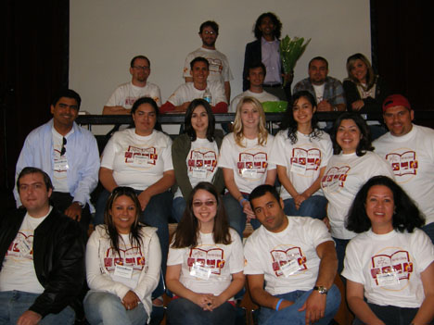
Free registration and lunch
Two student talk sessions,
including Pi Mu Epsilon
session with prizes &
freshman/sophomore session(s)
Panel discussions on career options, graduate school, summer opportunities
Panelists: Google, Dreamworks, Raytheon, NSA, JPL, Northrup Grumman, the Aerospace Corporation, Lawrence Livermore Labs, RAND, secondary education, actuarial science, biostats

Slide 10
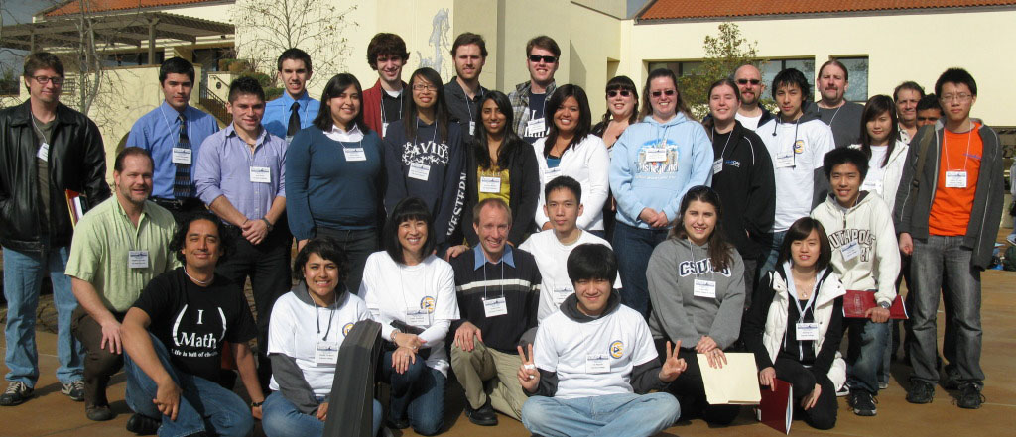
Keynote speakers:
Jennifer Quinn, Joe Gallian,
Aparna Higgins, Tony DeRose, speakers from Electronic Arts &Dreamworks, founder of TeachPi.org
In 2010: 16 public schools & 15 community colleges;
33 student talks from these institutions
Advertising through Facebook group, mailings, department websites, MAA Focus, MAA Section newsletters, e-mails to math clubs, conference website:
www.pcumc-math.org

Slide 11
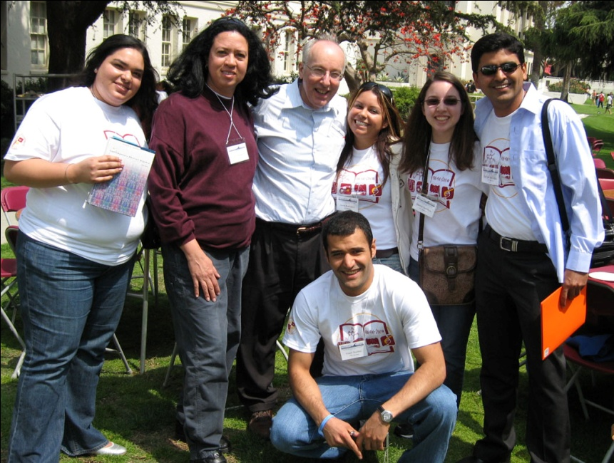
2008 expansion to entire
Pacific Coast (Northern CA,
Oregon, Washington)
2008 NSA grant provided funding for student travel/lodging;
27 students funded from 14 schools outside Los Angeles
Following year returned focus to greater Los Angeles area; 86% of 2009 participants from this region
2009 NSA funding for gas mileage from San Diego/Santa Barbara

Slide 12
Six years of SUMS
Year | Talks | Posters | Schools | Attend | Budget | RUMC
2005 | 16 | 11 | 33 | 233 | $5,850 | $2,500
2006 | 23 | 27 | 35 | 252 | $7,160 | $3,000
2007 | 28 | 32 | 46 | 237 | $6,960 | $2,700
2008 | 21 | 18 | 37 | 177 | $7,650 | $2,700
2009 | 29 | 20 | 42 | 256 | $7,900 | $2,700
2010 | 40 | 15 | 58 | 322 | $8,600 | $2,500

Slide 13
SUMS is many conferences at once
RUMC objectives | Additional JMU objectives
Regional students have an opportunity to present their work at a local conference | Increase JMU math majors’ interest in and exposure to research activity and mathematical culture
Regional students have an opportunity to see originalmathematical research done by their peers | Expose JMU students of all levels to exciting mathematics through talks by prominent, engaging invited speakers
 | Establish JMU as a leader in undergraduate research programs and activities
 | High school outreach and recruiting
 | Diversity mission: Encourage participation and representation from underrepresented groups

Slide 14
SUMS participants – last 3 years

Slide 15
SUMS regional participants

Slide 16

Northwest Undergraduate Mathematics Symposium

Slide 17
About:
Spring 2009, 2010:
  Held at Oregon State University, Corvallis, OR.
  Organized by Nathan Gibson and many students.
  2009: 33 attendees (17 speakers) representing EOU, OSU, Pacific, Willamette and WOU
  2010: 45 attendees (17 speakers) representing Humboldt State (CA), Lewis and Clark, OSU, Pacific, PSU, Reed, UO, Willamette and WOU
Spring 2011:
  To be held at Reed College, Portland, OR.
  Organized by David Perkinson and Nathan Gibson
Notes:
Spring 2011: hopefully wider reach (WA), I-5 corridor for ease of travel.

Slide 18
Format:
Spring 2009:
  Free registration and lunch
    Lunch break featuring Math Jeopardy and Mathacrostics
  Short (may be expository) and long talks
  Mostly internally funded (student fees) plus PME
Spring 2010:
  MAA-RUMC/internal (student fees and colloquium)
  Student speaker travel
  Keynote address by David Perkinson
  Panel discussion on graduate school
  T-shirts for speakers (others $14)
Notes:
New for 2011: new venue, poster session.

Slide 19
Rationale for Founding:
Personal: Hudson River, NES/MAA, MathFest
MathFest 2009: Portland, OR
  National spotlight to state and region
  Local students need practice to compete nationally (2 of 6 2009 PME Prize winners attended NUMS)
New PME chapters bring total to 6-OR, 6-WA
  Large pool of prospective participants
  Advisors are “active” in supporting undergraduates
Students’ Need:
  Interaction with students from other schools
  Strengthening bonds amongst each other
Notes:
Consider regional PME conference ($100)
Already been mentioned: Exposure to areas of math/research options

Slide 20
Master Key to Success: Delegate:
Student helpers:
  Website, logo, flyer, program, fundraising
  Day of: registration desk, session chairs
  Can claim “organizing committee”, “session chair”
Contacts at regional schools:
  Chair/undergrad advisor, PME/Mathclub advisor
  Feedback on dates, encourage students, post flyers (email pdf), organize vanpool, suggest keynote speakers, possibly host in the future
  Judges for prizes (feedback on back of form scanned and emailed to students afterward)
Notes:
Allocate travel money per school and have faculty member coordinate vanpool

Slide 21
Funding:
MAA-RUMC is great!!
  ..but limited/no money for food, keynote, prizes
Food: local pizza parlors/coffee houses may “sponsor” conference
Guest speaker: colloquium
Prizes: student clubs can do fundraising
  Selling pies on Pi day, or t-shirts/coffee mugs
  Local businesses generally give gift certificates
  OSU SIAM, AWM, PME raised $20 each for “specialty prizes”. Mathclub raised $50.
Notes:
Allocate travel money per school and have faculty member coordinate vanpool

Slide 22
Issues Encountered:
Indirect Costs
  Preferred: let MAA handle reimbursements
  Meet with grants office in person with paperwork
Student Fees Office works only with students
  At least one student closely involved with details
Last minute cancellations
  At least one graduate student standing by

Slide 23
Summary:
“If you build it, they will come.”
MAA-RUMC can help.
It is worth it.
  “Great idea! I hope this will expand in the future.”
  “It’s a very good opportunity for networking and understanding the kinds of work your fellow students are doing.”
  “I enjoyed my first academic conference.”
  “Great! Let’s do it again.”

