Slide 1
Topological Effects Quantum Hall Effect
PH671 - Transport

Slide 2
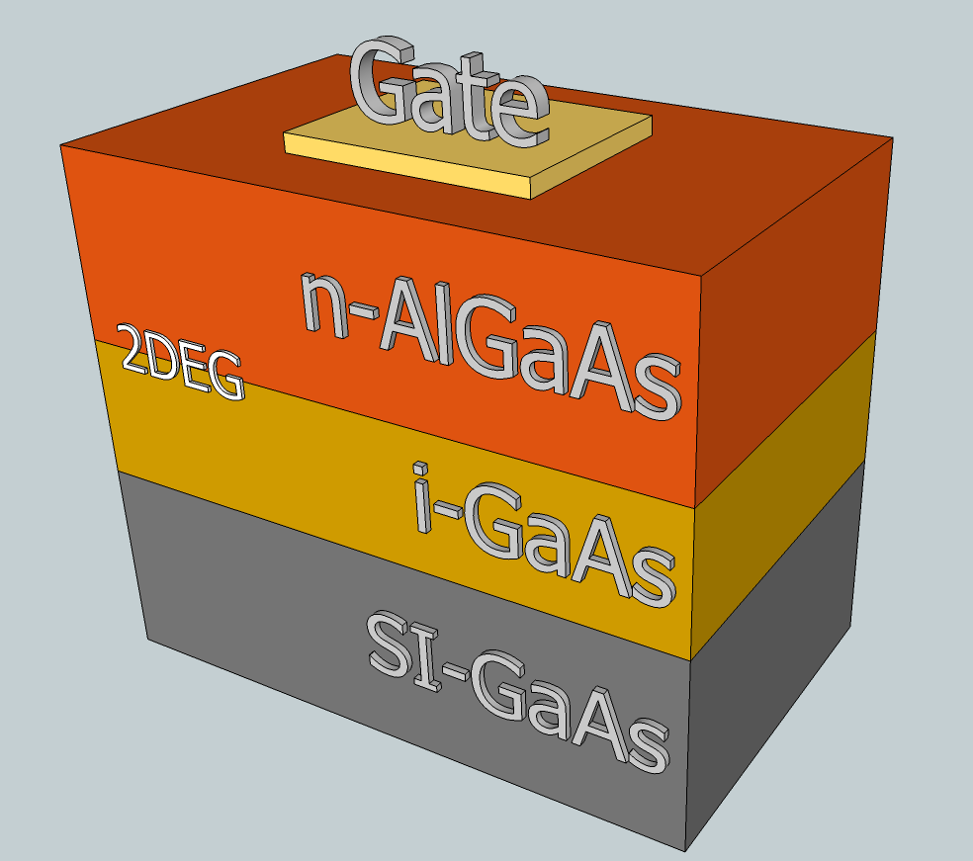
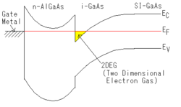
Aharonov-Bohm effect in charge-density wave loops with inherent temporal current switching
M. Tsubota, K. Inagaki, T. Matsuura and S. Tanda
EPL, 97 (2012) 57011 doi: 10.1209/0295-5075/97/57011
Notes:
https://upload.wikimedia.org/wikipedia/commons/e/e2/Sketch_of_a_heterostructure_-_2DEG_in_GaAs-GaAlAs.png

Slide 3
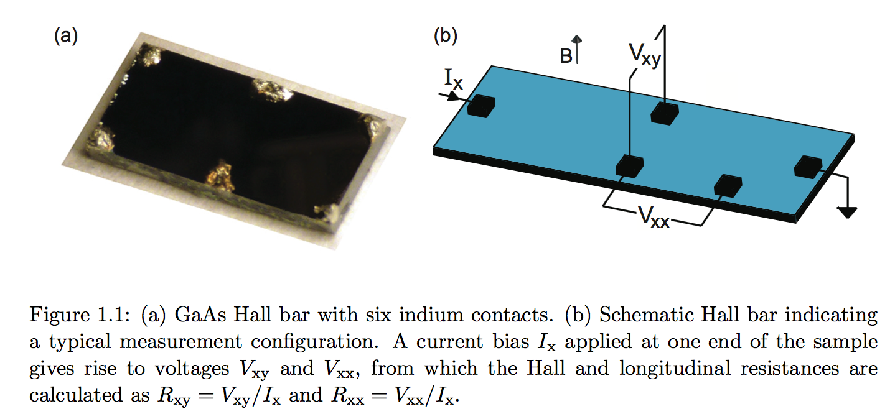
Interferometer-Based Studies of Quantum Hall Phenomena, Douglas T. McClure III (PhD thesis, Harvard, 2012)

Slide 4
Hall effect – tensor

Slide 5
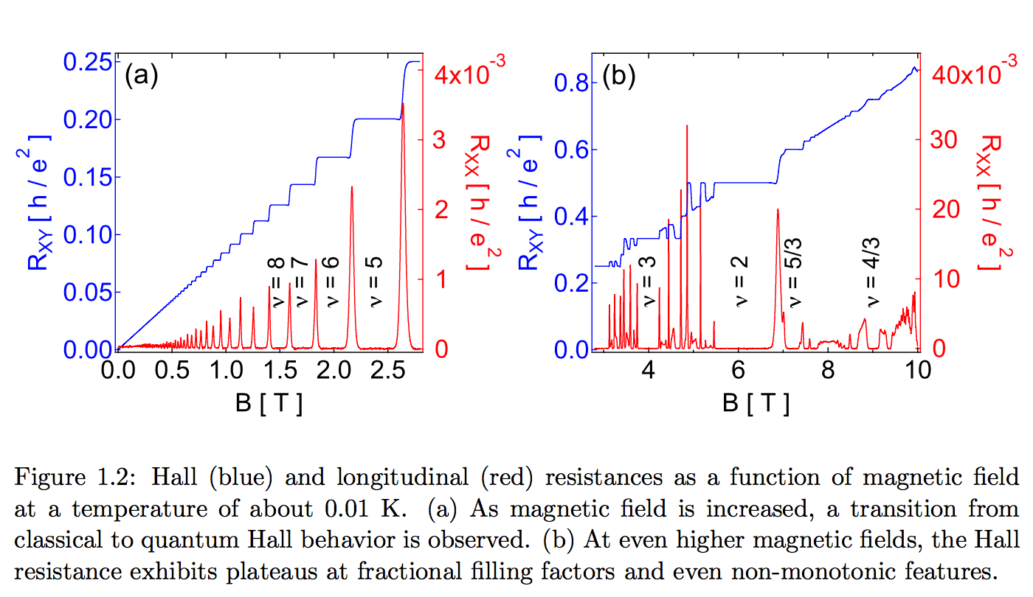
Interferometer-Based Studies of Quantum Hall Phenomena, Douglas T. McClure III (PhD thesis, Harvard, 2012)

Slide 6
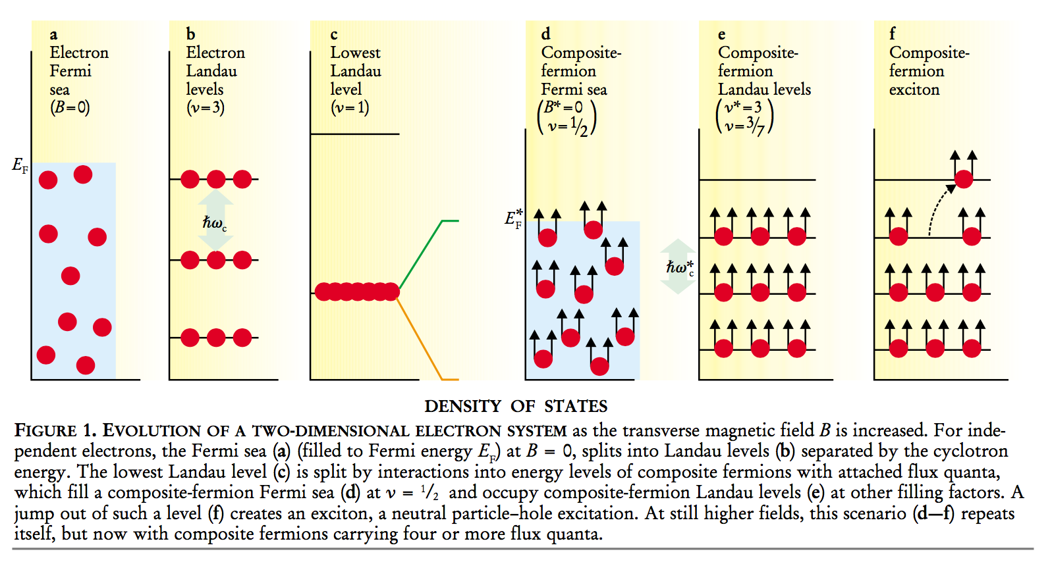
The Composite Fermion: A Quantum Particle and Its Quantum Fluids
Jainendra K. Jain
Citation: Physics Today 53(4), 39 (2000); doi: 10.1063/1.883035
Integer QHE
Fractional QHE

Slide 7
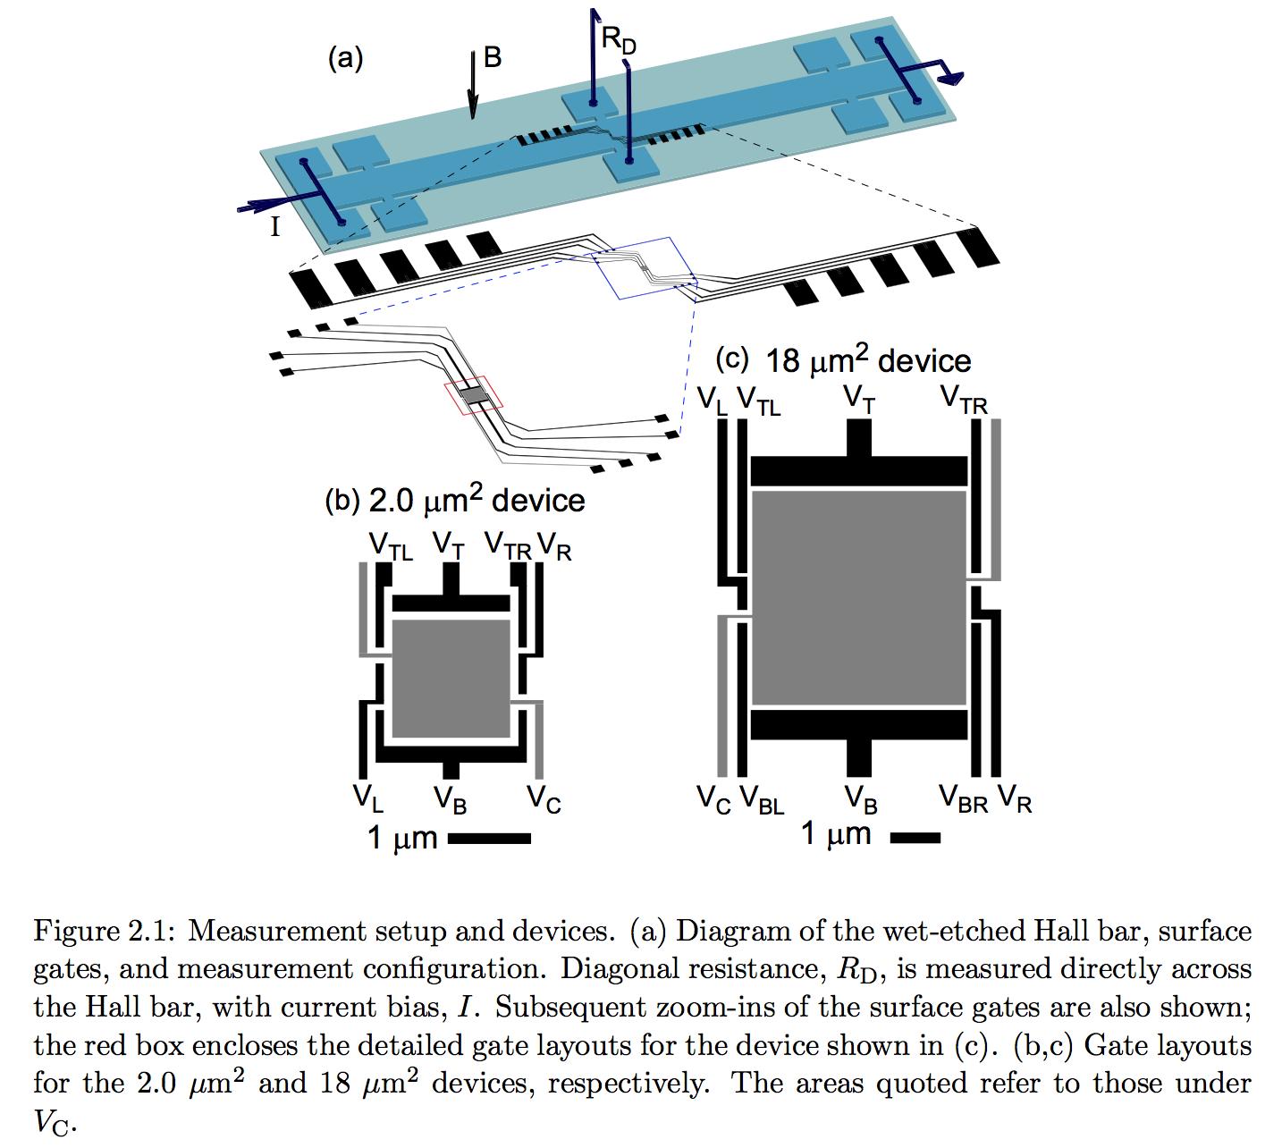
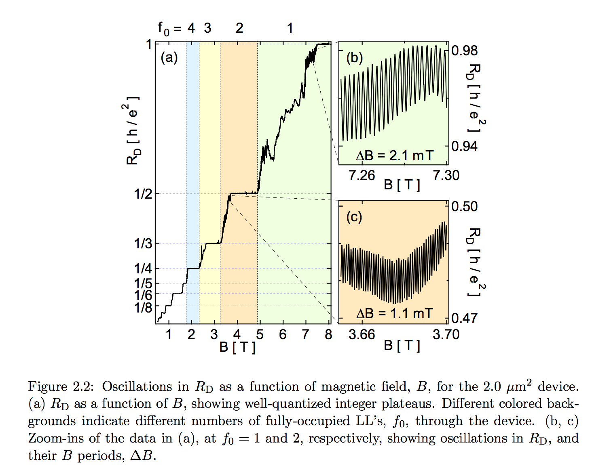
Interferometer-Based Studies of Quantum Hall Phenomena, Douglas T. McClure III (PhD thesis , Harvard, 2012)
Chapter 2: Distinct signatures for Coulomb blockade and Aharonov-Bohm interference in electronic Fabry-Perot interferometers

Slide 8
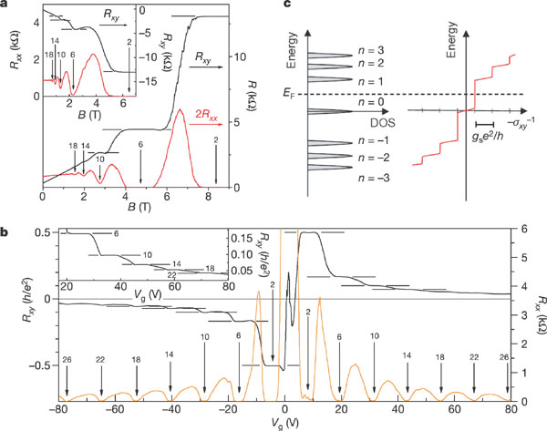
Experimental observation of the quantum Hall effect and Berry's phase in graphene
Yuanbo Zhang, Yan-Wen Tan, Horst L. Stormer and Philip Kim
Nature 438, 201-204 (10 November 2005)
doi:10.1038/nature04235
a, Hall resistance (black) and magnetoresistance (red) measured in the device in Fig. 1 at T = 30 mK and Vg = 15 V. The vertical arrows and the numbers on them indicate the values of B and the corresponding filling factor nu of the quantum Hall states. The horizontal lines correspond to h/e2nu values. The QHE in the electron gas is shown by at least two quantized plateaux in Rxy, with vanishing Rxx in the corresponding magnetic field regime. The inset shows the QHE for a hole gas at Vg = -4 V, measured at 1.6 K. The quantized plateau for filling factor nu = 2 is well defined, and the second and third plateaux with nu = 6 and nu = 10 are also resolved. b, Hall resistance (black) and magnetoresistance (orange) as a function of gate voltage at fixed magnetic field B = 9 T, measured at 1.6 K. The same convention as in a is used here. The upper inset shows a detailed view of high-filling-factor plateaux measured at 30 mK. c, A schematic diagram of the Landau level density of states (DOS) and corresponding quantum Hall conductance (sigmaxy) as a function of energy. Note that, in the quantum Hall states, Unfortunately we are unable to provide accessible alternative text for this. If you require assistance to access this image, or to obtain a text description, please contact npg@nature.com. The LL index n is shown next to the DOS peak. In our experiment the Fermi energy EF can be adjusted by the gate voltage, and Rxy-1 changes by an amount gse2/h as EF crosses a LL.
Notes:
http://www.nature.com.ezproxy.proxy.library.oregonstate.edu/nature/journal/v438/n7065/fig_tab/nature04235_F2.html

Slide 9
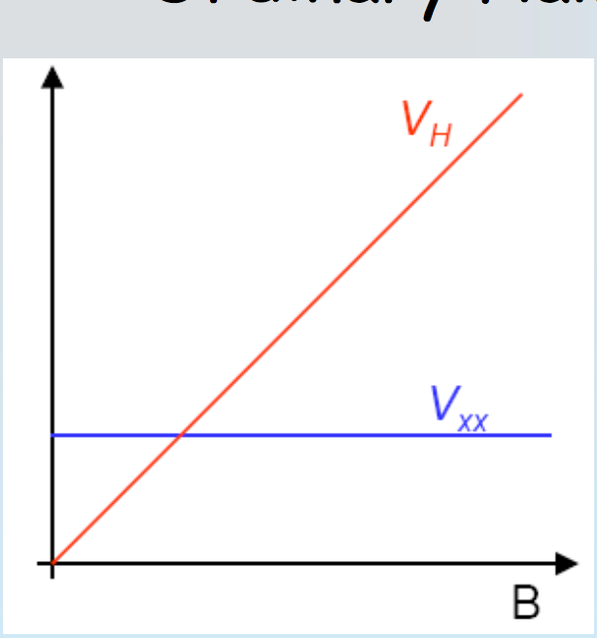
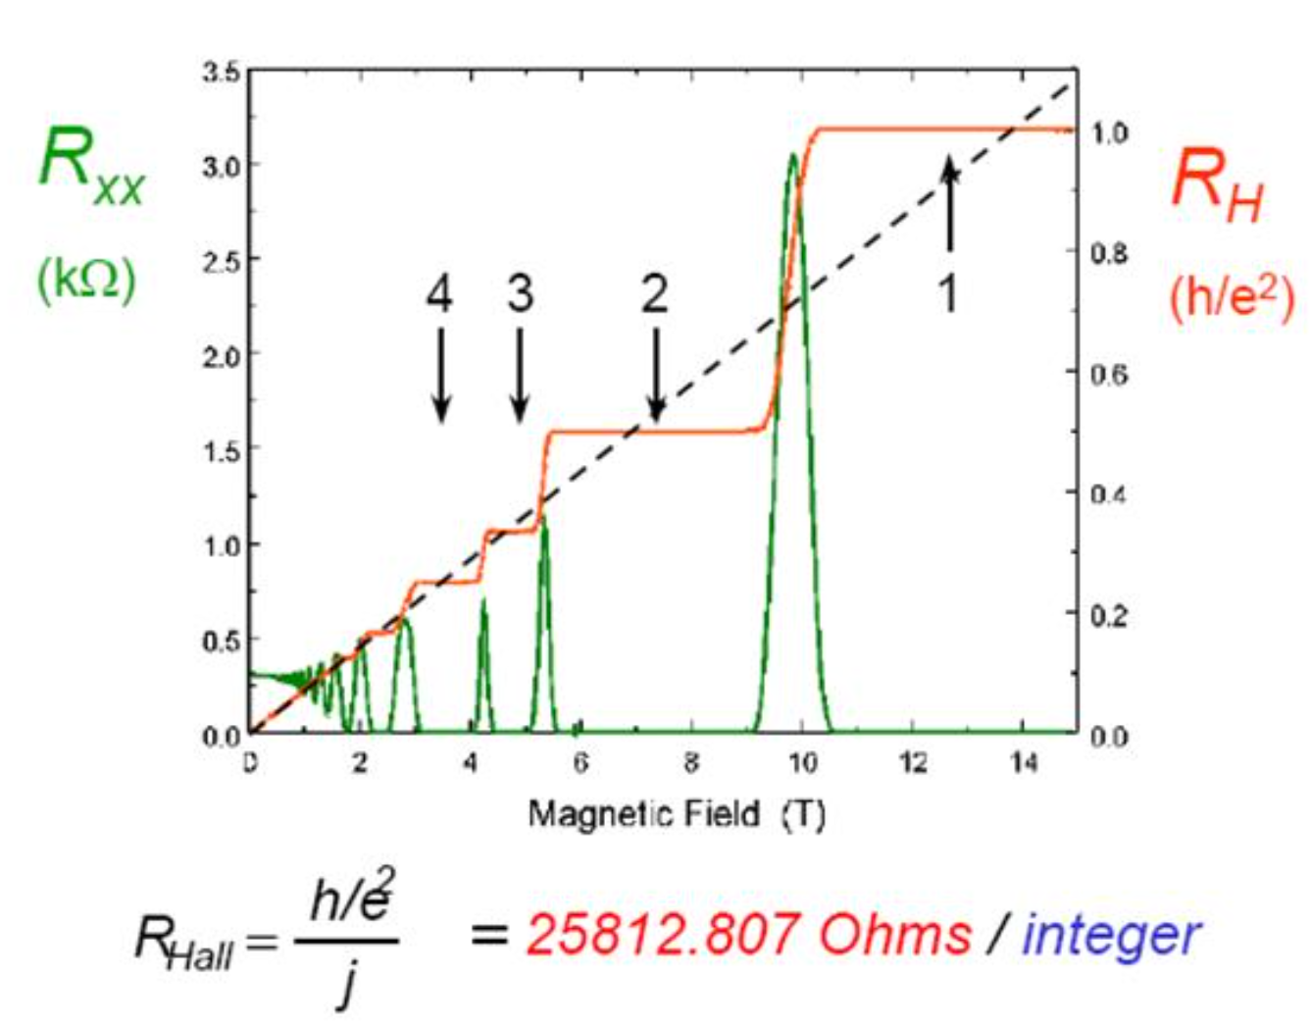
Ordinary Hall Effect
Integer Quantum Hall Effect
Shubnikov-de Haas oscillations
Notes:
http://folk.uio.no/pavlom/Introduction/Magnetotransport_2015.pdf

Slide 10
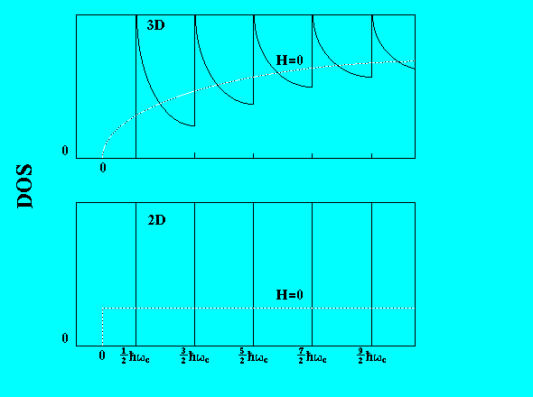
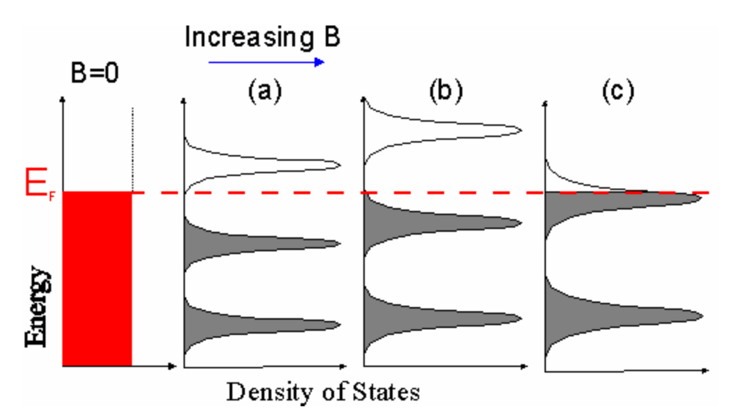
Density of States
Landau Levels
Broadening due to impurities
Landau Levels
3d
2d

Slide 11
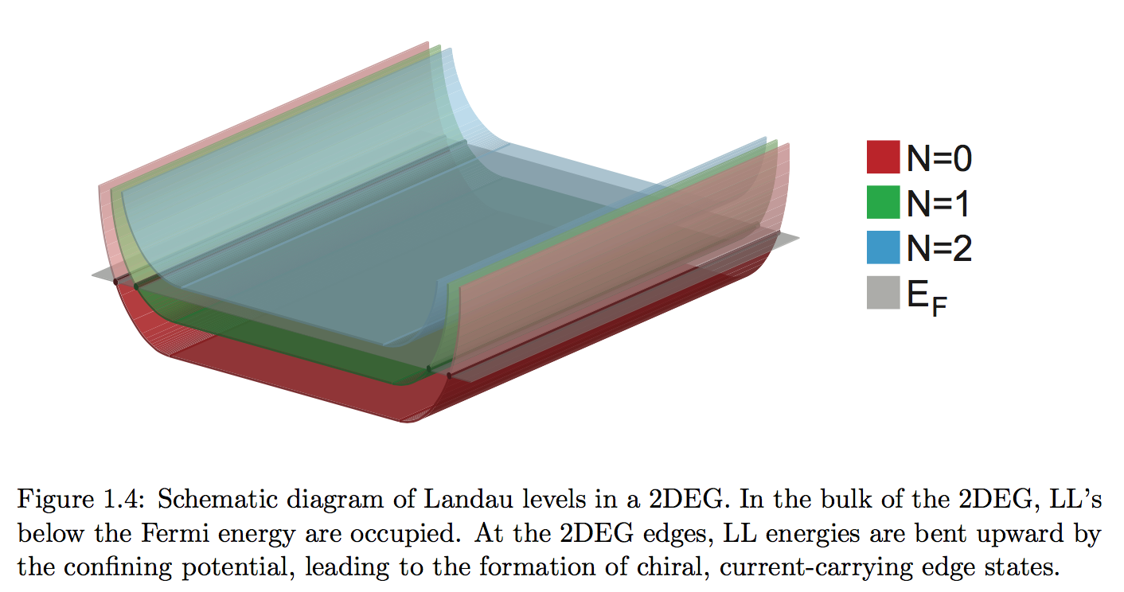
Interferometer-Based Studies of Quantum Hall Phenomena, Douglas T. McClure III (PhD thesis, Harvard, 2012)

Slide 12
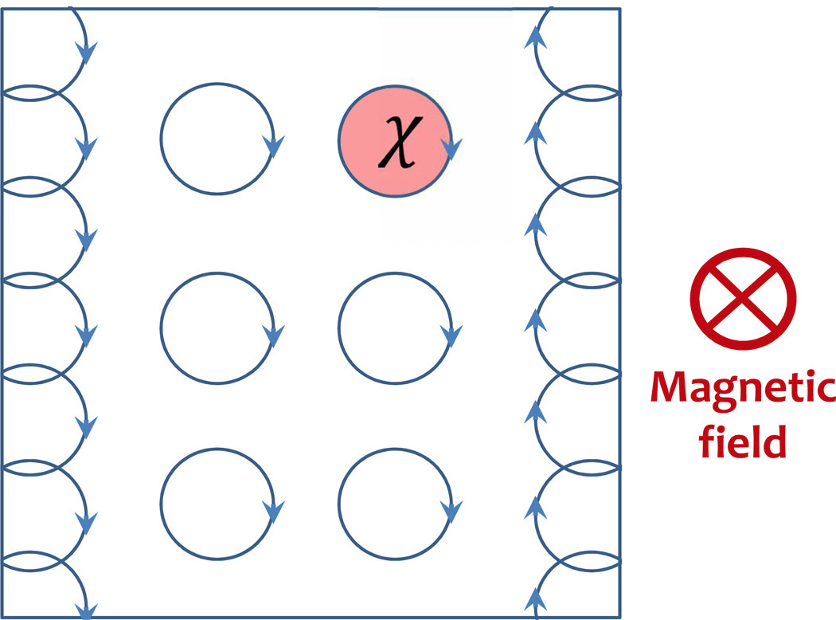
Figure 1. Cartoon of the quantum Hall effect (QHE). A 2D electron gas interacts with a strong magnetic field pointing into the plane. Electrons in the bulk of the material precess clockwise in a cyclotron orbit, picking up a phase χ associated with the encircled magnetic flux. Notice that at the left boundary of the gas, the electrons try to keep moving in circles and are forced to move downwards; the opposite happens in the right edge. These edge states constitute robust conducting cables, as they are largely immune to backscattering.
Notes:
https://www.google.com/search?q=quantum+hall+effect+edge+states&safe=active&tbm=isch&imgil=xbfXm5SqZTnivM%253A%253B-moLGKjYMr5qFM%253Bhttp%25253A%25252F%25252Fspie.org%25252Fnewsroom%25252Ftechnical-articles%25252F5703-topological-excitonics&source=iu&pf=m&fir=xbfXm5SqZTnivM%253A%252C-moLGKjYMr5qFM%252C_&usg=__hF15TcS7RbYtwZK84fhLYnyPcRo%3D&biw=1242&bih=675&ved=0ahUKEwiS1qaWv43MAhVS7mMKHYKnCAkQyjcINA&ei=pDcPV5L0HdLcjwOCz6JI#imgrc=xbfXm5SqZTnivM%3A

