Slide 1
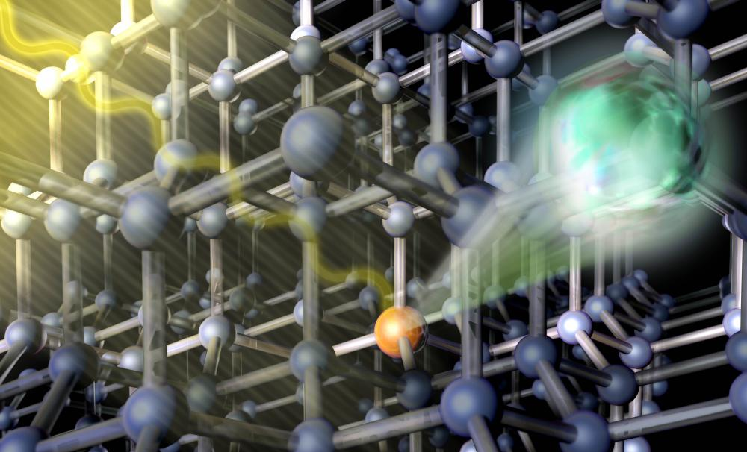
Photoexcited Electron Transport in Semiconductors
Kyle Vogt
Notes:
https://www.london-nano.com/research-and-facilities/highlight/a-light-touch-to-reading-electron-spins

Slide 2
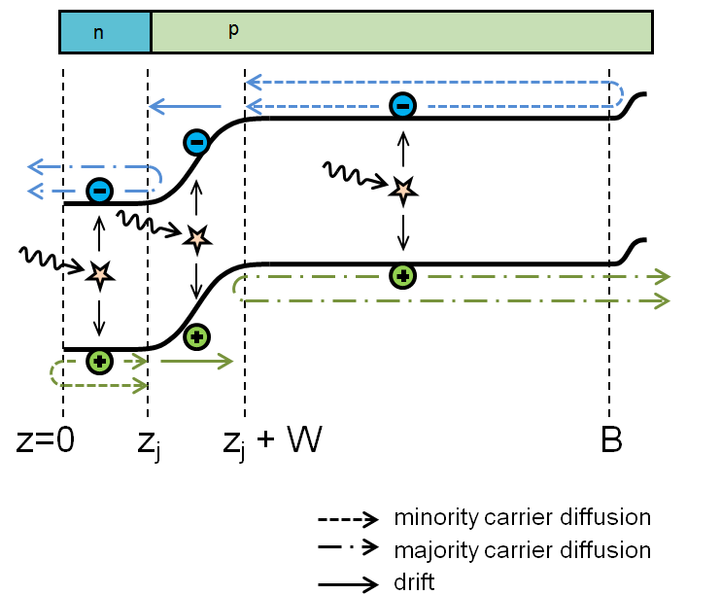
Outline
A brief history
P-N Junctions and Photovoltaics Under Illumination
Detailed balance and the intrinsic situation
Carrier concentration at finite T
Illumination
Electron diffusion => Total current => Rate Eqn.
Photoconductivity
Width of the depletion region
Current at the edge of a P-N Junction
Notes:
https://kb.lumerical.com/en/solar_cells_device_getting_started.html

Slide 3
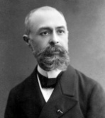
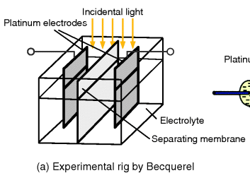
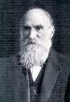
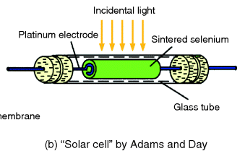
The Brief History
1839
Alexandre Becquerel (age 19) observes the photoelectric effect when he shined light on some silver chloride in an acid solution connected to platinum electrodes
1876
William Grylls Adams and his student Richard Day created the first solid state photovoltaic device
Notes:
http://wiley-vch.e-bookshelf.de/products/reading-epub/product-id/5028427/title/Photovoltaics.html
http://www.eoearth.org/files/110701_110800/110743/Adams1.jpg
http://www.virtualmuseum.ca/edu/ViewLoitDa.do;jsessionid=8EFB9A8AC55A7976562206F0426E1157?method=preview&lang=EN&id=20275

Slide 4
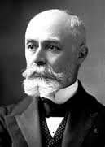
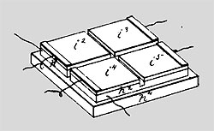
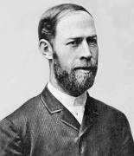
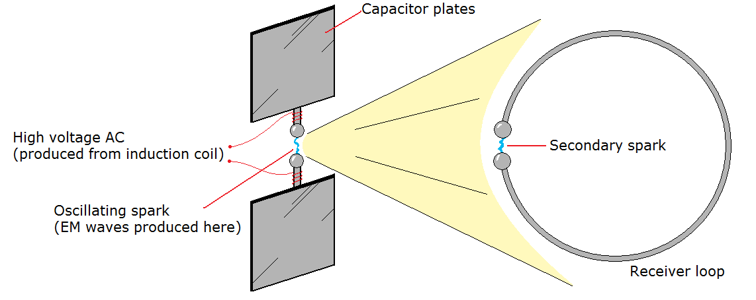
The Brief History
1883
Charles Fritts develops what is essentially the first thin film solar cell based on selenium and gold leaf. It had an efficiency of ~1%
1887
Heinrich Hertz observes the photoelectric effect (sort of)
Notes:
http://eliseosebastian.com/wp-content/uploads/2011/05/images-3.jpg
http://www.ecocitizenaustralia.com.au/charles-edgar-fritts-solar-power-pioneer/
https://en.wikipedia.org/wiki/Heinrich_Hertz
http://dc.edu.au/hsc-physics-ideas-to-implementation/

Slide 5
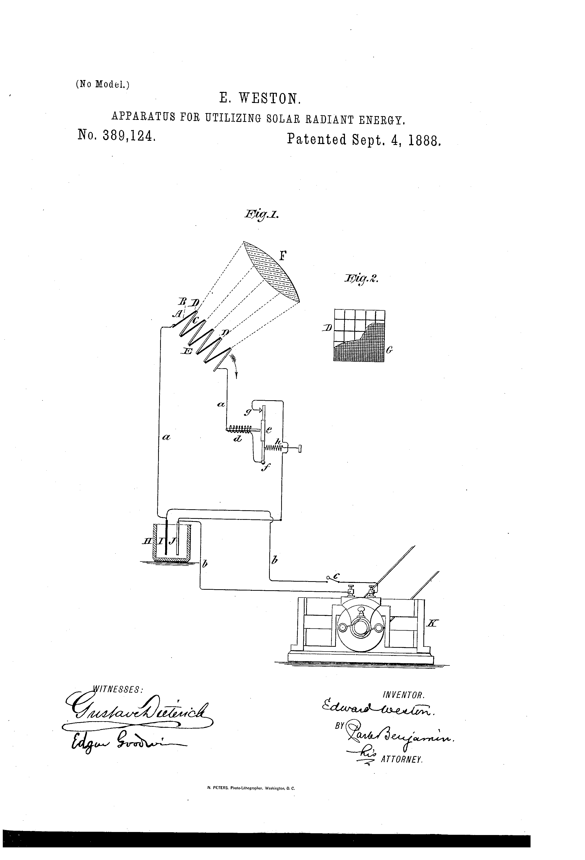
The Brief History
1888
The first US Patent for a “solar cell” is filed by Edward Weston. It was a thermopile!
“I concentrate or converge the solar beam upon any electrogenerative apparatus which depends upon an increase of its temperature for the production of an electric current, or, in other words, which will yield electrical energy in a proportion to the increase of temperatures to which it is subjected. A thermoelectric element wherein two bodies of dissimilar metal are placed side by side united at one end, and everywhere else insulated from one another, is such an electro-generative apparatus. When several of such elements are joined in series, so that their alternate junctions lie near together and in one plane, then an arrangement is termed a thermopile.”
Notes:
https://en.wikipedia.org/wiki/Edward_Weston_%28chemist%29
https://www.google.com/patents/US389124

Slide 6
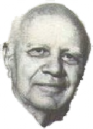
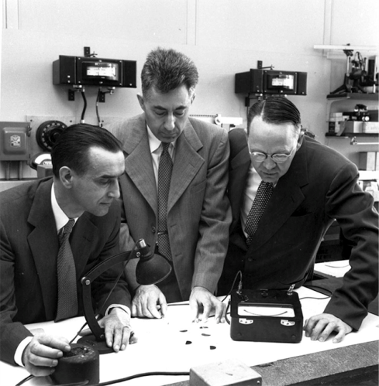
The Brief History
1939
Russel Ohl develops the P-N junction at Bell Laboratories, files the patent for the “Light Sensitive Device” in 1941. It’s accepted in 1946
1954
Fueled by the space race, Bell Labs’ Daryl Chaplin, Calvin Fuller and Gerald Pearson work together to create the (first useful) silicon photovoltaic cell at Bell Labs, boasting a 6% efficiency
Notes:
http://www.atonenergy.com/page3.html
https://www.google.com/patents/US2402662
https://tinhte.vn/threads/moi-tuan-1-phat-minh-nhin-lai-chang-duong-phat-trien-140-nam-cua-pin-nang-luong-mat-troi.2290519/

Slide 7
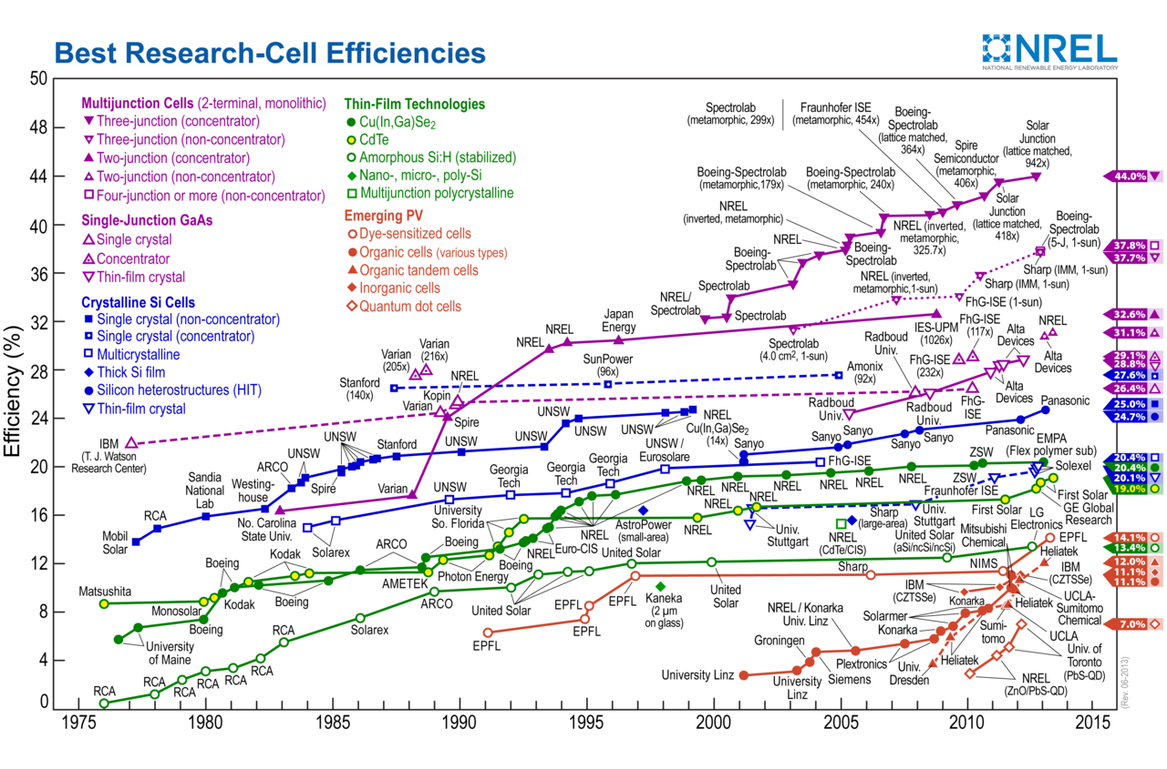
The Brief History
From there, the name of the game is to optimize! Make them cheaper, better, and more efficient! Make multijunctions, organics, quantum dots, concentrators!

Slide 8
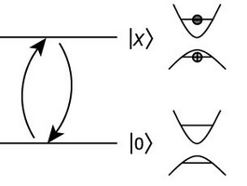
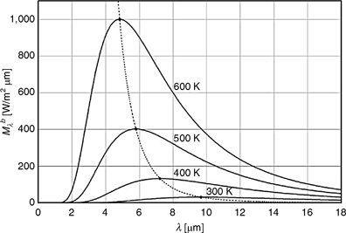
Detailed Balance
Fact: an electrons position in k-space is not static
At a temperature T, we must be able to define a thermodynamic equilibrium
Notes:
http://link.springer.com.ezproxy.proxy.library.oregonstate.edu/referenceworkentry/10.1007%2F978-3-540-77877-6_64

Slide 9
n at T: Definitions
n_{o} = electron density in conduction band at thermal equilibrium
n = total density of conduction band electrons (not necessarily at equilibrium)
n_{e} = (n - n_{o}) = excess electron density in conduction band caused by a departure from equilibrium
We can write similar expressions for holes, but we won’t. Now calculate!

Slide 10
n at T: Definitions
But wait, the integral is not analytically solveable!
We’ll introduce the Fermi-Dirac integrals to get a sense for the general solutions of these problems, which are more tractable in their asymptotic limits.
Notes:
Blakemore, Solid State Physics, W.B. Saunders Company, 1974, Chapter 3

Slide 11
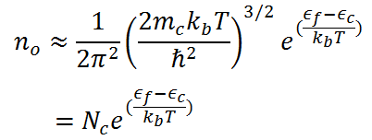
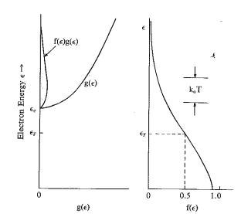
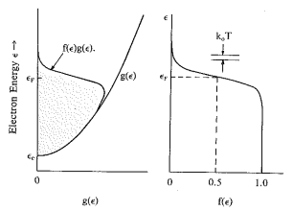
n at T: Solutions
These forms are generally known as
non-degenerate and degenerate
Notes:
Blakemore, Solid State Physics, W.B. Saunders Company, 1974, Chapter 4

Slide 12
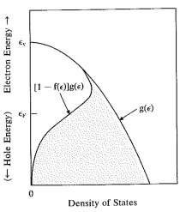
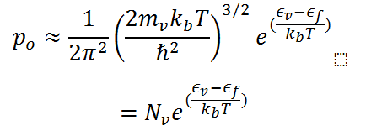
n at T: Solutions
We’ll be in the non-degenerate regime as we want to know things about semi conductors that aren’t at T=0, or … metals
And we’ll replace that junky term out front with an N, which we
will call the effective density of states.

Slide 13
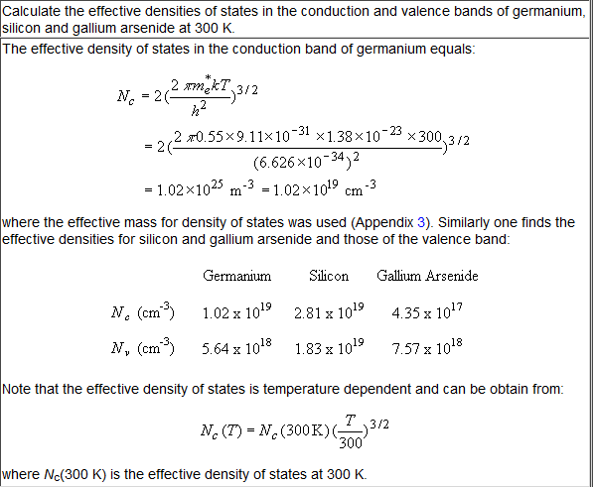
n at T: Solutions
Estimate N_{c}, N_{v}!
Notes:
http://ecee.colorado.edu/~bart/book/book/chapter2/ch2_6.htm

Slide 14
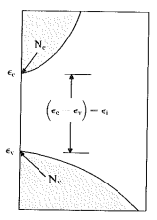
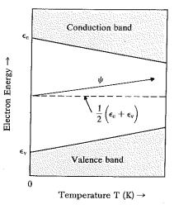
The Intrinsic Situation
Define the intrinsic conditon:
It follows that
And then
T dependence
of Fermi Level
Intrinsic Gap

Slide 15
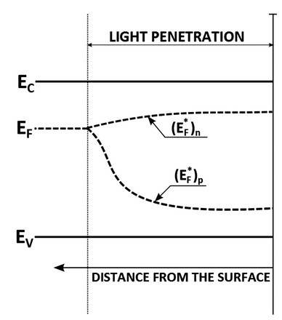
Breaking Equilibrium
We can add photo excited carriers into the mix by counting n and p in reference to some new energies:
The Quasi-Fermi levels, and , then we can modify the intrinsic carrier concentration thusly
in n-type semicond.
Notes:
http://pubs.rsc.org.ezproxy.proxy.library.oregonstate.edu/en/content/articlehtml/2015/cs/c4cs00469h

Slide 16
Restoring Equilibrium
These concentrations will eventually fall back to their respective Fermi levels, but how?
Since , we can say
and therefore
Similarly,
And
in n-type semicond.
Divide by electron charge
Notes:
http://pubs.rsc.org.ezproxy.proxy.library.oregonstate.edu/en/content/articlehtml/2015/cs/c4cs00469h

Slide 17
Restoring Equilibrium
These concentrations will eventually fall back to their respective Fermi levels, but how?
Since , we can say
and therefore
Similarly,
And
in n-type semicond.
This is a voltage that tends to restore equilibrium!!
Notes:
http://pubs.rsc.org.ezproxy.proxy.library.oregonstate.edu/en/content/articlehtml/2015/cs/c4cs00469h

Slide 18
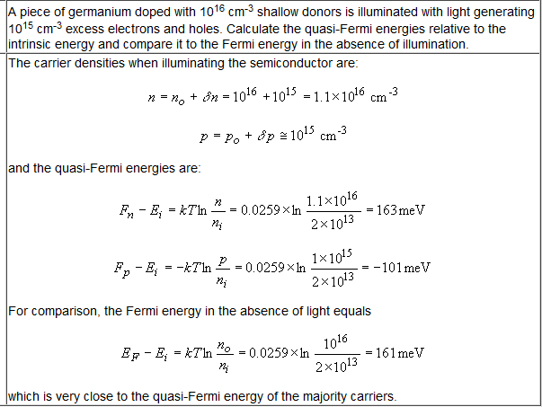
Restoring Equilibrium
Estimate!!!
Notes:
http://ecee.colorado.edu/~bart/book/book/chapter2/ch2_6.htm

Slide 19
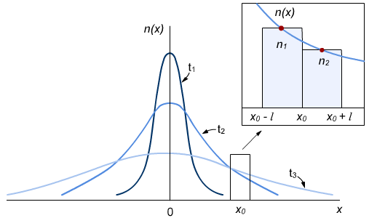
Restoring Equilibrium
Diffusion
When there is a large concentration of carriers in one region, they will tend to equilibrate via diffusion, among other processes.
We find the particle flux through the point
where is scattering length, is the average time between scattering events. We’ve also used the fact that half of the particles from each location, on average will be moving through the point,

Slide 20
Restoring Equilibrium
Diffusion
We can define the local populations as
And assuming the slope is quasi-linear on a length scale comparable to the scattering length, we write
So the diffusion current is

Slide 21
Total Current
Then the total current is
with
where is the mobility, so we can write
separately for electrons and holes

Slide 22
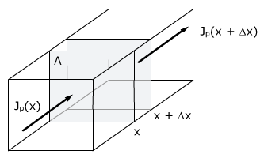
The Rate Equation
Our current density flows through some area A, and the change in carrier concentration per time in the volume is going to be be the sum of the change in the particle flux from to , the intrinsic (thermal) generation (g) and recombination (r) rates, and the external generation rate (G), or
Which is just
separately for electrons and holes

Slide 23
The Rate Equation
Conventionally, the term (r-g) is written in terms of the excess carrier density so that
and
where is the electron lifetime. This equation is often times called the continuity equation as well.
We also will adhere to the more formal vector notation here as well.

Slide 24
The Rate Equation
Then we can insert our expression for the current
into

Slide 25
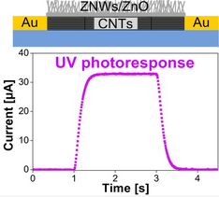
Photoconductivity
In order to find an easy expression for the photoconductivity, we’ll just go ahead and completely butcher the rate equation by assuming all steady state conditions: No drift, No diffusion, No time dependence of the carrier concentration
0!
Steady
State
Notes:
J.G. Ok, J. Lee, H. Baac, S. Tawfick, L.J. Guo, A.J. Hart.
Rapid anisotropic photoconductive response of ZnO-coated aligned carbon nanotube sheets
Applied Materials and Interfaces. 6(2):874-881, 2014

Slide 26
Photoconductivity
So then for very low biases, we can say
Then with,
We can separate the the intrinsic conductance and the photoconductance such that
And
Which is perhaps a gross oversimplification, but is still a nice simple form.
Steady
State
Notes:
J.G. Ok, J. Lee, H. Baac, S. Tawfick, L.J. Guo, A.J. Hart.
Rapid anisotropic photoconductive response of ZnO-coated aligned carbon nanotube sheets
Applied Materials and Interfaces. 6(2):874-881, 2014

Slide 27
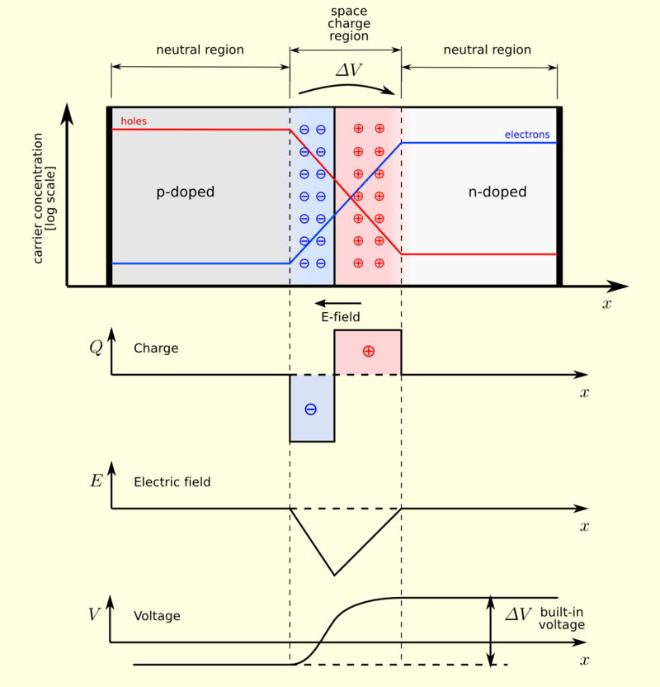
The P-N Junction
We’re going to skip the formalism with the dopants and jump straight into calculating the width of the depletion region, and then calculate the current due to the depletion region. We’ll start by looking at the charge density
where is the density of n-type dopants and
is the density of p-type dopants. In the depletion region
-x_{p}
0
x_{n}

Slide 28
The P-N Junction
Now, we can solve Poisson’s equation
In the region where
Likewise, where
Apply the boundary condition
In order to find the values of the constants
-x_{p}
0
x_{n}

Slide 29
The P-N Junction
Then we find
In the region where
Likewise, where
Now we’ll integrate one more time
-x_{p}
0
x_{n}

Slide 30
The P-N Junction
Then we find
In the region where
Likewise, where
Apply boundary conditions
-x_{p}
0
x_{n}

Slide 31
The P-N Junction
Then we find
In the region where
Likewise, where
Then V_{max} or the “built-in” voltage is
-x_{p}
0
x_{n}

Slide 32
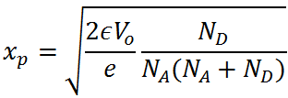
The P-N Junction
Then using we find
Which allows us to say that
And finally,
-x_{p}
0
x_{n}

Slide 33
The P-N Junction
Now, we want to find the current that is generated as a result of the P-N junction.
Things we will ignore:
-Majority carrier diffusion into the junction
-Current generation inside of the depletion region
Non-intuitive things we will include:
-MINORITY carrier diffusion into the depletion region, we’ll call these carriers .
-The boundary condition
-x_{p}
0
x_{n}

Slide 34
The P-N Junction
In order to find the current, we’ll solve the continuity equation
in the steady state, and at the egde of the depletion region so that the electric field is 0.
Where we’ve used . And since
-x_{p}
0
x_{n}

Slide 35
The P-N Junction
Then the general solution is
Since , B=0
And since , A=0

Slide 36
The P-N Junction
Inserting these carrier concentrations back into the rate equation and evaluating on the edges of the depletion region, we find
Which is often written as

Slide 37
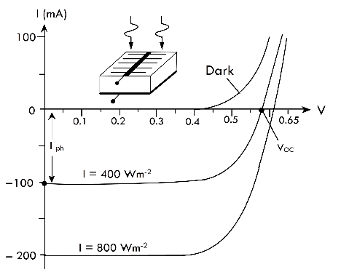
The P-N Junction
And the interpretation of this is normally that the first part is just the diode equation and the second term acts as an offset that is associated with the absorption of photons and therefore electron generation

Slide 38
Summary
Equilibrium
Non-Equilibrium
Current in a semi-conductor
Conductance
The P-N Junction
The Continuity Eqn

Slide 39
Questions?
Equilibrium
Non-Equilibrium
Current in a semi-conductor
Conductance
The P-N Junction
The Continuity Eqn

Slide 40
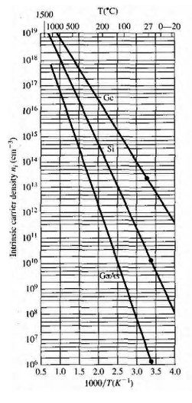
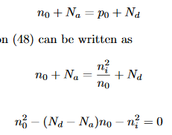
Notes:
http://mon.univ-montp2.fr/claroline/backends/download.php?url=L3BhcnRJSUlfc2VtaWNvbmR1Y3Rvcl9hdF9lcXVpbGlicml1bV9wcmludC5wZGY%3D&cidReset=true&cidReq=GMEE108

Slide 41
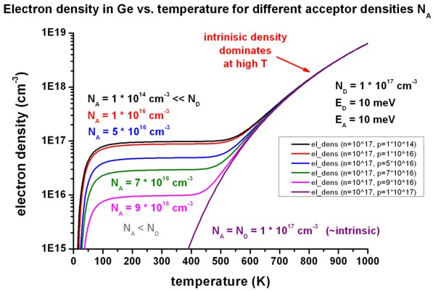
Notes:
http://www.nextnano.com/nextnano3/tutorial/1Dtutorial_doped_semiconductors.htm

Slide 42
Notes:
http://mon.univ-montp2.fr/claroline/backends/download.php?url=L3BhcnRJSUlfc2VtaWNvbmR1Y3Rvcl9hdF9lcXVpbGlicml1bV9wcmludC5wZGY%3D&cidReset=true&cidReq=GMEE108
http://www.ece.umd.edu/~dilli/courses/enee313_spr09/files/supplement2_doping_EFexamples.pdf

Slide 43
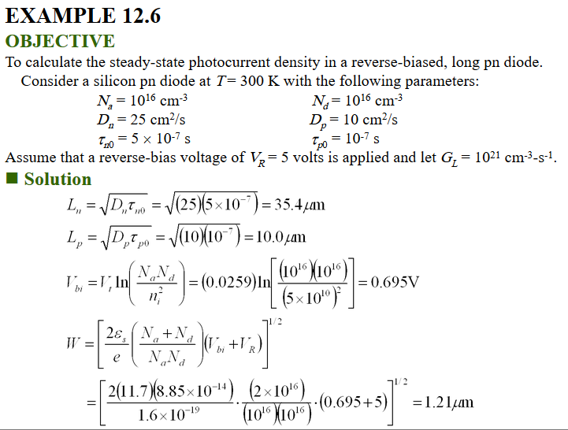
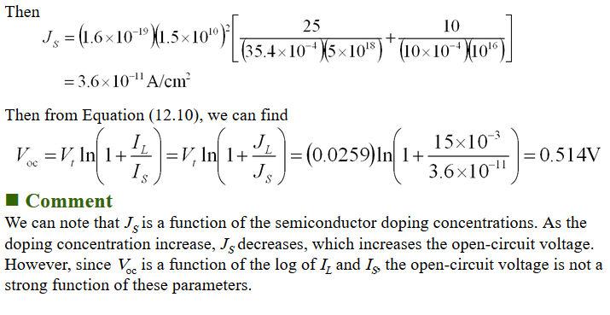
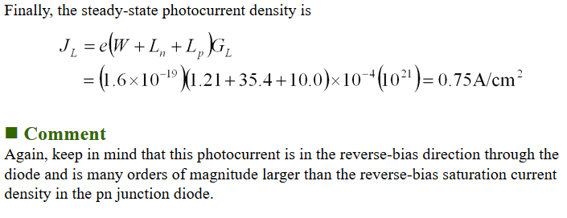
Notes:
http://slideplayer.com/slide/8054548/
Publish Gwendolyn Butler, Modified 9 years ago
13 views
Presentation on theme: "EXAMPLE 12.1 OBJECTIVE To calculate the thickness of a semiconductor that will absorb 90 percent of the incident photon energy. Consider silicon and assume." — Presentation transcript:
Slide 1
EXAMPLE 12.1 OBJECTIVE To calculate the thickness of a semiconductor that will absorb 90 percent of the incident photon energy. Consider silicon and assume that in the first case the incident wavelength is = 1.0  m and in the second case, the incident wavelength is = 0.5  m. Solution From Figure 12.4, the absorption coefficient is   10 2 cm -1 for = 1.0  m. If 90 percent of the incident flux is to be absorbed in a distance d, then the flux emerging at x = d will be 10 percent of the incident flux. We can write Solving for the distance d, we have In the second case, the absorption coefficient is   10 4 cm -1 for = 0.5  m. The distance d, then, in which 90 percent of the incident flux is absorbed, is Comment As the incident photon energy increases, the absorption coefficient increase rapidly, so that the photon energy can be totally absorbed in a very narrow region at the surface of the semiconductor. Slide 2
EXAMPLE 12.2 OBJECTIVE To calculate the generation rate of electron-hole pairs given an incident intensity of photons. Consider gallium arsenide at T = 300 K. Assume the photon intensity at a particular point is I v (x) = 0.05 W/cm 2 at a wavelength of = 0.75  m. This intensity is typical of sunlight, for example. Solution The absorption coefficient for gallium arsenide at this wavelength is   0.7  10 4 cm -1. The photon energy, using Equation (12.1), is Then, from Equation (12.6) and including the conversion factor between joules and eV, we have, for a unity efficiency factor, If the incident photon intensity is a steady-state intensity, then, from Chapter 8, the steady-state excess carrier concentration is  n = g , where  is the excess minority-carrier lifetime. If  = 10 -7 s, for example, then  n = (1.33  10 21 )(10 -7 ) = 1.33  10 14 cm -3 Comment This example gives an indication of the magnitude of the electron-hole generation rate and the magnitude of the excess carrier concentration. Obviously, as the photon intensity decreases with distance in the semiconductor, the generation rate also decreases. Slide 3
EXAMPLE 12.3 OBJECTIVE To calculate the open-circuit voltage of a silicon pn junction solar cell. Consider a silicon pn junction at T = 300 K with the following parameters: N a = 5  10 18 cm -3 N d = 10 16 cm -3 D n = 25 cm 2 /s D p = 10 cm 2 /s  n0 = 5  10 -7 s  p0 = 10 -7 s Let the photocurrent density be J L = I L /A = 15 mA/cm 2 Solution We have that We can calculate and Slide 4
Then Then from Equation (12.10), we can find Comment We can note that J S is a function of the semiconductor doping concentrations. As the doping concentration increase, J S decreases, which increases the open-circuit voltage. However, since V oc is a function of the log of I L and I S, the open-circuit voltage is not a strong function of these parameters. Slide 5
EXAMPLE 12.4 OBJECTIVE To calculate the open-circuit voltage when solar concentration is used. Consider the silicon pn junction solar cell described in Example 12.3. Let the solar intensity increase by a factor of 10. Solution The photocurrent density in Example 12.3 for one sun was J L = 15 mA/cm 2. If the intensity of sunlight increases by a factor of 10, then the photocurrent density for 10 suns is J L = 150 mA/cm 2. The reverse-saturation current density J S remains unchanged at J S = 3.6  10 -11 A/cm 2 (assuming the temperature remains constant). The open-circuit voltage from Equation (12.10) is Comment The open-circuit voltage increases slightly as the solar concentration increases, which means that the efficiency will increase slightly with solar concentration. Slide 6
EXAMPLE 12.5 OBJECTIVE To calculate the gain of a silicon photodetector. Consider an n-type silicon photoconductor with a length L = 100  m, cross-sectional area A = 10 -7 cm 2, and minority carrier lifetime  p = 10 -6 s. Let the applied voltage be V = 10 volts. Solution The electron transit time is determined as The photoconductor gain is then Comment The fact that a photoconductor  a bar of semiconductor material  has a gain may be surprising. Slide 7
EXAMPLE 12.6 OBJECTIVE To calculate the steady-state photocurrent density in a reverse-biased, long pn diode. Consider a silicon pn diode at T = 300 K with the following parameters: N a = 10 16 cm -3 N d = 10 16 cm -3 D n = 25 cm 2 /s D p = 10 cm 2 /s  n0 = 5  10 -7 s  p0 = 10 -7 s Assume that a reverse-bias voltage of V R = 5 volts is applied and let G L = 10 21 cm -3 -s -1. Solution Slide 8
Finally, the steady-state photocurrent density is Comment Again, keep in mind that this photocurrent is in the reverse-bias direction through the diode and is many orders of magnitude larger than the reverse-bias saturation current density in the pn junction diode. Slide 9
EXAMPLE 12.7 OBJECTIVE To calculate the photocurrent density in a PIN photodiode. Consider a silicon PIN diode with an intrinsic region width of W = 20  m. Assume that the photon flux is 10 17 cm -2 -s -1 and the absorption coefficient is  = 103 cm -1. Solution The generation rate of electron-hole pairs at eh front edge of the intrinsic region is G L1 =  0 = (10 3 )(10 17 ) = 10 20 cm -3 -s -1 and the generation rate at the back edge of the intrinsic region is G L2 =  0 -  W = (10 3 )(10 17 ) exp[  (10 3 )(20  10 -4 )] = 0.135  10 20 cm -3 -s -1 The generation rate is obviously not uniform throughout the intrinsic region. The photocurrent density is then J L = e  0 (1  e  W ) = (1.6  10 -19 )(10 17 ){1  exp[  (10 3 )(20  10 -4 )]} = 13.8 mA/cm 2 Comment The prompt photocurrent density of a PIN photodiode will be larger than that of a regular photodiode since the space charge region is larger in a PIN photodiode. Slide 10
EXAMPLE 12.8 OBJECTIVE To calculate the reflection coefficient at a semiconductor-air interface. Consider the interface between a GaAs semiconductor and air. Solution The index of refraction for GaAs is = 3.66 and for air is = 1.0. The reflection coefficient is Comment A reflection coefficient of  = 0.33 means that 33 percent of the photons incident from the gallium arsenide on the gallium arsenide-air interface are reflected back into the semiconductor. Slide 11
EXAMPLE 12.9 OBJECTIVE To calculate the critical angle at a semiconductor-air interface. Consider the interface between a GaAs and air. Solution The GaAs, = 3.66 and for air, = 1.0. The critical angle is Comment Any photon that is incident at an angle greater than 15.9  will be reflected back into the semiconductor.
Download "EXAMPLE 12.1 OBJECTIVE To calculate the thickness of a semiconductor that will absorb 90 percent of the incident photon energy. Consider silicon and assume."
Similar presentations
EXAMPLE 9.1 OBJECTIVE Calculate the minority-carrier concentration at the edge of the space charge region of a pn junction when forward-bias voltage is.
EXAMPLE 5.1 OBJECTIVE Calculate the built-in potential barrier of a pn junction. Consider a silicon pn junction at T = 300 K with doping concentrations.
EXAMPLE 8.1 OBJECTIVE To determine the time behavior of excess carriers as a semiconductor returns to thermal equilibrium. Consider an infinitely large,
EEE 598: Advanced Solar CellsFall 2009Honsberg 1 Solar Cell Operation Key aim is to generate power by: (1) Generating a large short circuit current, I.
Chapter 6 Photodetectors. Content Physical Principles of Photodiodes pin, APD Photodetectors characteristics (Quantum efficiency, Responsivity, S/N) Noise.
EXAMPLE 10.1 OBJECTIVE To determine the excess minority-carrier electron concentration in the base of an npn bipolar transistor. Consider a uniformly doped.
© S.N. Sabki Revision CHAPTER 9 CHAPTER 9 Part II.
EXAMPLE 3.1 OBJECTIVE Calculate the probability that an energy state in the conduction band at E = E c + kT is occupied by an electron and calculate the.
Chapter 8 Optoelectronic Devices (brief introduction)
Department of Aeronautics and Astronautics NCKU Nano and MEMS Technology LAB. 1 Chapter I Introduction June 20, 2015June 20, 2015June 20, 2015.
ENE 311 Lecture 9. Junction Breakdown When a huge reverse voltage is applied to a p-n junction, the junction breaks down and conducts a very large current.
ENE 311 Lecture 6. Donors and Acceptors We have learned how to find new position of Fermi level for extrinsic semiconductors. Now let us consider the.
EXAMPLE 6.1 OBJECTIVE Determine the potential  Fp in silicon at T = 300 K for (a) N a = 10 15 cm -3 and (b) N a = 10 17 cm -3. Solution From Equation.
Forward Bias Law of the Junction: Minority Carrier Concentrations and Voltage n p (0) is the electron concentration just outside the depletion region on.
PN Junctions1 Solid State Electronics PN Junctions Ronan Farrell Recommended Book: Streetman, Solid State Electronic Devices.
Transverse modes The distribution of the radiation intensity beam across the cross sectional area perpendicular to the optical laser axis has different.
CHAPTER 5 Carrier Transport Phenomena (An importat chapter) Describe the mechanism of carrier drift and induced drift current due to an applied electric.
1 V. Semiconductor Photodetectors (PD)  Introduction  Photoconductors  P-i-N photodiodes  Schottky Barrier (M-S) Photodetectors  Avalanche photodiodes.
1 Chapter 9. PN-junction diodes: Applications Diode applications: –Rectifiers –Switching diodes –Zener diodes –Varactor diodes (Varactor = Variable reactance)
1 Semiconductor Optical Sources. 2 Source Characteristics Important Parameters –Electrical-optical conversion efficiency –Optical power –Wavelength –Wavelength.
PN Junctions42 Diodes under Bias Qualitatively the function of the diode under bias can be described best in terms of energy band levels. In the intrinsic.
Solar Cells. The electrical conductivity of semiconductors Conductivity increases as T decreases. Low T sensors!
Power Point for Optoelectronics and Photonics: Principles and Practices Second Edition ISBN-10: 0133081753 Second Edition Version 1.014 [19 January 2013]
From Principles of Electronic Materials and Devices, Third Edition, S.O. Kasap (© McGraw-Hill, 2005) These PowerPoint color diagrams can only be used by.
ECE 250 – Electronic Devices 1 ECE 250 Electronic Device Modeling.
© Electronics ECE 1312 Recall-Lecture 2 Introduction to Electronics Atomic structure of Group IV materials particularly on Silicon Intrinsic carrier concentration,
ECSE-6290 Semiconductor Devices and Models II Spring, 2010 S. Sawyer 1-1 ECSE-6290 Semiconductor Devices and Models II Lecture 20: Laser Diodes Shayla.
OPTICAL SOURCES LED. -Requires less complex drive circuitry -No thermal and optical stabilization circuits are needed -Fabricated less expensively LED.
Higher Physics Semiconductor Diodes. Light Emitting Diode 1 ○ An LED is a forward biased diode ○ When a current flows, electron-hole pairs combine at.
DC Analysis Representation of diode into three models Ideal case – model 1 with V  = 0 Piecewise linear model 2 with V  has a given value Piecewise linear.

Slide 44
Annual mean solar radiation measured in Langley (1cal/cm^2=4.19J/cm^2)
Is about 300-500 langleys with majority at 350-399
Low crystallographic defect density gives diffusion lengths of <100um
Notes:
https://en.wikipedia.org/wiki/Solar_luminosity
Mazer, An Introduction to crystalline photovoltaic technology

