Slide 1
Majorana Fermions
Robert Harrison
PH 671
April 29, 2016

Slide 2
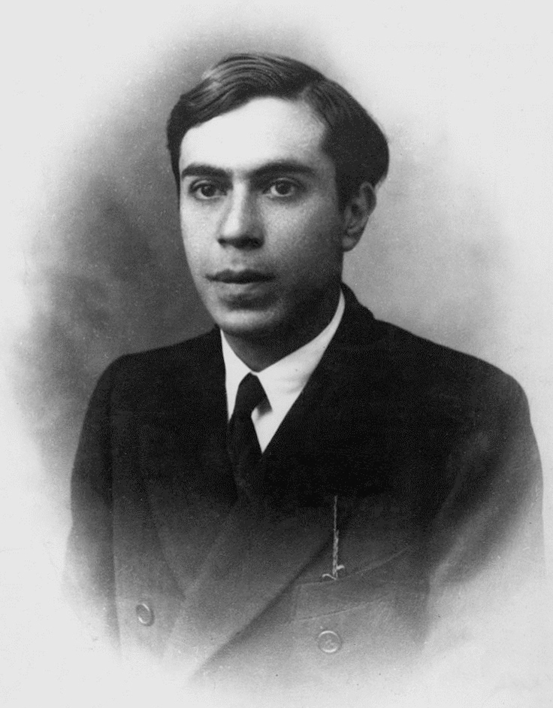
Beginnings
Majorana Fermions were first posited by Ettore Majorana, a contemporary of Fermi and Dirac, in 1937
Majorana imagined the possibility of a fermion which is its own antiparticle

Slide 3
None of the standard model fermions (with the possible exception of the neutrino) are their own antiparticles.
As such, they are sometimes called Dirac fermions in opposition to Majorana fermions.
Aside from particle physics, Majorana Fermions can also exist in condensed matter physics as quasiparticle excitations in superconductors.
These excitations can be used to form Majorana bound states which obey non-Abelian statistics

Slide 4
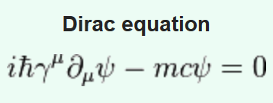
The Dirac Equation, derived by Dirac in 1928, incorporates special relativity in the context of quantum mechanics. It is a relativistically correct version of Schrödinger’s Equation, and governs all massive spin-½ particles for which parity is a symmetry.
Majorana considered the case where the Dirac equation was modified slightly by introducing the charge conjugated spinor:
with

Slide 5
In the preceding equations, charge conservation can only be preserved if ψ is charge neutral.
A Majorana particle is then a particle which satisfies the Majorana equation with the further condition that ψ=ψ_{c} .
(This is to say, a Majorana particle is its own antiparticle.)

Slide 6
Superconducting States
In superconducting materials, Majorana fermions can emerge as (non-fundamental) quasiparticles. This becomes possible because a quasiparticle in a superconductor is its own antiparticle.
An important reason that Majorana Fermions in superconductors are of interest is because they would obey a strange set of statistics – they are not in fact proper fermions but rather non-Abelian anyons (although, for some reason, they are still colloquially referred to as fermions)

Slide 7
Non-Abelian Anyons?
Non-abelian statistics: particle exchanges are non-trivial operations, and in general do NOT commute
This is far removed from ordinary known particles, in which the exchange operation either has the effect of multiplying by 1 (for bosons) or -1 (for fermions)
A normal fermionic state is actually a superposition of two MF states, so in some sense an MF is “half” a true fermion

Slide 8
Any fermion can be written as the combination of two Majorana fermions
A real part and an imaginary part, each of which is an MF, respectively
Usually, these two states are spatially localized close to each other, and so cannot be addressed independently (i.e. you don’t see the familiar fermions exhibit this behavior)
In some cases, however, it should be possible to spatially separate the half-states, in which case you would have a delocalized fermionic state which exhibits the non-abelian statistics of individual MFs
A highly delocalized fermionic state would be protected from most types of decoherence, since local perturbations generally cannot affect both Majorana constituents simultaneously
This is fact is the principle motivating low-decoherence topological quantum computation

Slide 9
Since an MF is its own hole, an MF must be an equal superposition of an electron and a hole state.
In superconductors, so-called Boguliubov quasiparticles (broken Cooper pairs) have both an electron and a hole component
MFs are similar in some ways to the Boguliubov quasiparticles, but differ in that a pair of MFs will necessarily have equal spin projections
Isolated MFs occur in general in vortices and edges of effectively spinless superconducting systems with certain symmetries

Slide 10
Superconductivity is a collective phenomenon where electrons at the Fermi level cannot exist as single particles but are attracted to each other, forming Cooper pairs. This causes an energy gap, the superconducting gap, in the electronic single-particle spectrum.
In a topological insulator, the bulk electronic structure has an insulating band gap whereas the surface shows protected electron states due to the nontrivial topology.
A topological superconductor has a superconducting gap in the bulk but shows protected states on its boundaries or surfaces.
However, unlike a topological insulator where the surface states consist of electrons, the surface states in a topological superconductor are made up of Majorana fermions.

Slide 11
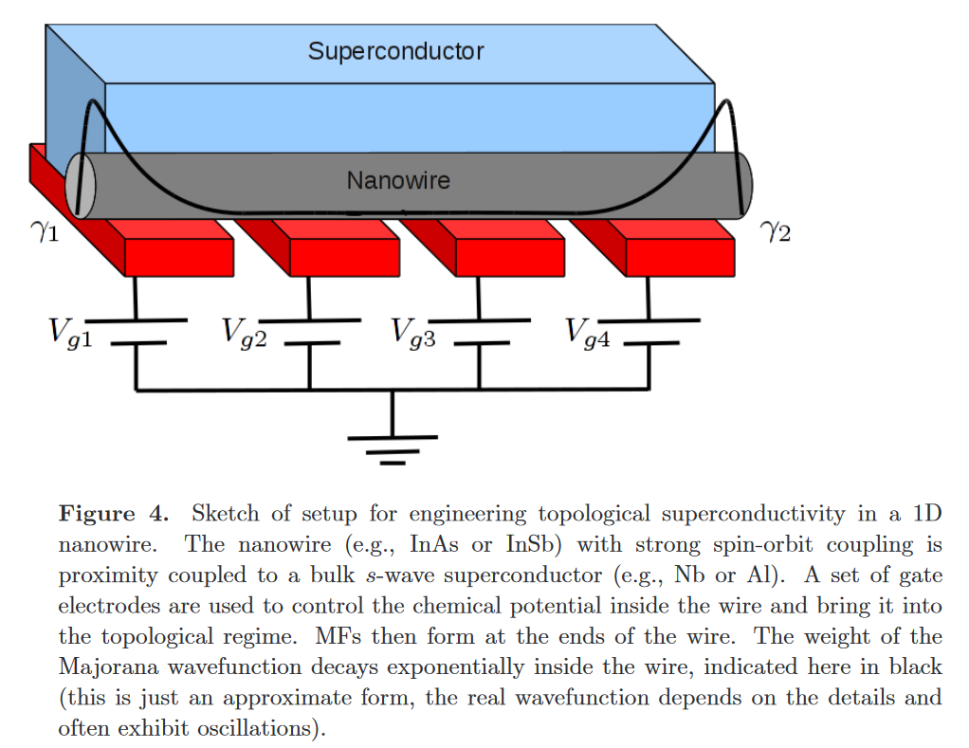
Leijnse, Martin and Karsten Flensberg. Introduction to topological superconductivity and Majorana fermions. Semicond. Sci. Technol. 27, 124003 (2012)

Slide 12
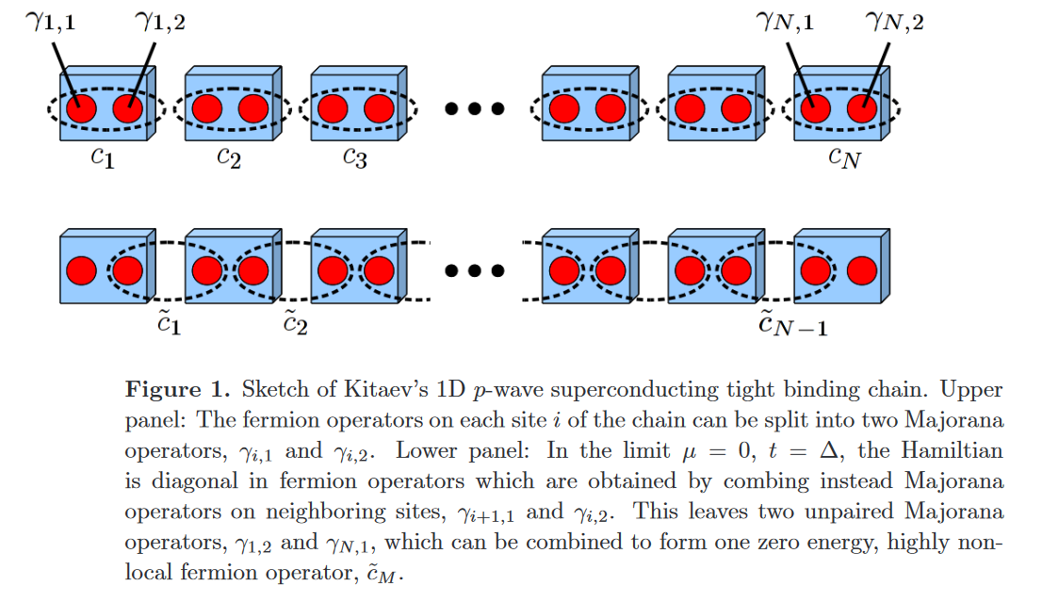
Leijnse, Martin and Karsten Flensberg. Introduction to topological superconductivity and Majorana fermions. Semicond. Sci. Technol. 27, 124003 (2012)

Slide 13
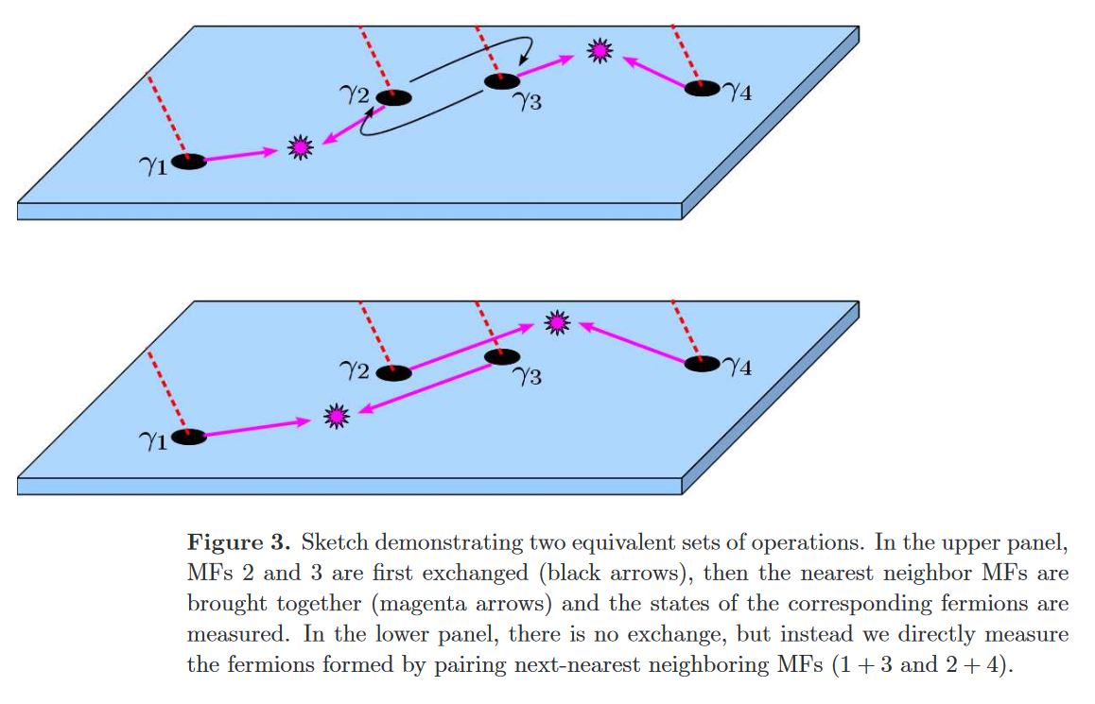
Leijnse, Martin and Karsten Flensberg. Introduction to topological superconductivity and Majorana fermions. Semicond. Sci. Technol. 27, 124003 (2012)

Slide 14
The possibility of creating stable MF states in topological superconductors could be one avenue to future quantum computation
Use a set of particle exchange as a “computation”
MFs provide the benefit of being relatively stable due to the delocalization described before

Slide 15
MFs in Quantum Spin Liquids?
Just this month, Banerjee et al. have claimed to observe MFs in QSLs:
Quantum spin liquids (QSLs) are topological states of matter exhibiting remarkable properties such as the capacity to protect quantum information from decoherence. Whereas their featureless ground states have precluded their straightforward experimental identification, excited states are more revealing and particularly interesting owing to the emergence of fundamentally new excitations such as Majorana fermions. Ideal probes of these excitations are inelastic neutron scattering experiments. These we report here for a ruthenium-based material, α-RuCl₃, continuing a major search (so far concentrated on iridium materials) for realizations of the celebrated Kitaev honeycomb topological QSL. Our measurements confirm the requisite strong spin–orbit coupling and low-temperature magnetic order matching predictions proximate to the QSL. We find stacking faults, inherent to the highly two-dimensional nature of the material, resolve an outstanding puzzle. Crucially, dynamical response measurements above interlayer energy scales are naturally accounted for in terms of deconfinement physics expected for QSLs. Comparing these with recent dynamical calculations involving gauge flux excitations and Majorana fermions of the pure Kitaev model, we propose the excitation spectrum of α-RuCl₃ as a prime candidate for fractionalized Kitaev physics.

Slide 16
Questions?

