Slide 1
Tunneling
PH671 - Transport

Slide 2
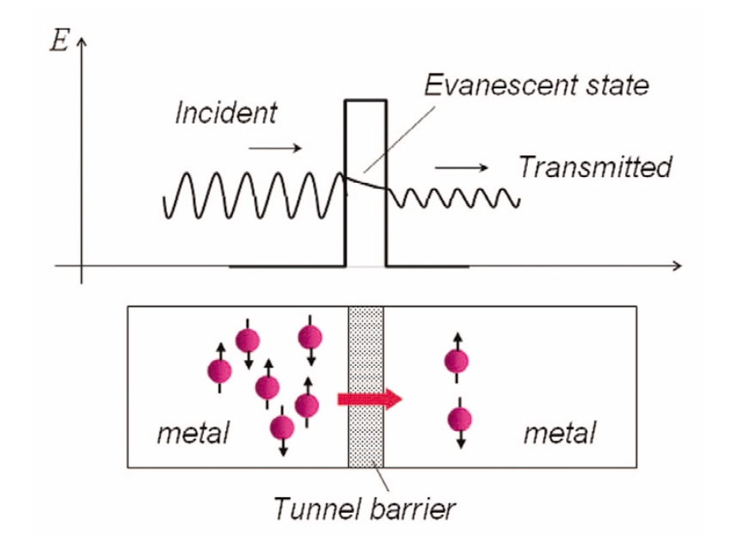
Tunneling (MIM)
Notes:
Magnetic Tunnel Junctions
Jian-Gang (Jimmy) Zhu1,* and Chando Park
NOVEMBER 2006 | VOLUME 9 | NUMBER 11

Slide 3
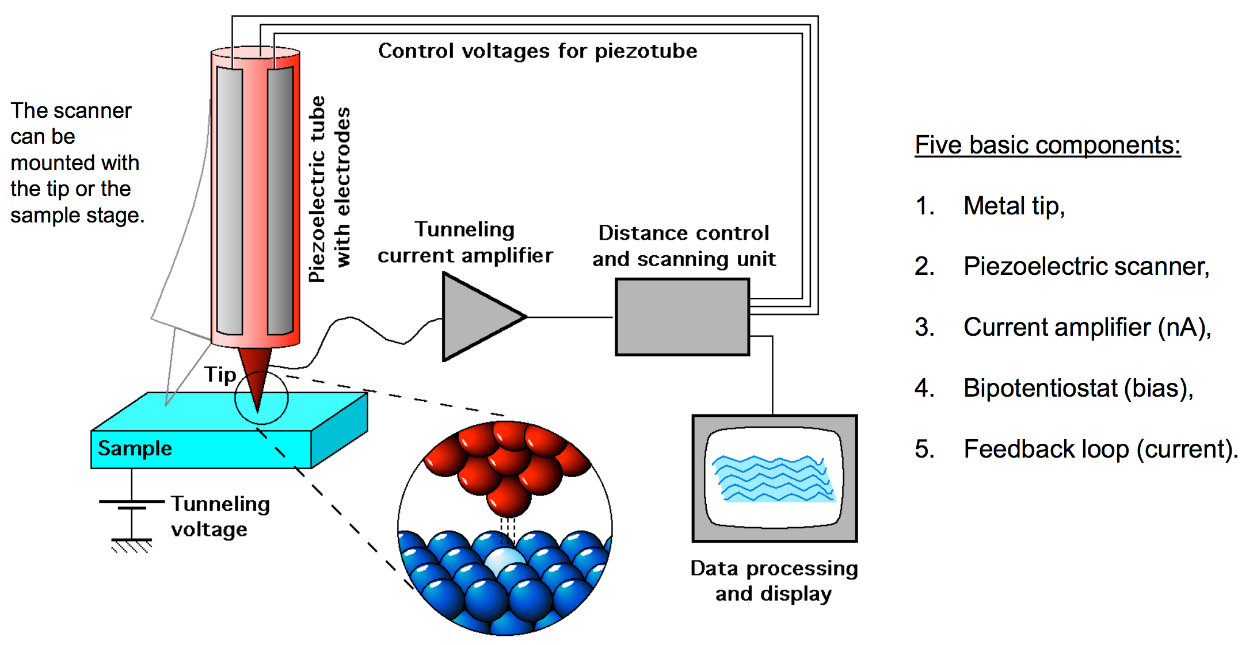
Scanning tunneling microscopy (STM)

Slide 4
Scanning tunneling microscopy (STM)

Slide 5
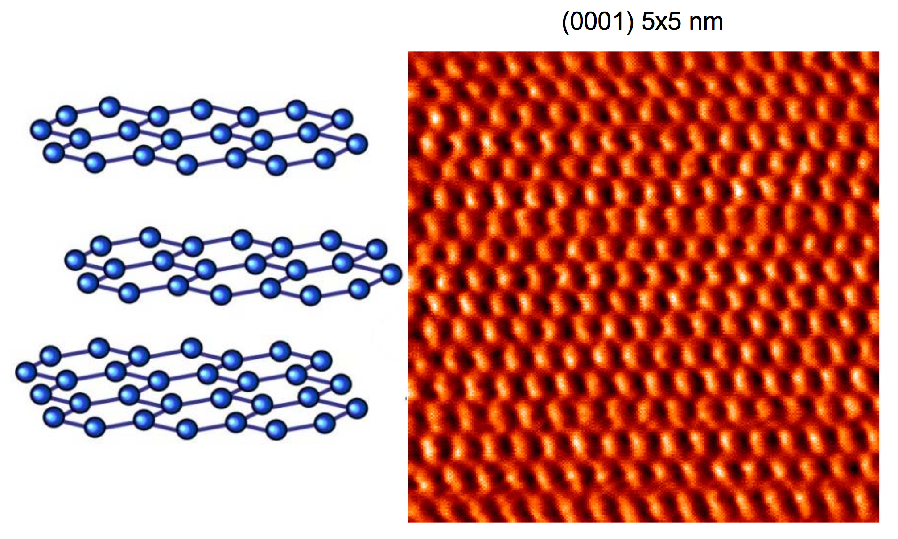
HOPV graphite

Slide 6
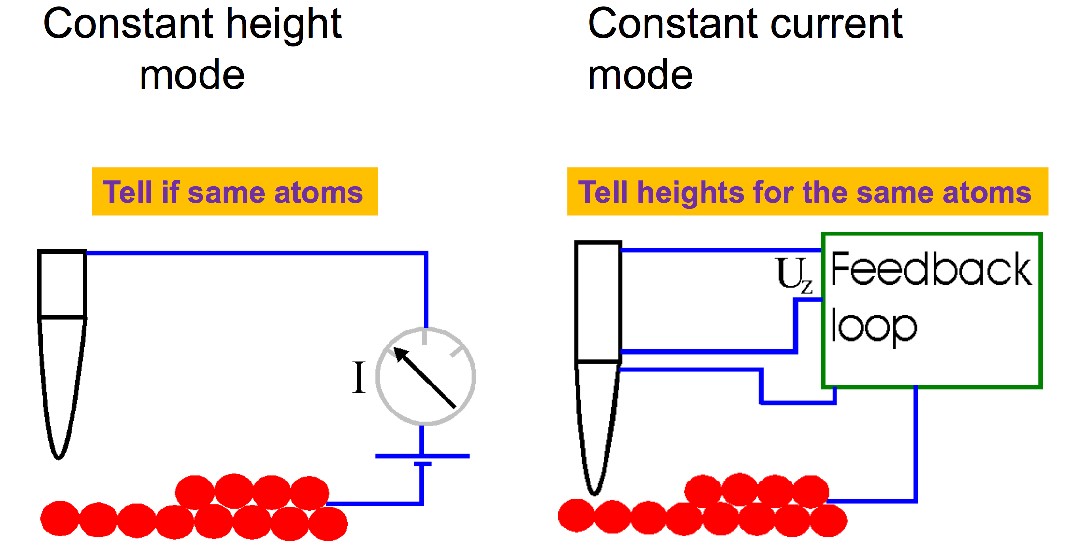
Different information

Slide 7
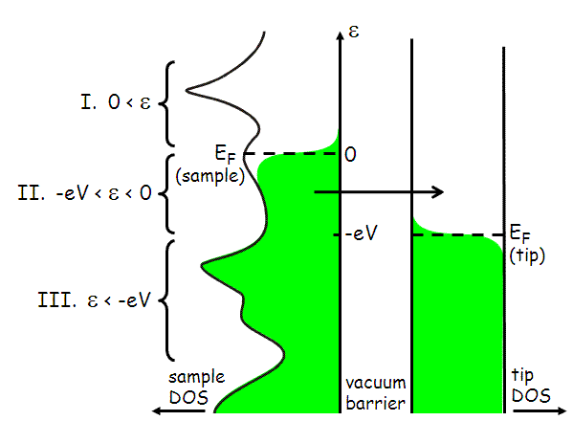
Tunneling current
Notes:
http://hoffman.physics.harvard.edu/research/STMtechnical.php

Slide 8
Tunneling current
Notes:
http://hoffman.physics.harvard.edu/research/STMtechnical.php

Slide 9
Tunneling current
f is a step function
tip has a flat DoS
Notes:
http://hoffman.physics.harvard.edu/research/STMtechnical.php

Slide 10
Tunneling current
WKB Approx for M
m : mass of the electron
s : width of the barrier (tip-sample separation)
φ : barrier height- (mix of W_{tip} and W_{sample})
Notes:
http://hoffman.physics.harvard.edu/research/STMtechnical.php

Slide 11
Tunneling current probes distance
Differential conductance probes density of states
Notes:
http://hoffman.physics.harvard.edu/research/STMtechnical.php

Slide 12
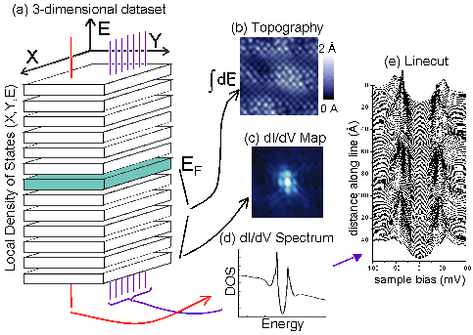
STM measurements
Notes:
http://hoffman.physics.harvard.edu/research/STMmeas.php

Slide 13
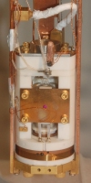
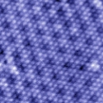
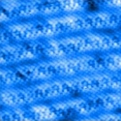
STM measurements
Bi2Se3
Bi2Sr2CaCu2O8+x
NbSe2
Notes:
http://hoffman.physics.harvard.edu/research.php

Slide 14
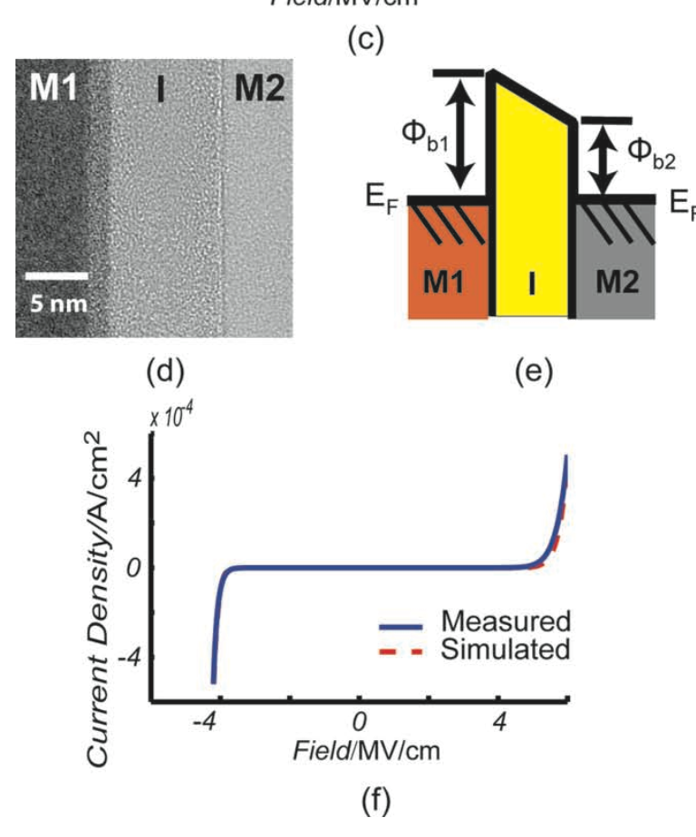
MIM diodes
Adv. Mater. 2011, 23, 74–78
Explain the form of the I-V curve.
What are the work functions of the two metals?
Notes:
Advancing MIM Electronics: Amorphous Metal Electrodes
E. William Cowell III, Nasir Alimardani, Christopher C. Knutson, John F. Conley Jr., Douglas A. Keszler, Brady J. Gibbons, and John F. Wager
Adv. Mater. 2011, 23, 74–78

Slide 15
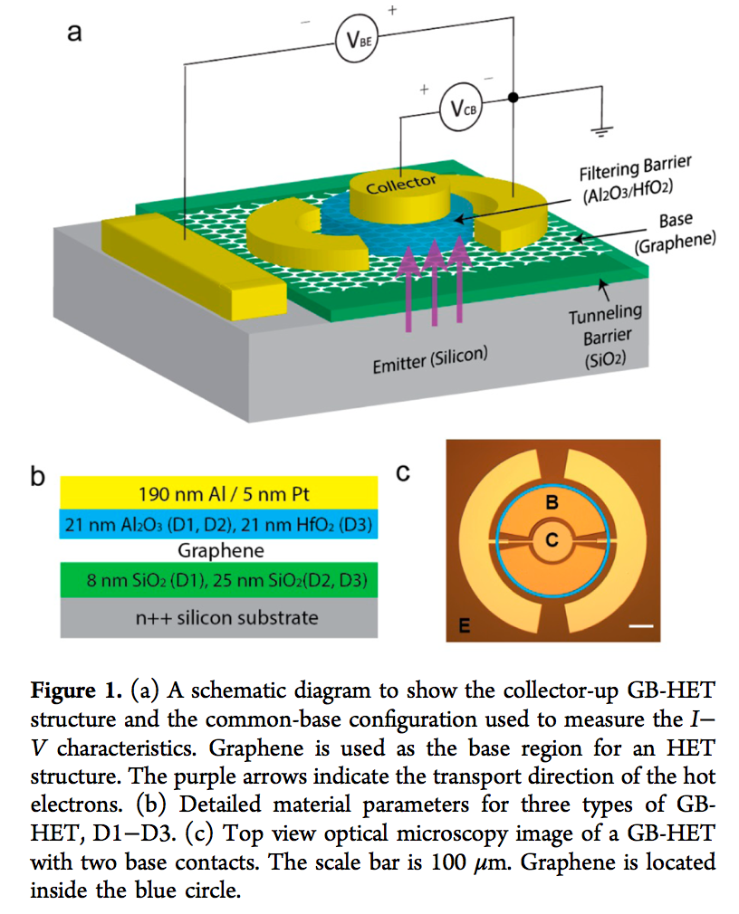
Graphene HET
Nano Lett. 2013, 13, 2370−2375
Notes:
Vertical Graphene-Base Hot-Electron Transistor
Caifu Zeng,† Emil B. Song,†,‡ Minsheng Wang,† Sejoon Lee,†,§ Carlos M. Torres, Jr.,† Jianshi Tang,† Bruce H. Weiller,‡ and Kang L. Wang
Nano Lett. 2013, 13, 2370−2375

Slide 16
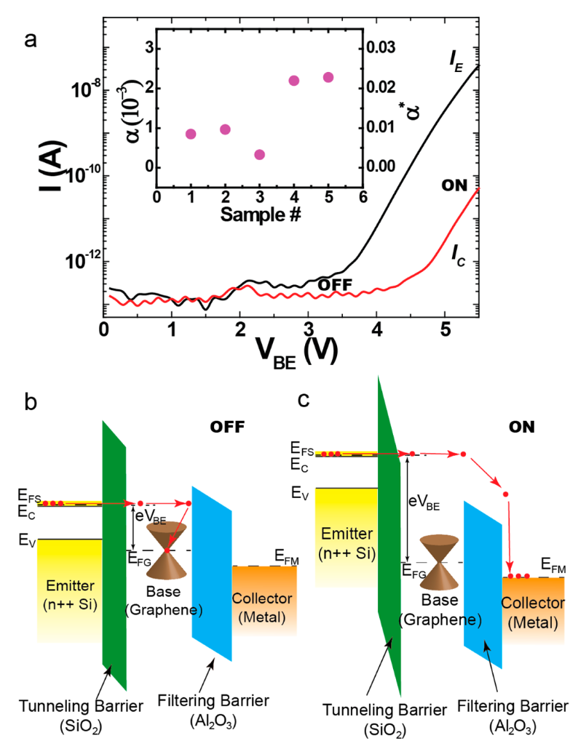
Graphene HET
Nano Lett. 2013, 13, 2370−2375
Explain the form of the I-V curve.
How does the device work?
Notes:
Vertical Graphene-Base Hot-Electron Transistor
Caifu Zeng,† Emil B. Song,†,‡ Minsheng Wang,† Sejoon Lee,†,§ Carlos M. Torres, Jr.,† Jianshi Tang,† Bruce H. Weiller,‡ and Kang L. Wang
Nano Lett. 2013, 13, 2370−2375

Slide 17
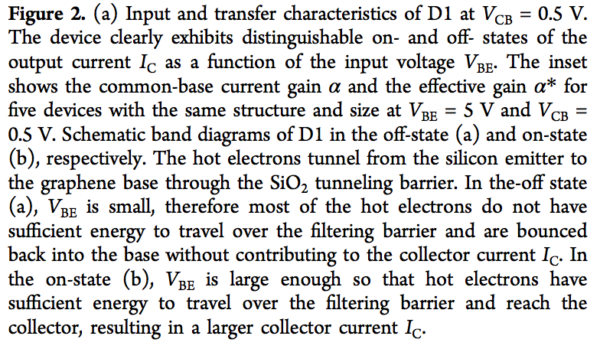
Graphene HET
Nano Lett. 2013, 13, 2370−2375
Notes:
Vertical Graphene-Base Hot-Electron Transistor
Caifu Zeng,† Emil B. Song,†,‡ Minsheng Wang,† Sejoon Lee,†,§ Carlos M. Torres, Jr.,† Jianshi Tang,† Bruce H. Weiller,‡ and Kang L. Wang
Nano Lett. 2013, 13, 2370−2375

Slide 18
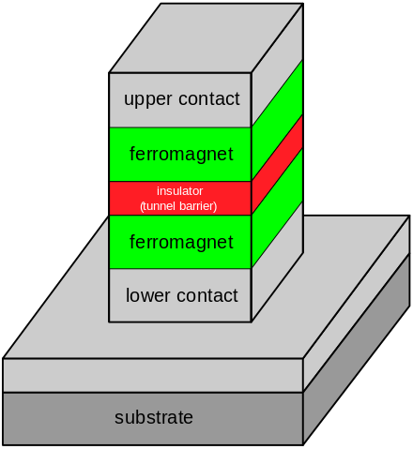
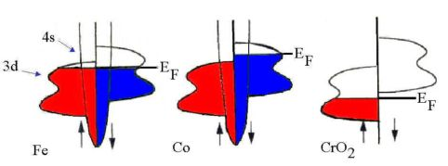
TMR Junction
Ref?
Notes:
`Wikipedia magnetic tunneling
http://www.tcd.ie/Physics/Magnetism/Research/halfmetals.php – CrO2 is a half metal ; Fe, Co are traditional ferromagnets

Slide 19
TM Junction
Explain the tuneling effect
Notes:
`Wikipedia magnetic tunneling
ipedia.org/wiki/Tunnel_magnetoresistance#/media/File:TunnelSchema_TMR.svg

Slide 20
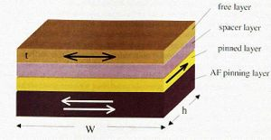
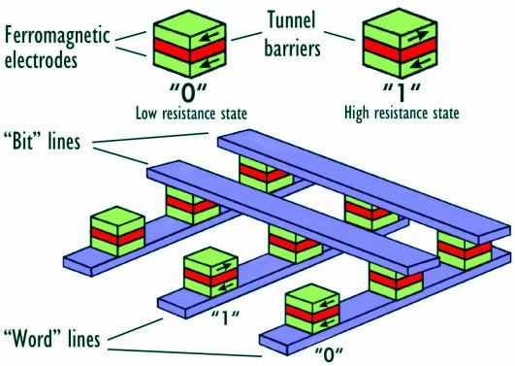
SPINTRONICS
The spin valve is the simplest magnetoresistive device.
Two ferromagnetic layers separated by a metallic spacer. One FM layer is pinned; the other is free to switch between parallel and antiparallel alignments corresponding to the low and high resistivity states, respectively.
If the magnetization in the two layers is parallel => easy passage of spin polarized electrons ; if not then very difficult passage.
“GMR” = giant magnetoresistance
Already (1997) in your computers - market was worth billions.
Now (2000’s) replaced by magnetic tunnel junctions.
http://www.tcd.ie/Physics/Magnetism/Research/halfmetals.php

Slide 22
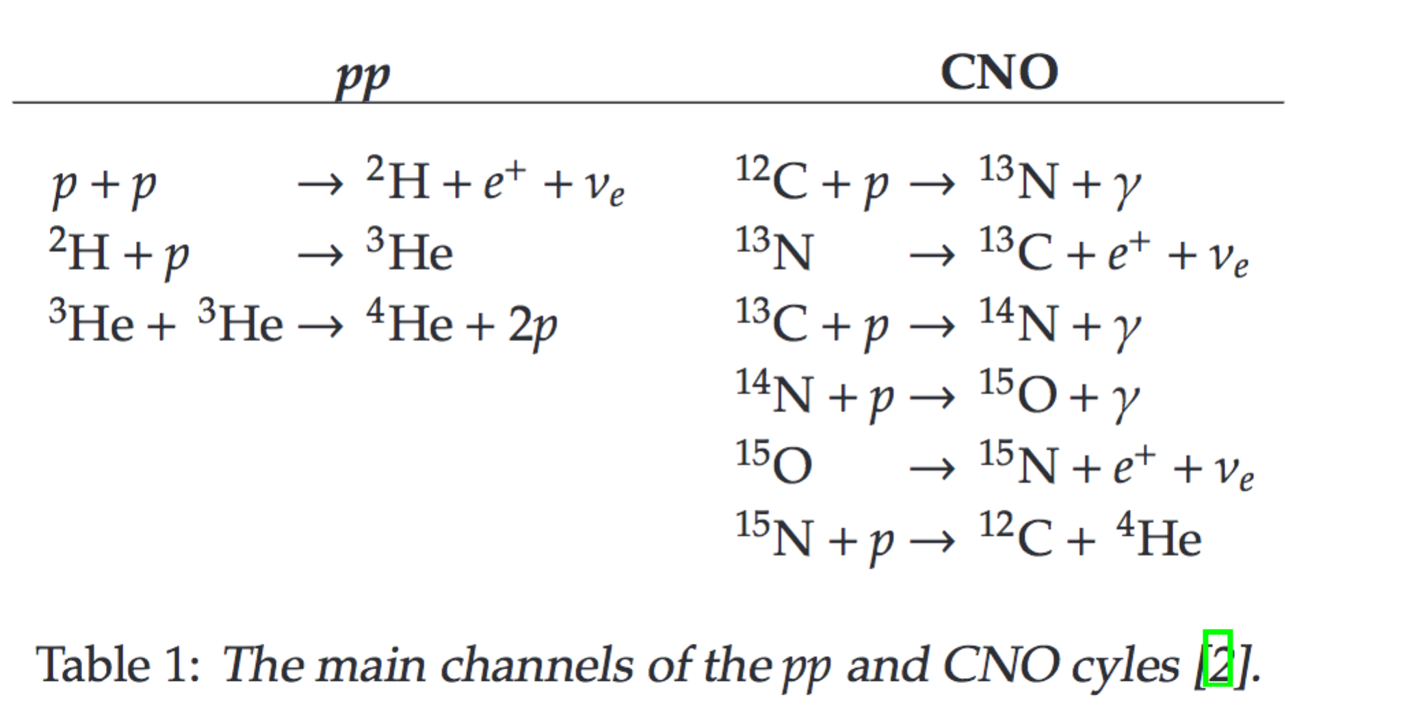
Star formation

Slide 23
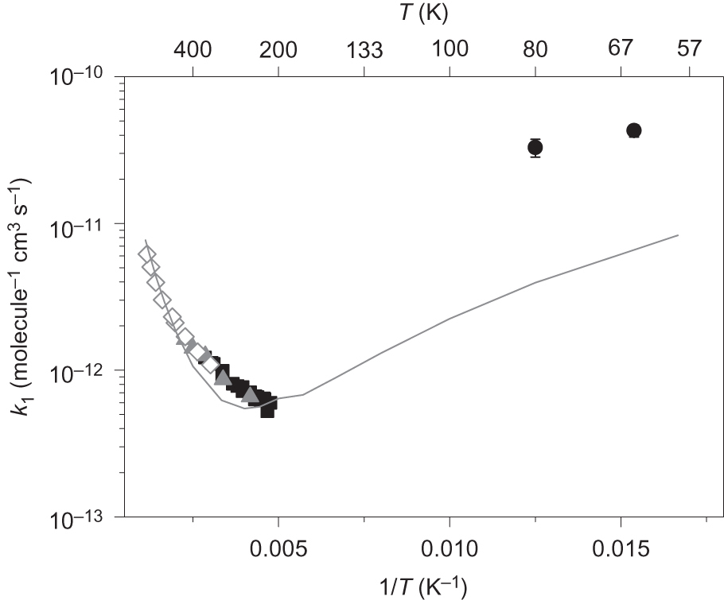
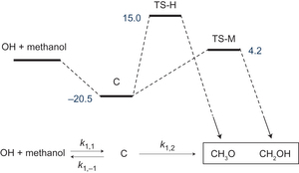
Formation of life …
Accelerated chemistry in the reaction between the hydroxyl radical and methanol at interstellar temperatures facilitated by tunneling, Robin J. Shannon, Mark A. Blitz, Andrew Goddard & Dwayne E. Heard , Nature Chemistry 5, 745–749 (2013) doi:10.1038/nchem.1692

