Slide 1
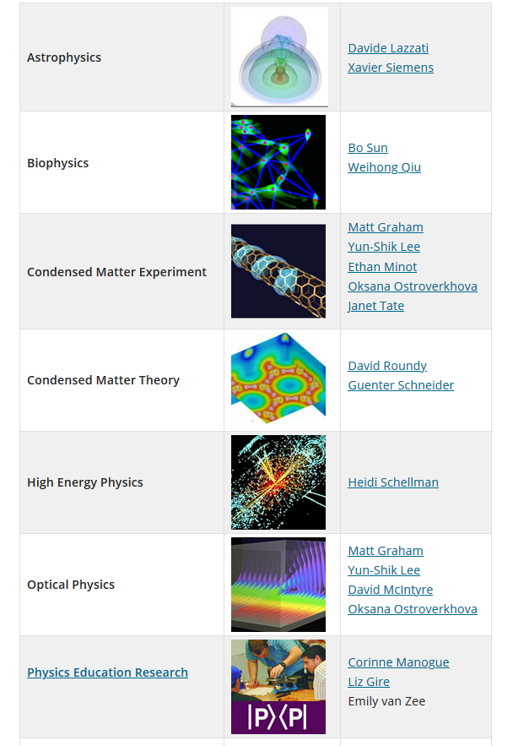

Scavenger Hunt
1) Go to https://physics.oregonstate.edu/research-department-physics
2) Pick a physics research area
3) Which group(s) in ONE research area have the most undergraduate researchers?
3) What scholarly journals does this research area use?

Slide 2
Research and Publishing Process
Peer
Review
Expt/
Theoretical
Results
Write
Paper/Conf
Paper
Accepted
Submit
Paper
Paper
Rejected

Slide 3
Research and Publishing Process
Peer
Review
Research
Expt/
Theoretical
Results
Write
Paper/Conf
Paper
Accepted
Submit
Paper
Paper
Requires Revisions
Revise paper
(More Expt/Theory)
Paper
Rejected
Submit
to Different Journal

Slide 4
Research and Publishing Process
Peer
Review
Research
Expt/
Theoretical
Results
Write
Paper/Conf
Paper
Accepted
Submit
Paper
Paper
Requires Revisions
Revise paper
(More Expt/Theory)
Paper
Rejected
Submit
to Different Journal

Slide 6
Scavenger Hunt
1) Go to https://physics.oregonstate.edu/research-department-physics
2) Pick a physics research area
3) Which group(s) in ONE research area have the most undergraduate researchers?
3) What scholarly journals does this research area use?

Slide 7
https://physics.oregonstate.edu/senior-thesis-projects-20202021

Slide 8
WIC Fair – Feb 10 2020

