Slide 1

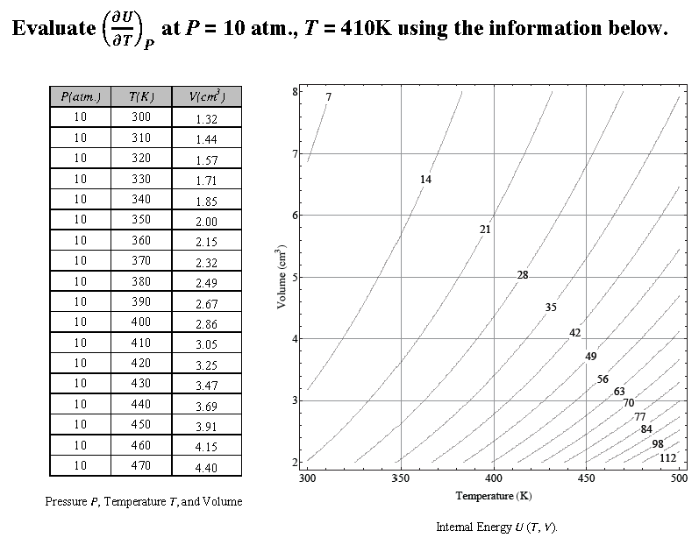
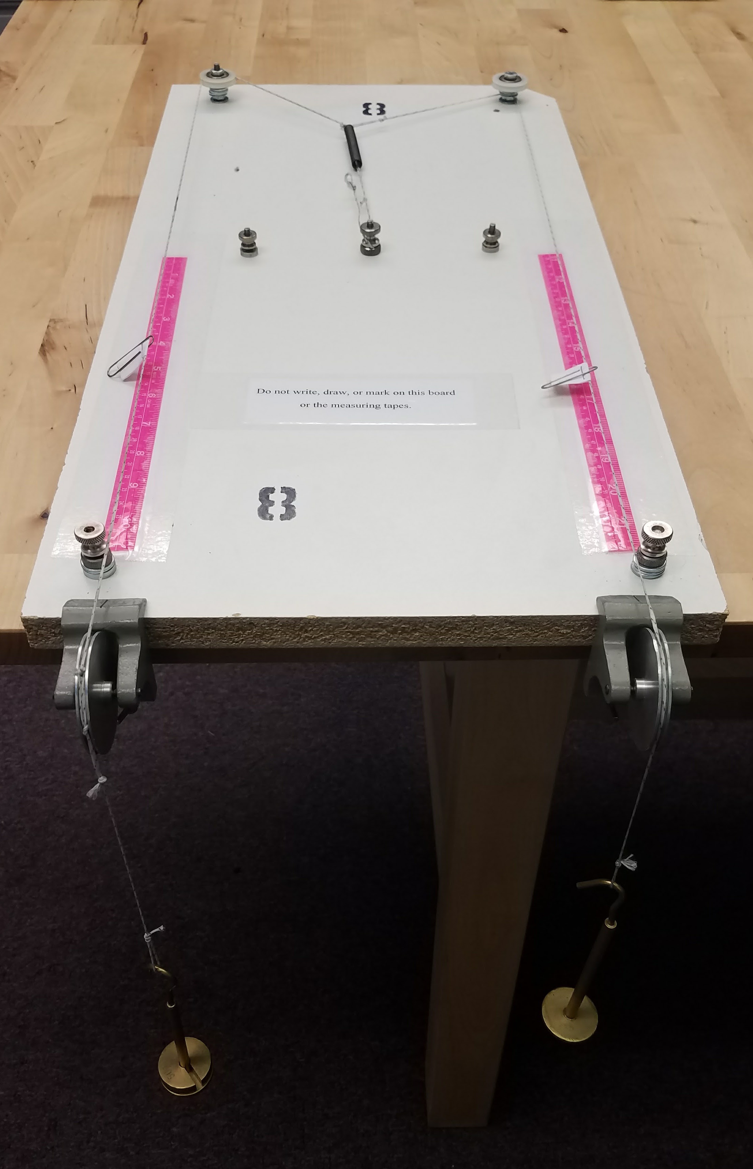
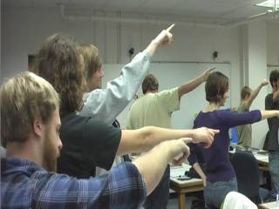
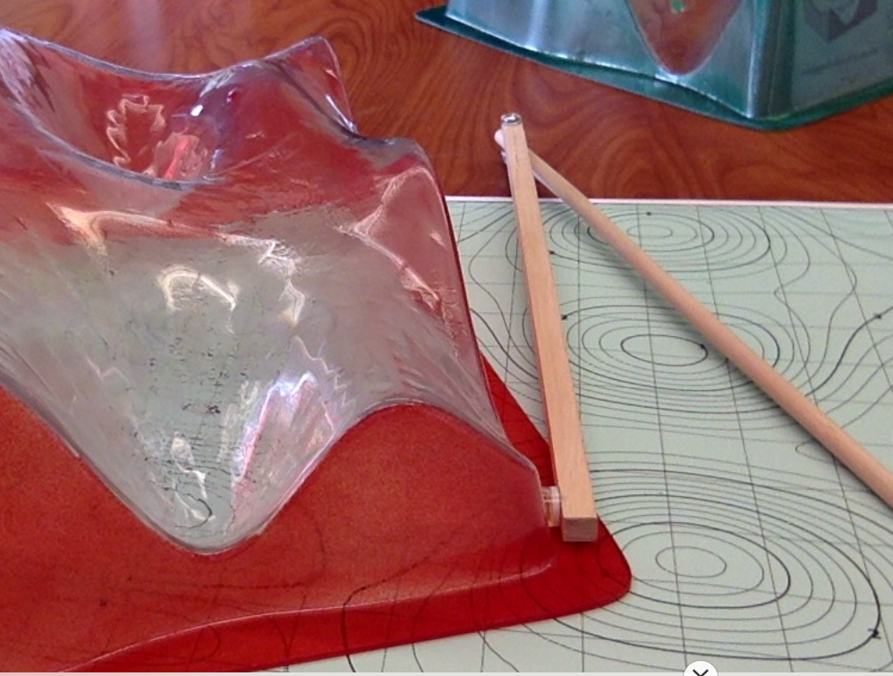
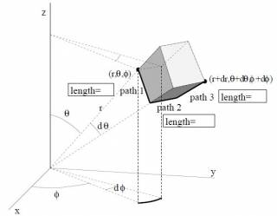
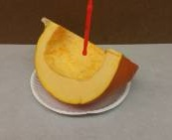

A Learning Progression for Partial Derivatives
Corinne A. Manogue Tevian Dray
Paul J. Emigh Elizabeth Gire David Roundy
A Story about Differentials
Example Concept Image – Tables and Contour Maps
Anchor – Expert Concept Image
Differentials underpin the entire learning progression
physicists reason about small quantities, which is not how derivatives are commonly taught in math courses
differentials represent small “enough”quantities
differentials linearize complicated equations
differentials can be manipulated algebraically
PRIMUS 2017 – Dray et al.
Differentials describe the small changes necessary to define the derivative from representations of data.
Derivatives can be thought of as “ratios of small changes” using a variety of representations
tables with two columns (ordinary)
tables with three columns (partial)
contour maps (partial)
A concept image should emphasize coordination and translation between representations (e.g., transferring information from a table to a contour map).
PR-PER in progress – Bajracharya et al.
Experts’ concept images of partial derivatives
involves many solution paths
is strengthened by sense-making
varies from person to person and from field to field (math experts and physics experts are not the same!)
Based on task-based interviews with experts
PERC 2012 – Kustusch et al.
PRST-PER 2014 – Kustusch et al.
Anchor – Novice
Understanding
Students are good at
thinking of the derivative as a slope
relating the derivative to changes
computing derivatives algebraically
Students need more practice
viewing the derivative as a ratio
thinking about small changes and when a change is “small enough”
Based on research surveys
PERC 2017 – Emigh et al.
Upper-level Electromagnetism
Name the Experiment!
AJP 2014 – Roundy et al.
Upper-level Thermodynamics
Vector Calculus
Example Representations – Algebraic,
Graphical, Tangible, Embodied
Intermediate Mechanics
Partial derivatives machine
PERC 2017 – Vignal et al.
PRST-PER 2015 – Roundy et al.
PERC 2014 – Roundy et al.
PERC 2013 – Sherer et al.
Differentials in spatial settings can be combined into the algebraic vector differential, which describes all directions at once. The multivariable chain rule becomes a statement about the gradient
Equation (1) can be used to find:
any directional derivative
the total derivative with respect to a parameter like time
properties of the gradient (e.g., it is perpendicular to the level curves and its magnitude is the slope in the steepest direction)
Coll. Math. J. 2010 – Dray and Manogue
Coll. Math. J. 2003 – Dray and Manogue
Example Task Analysis – Identifying Partial Derivatives from Total Differentials
Differentials equations can be manipulated to solve many thermodynamics problems
total differentials are always linear
substitution is an effective strategy, even for complicated equations
chain rules can be determined quickly
Legendre transformations commonly use differentials
coefficients that are equivalent to partial derivatives can often be identified as physical quantities
PERC 2017 – Vignal et al. and Founds et al.
Free Energy
Students pointing in the direction of the gradient
Plastic surfaces
raisingcalculus.winona.edu
Multivariable Calculus
Acknowledgements: We would like to thank the members of the Paradigms research project over many years. This work was supported in part by NSF grant DUE-1323800.
Representations for the vector differential and volume element in spherical coordinates
Learning Progression
Concept Image
Task Analysis
Representations
Research
Learning progressions include:
upper and lower anchors
hypotheses about learning
descriptions of how students might develop ways of thinking
empirically tested curricular elements
LPs in Science 2012 – Plummer
CPRE 2009 – Corcoran et al.
A concept image includes the set of all mental pictures, associated properties and processes associated with a concept. Middle-division students need rapidly to develop rich concept images.
Students should be able to go back and forth between various elements.
CBMS 2000 – Zandieh,
Ed. Stud. Math. 1981 – Tall & Vinner
Cognitive task analysis triangulates information from informal/formal research, existing PER, classroom work, feedback from teachers, TAs, student focus groups, etc.
Discussion identifies themes that recur and lead to rich concept images.
AJP 2009 – Redish & Hammer
PERC 2009 – Manogue & Gire
Different representations have material features that support different kinds of reasoning and problem-solving.
We use and develop representations that relate different elements of a rich concept image and/or task.
Cognition in the Wild 1995 – Hutchins
PERC 2012 – Gire & Price
It is not possible to validate an entire learning progression that spans four undergraduate years and multiple math and physics subdisciplines. Instead, we empirically validate in snapshots across the curriculum using a wide variety of formal and informal methods and perspectives.
PERC 2017 – Manogue et al.

