Slide 1
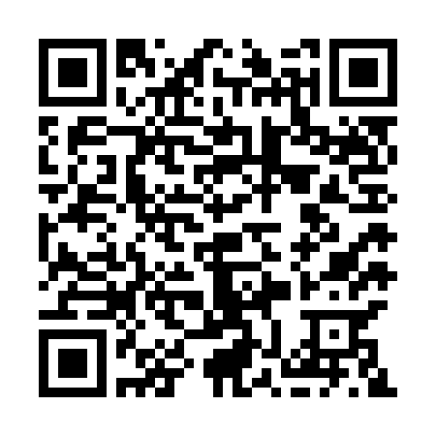

Determining Partial Derivatives from Contour Graphs
Paul J. Emigh
Corinne Manogue
8 January, 2018 San Diego CA

Slide 2
Idealized trajectory through concepts
Research snapshots along the progression
Curriculum development
  Session GD04 “An Upper-division Learning Progression on Partial Derivatives”
Notes:
Cue multiple representations and representational features early

Slide 3
Research Snapshot
Post-instruction interviews
After a full year of junior-level instruction, including
  Thermodynamics
  Electro- and magneto-statics
Problem-solving tasks in both contexts using contour graphs

Slide 4
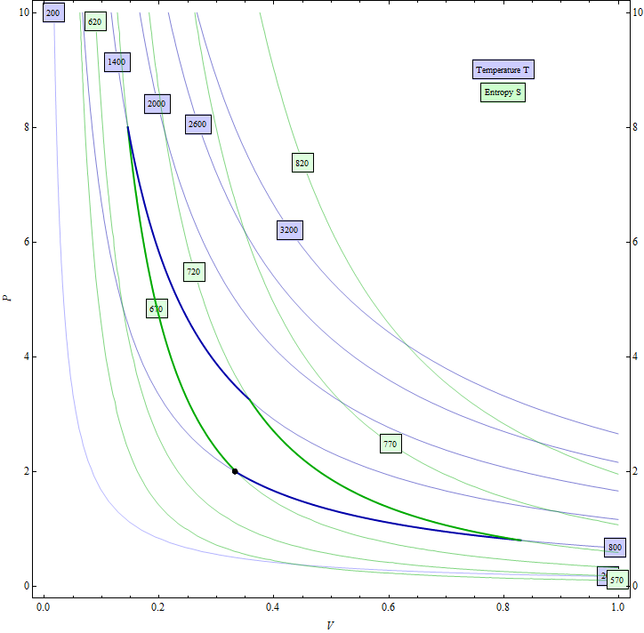
Contour Graph – Thermodynamics

Slide 5
Contour Graph – Thermodynamics
The graph shows pressure vs. volume for a gas
The bold paths are processes that are part of some cycle
Determine the derivative of p with respect to V at the indicated point

Slide 6
Which derivative do you want?

Slide 7
Which derivative do you want?
The contour graph must be narrowed
  from a relationship between four variables
  (p, V, T, S)
  to a specific relationship between only two variables (p and V)
A different narrowing gives a different derivative

Slide 8
Research Questions
  What two-variable relationship(s) did students narrow to when asked for a non-specific derivative?
  What representational features were associated with such narrowing?
N = 9
  Case study: Pat

Slide 9
Narrowing to the bold path
Pat drew a line “tangent” to the bold path
  “I’m looking at this graph and just kind of imposing in my mind that [the bold paths are] a function p(V).”
  “Oh it’s like an engine.”
p(V)

Slide 10
Narrowing to the bold path
“So the derivative at that point is the slope of the line tangent to that and it doesn’t really look like it’s a smooth function there. So I’m not really sure if this will work.”
p(V)

Slide 11
Narrowing to the bold path
Pat then tried to use a Maxwell relation, which was unproductive
?
?
?
?
?
?
?
?
?
?
?
?
?
?
?

Slide 12
Narrowing to the contour lines
The interviewer asked what would happen if Pat took a derivative from one side
  “If we just look at the graph of constant temperature and take a tangent line there.”
  Pat labels this blue curve p(V)_{T=constant}
p(V)_{T=constant}

Slide 13
Narrowing to the contour lines
“So ∂p/∂V with constant S is not going to be the same thing as ∂p/∂V with constant T.”
  Pat labels these two derivatives with subscripts
p(V)_{T=constant}

Slide 14
Discussion
Pat narrowed to the bold path, struggled for awhile, and eventually narrowed to the contours of constant T and S
The representation that Pat found helpful was to give the “narrowed” curve a functional name like p(V)
Pat did not initially invoke the subscript notation for partial derivatives, though it formed a part of their final explanation

Slide 15

Thank you!
Paradigms in Physics – Oregon State University
Faculty
Corinne Manogue
Liz Gire
Tevian Dray
David Roundy
Emily van Zee
Collaborator
Rabindra Bajracharya
Graduate Students
Mike Vignal
Greg Mulder
Mackenzie Lenz
Kelby Hahn
Jonathan Alfson
Undergraduate Student
Ian Founds

