Slide 1

Supporting Sense-Making in Sophomore Mechanics
Elizabeth Gire
Paul J. Emigh
MacKenzie Lenz
Kelby Hahn
AAPT Winter 2018

Slide 2
Outline
Physics Sense-Making
Description of the Course
Evidence
Challenges

Slide 3
Physics Sense-Making
Sense-making is seeking understanding of or comprehensibility between
Symbolic representations
Concepts
Geometric relationships
Real-world intuitions and observations

Slide 4
What is needed?
Cognitive resources
  Sense-making strategies
  Relevant knowledge/experiences
Know when
  Metacognition
Know that you ought to
  Epistemic framing
See the value
  → Explicit discussion/tags
  → Intermediate level
  → Review idealized systems (projectiles, harmonic osc.)
  → Metacognitive prompting
  → Modeling & Scaffolding/Fading
  → “Professional practice”
  → Active engagement
  → Reward structure

Slide 5
Techniques of Theoretical Mechanics
New course developed as part of Paradigms 2.0
Sophomore-level physics majors
10 Weeks (spring quarter)
Prerequisites
  2nd quarter intro physics (intro mechanics)
  Multi-variable calculus is prerequisite
Textbooks:
  Taylor, Classical Mechanics
  Dray Geometry of Special Relativity

Slide 6
Topics
Mechanics Topics
Velocity Dependent Forces
Time Varying Mass
Lagrangian Mechanics
Intro to Hamiltonian Mechanics
Relativistic Kinematics
Relativistic Collisions
Math Topics
ODE’s by separation
Power Series
Partial Derivatives
Matrix Algebra
Circle/Hyperbola Trig
Sense-Making Strategies
Dimensions
Functional Behavior
Signs
Special Case Analysis
Power Series Approximation
Reasonable Magnitude
Conceptual Connection
Relate to Prior Knowledge
Visualization
Assumptions/Idealizations
Predict the Form of the Answer

Slide 7
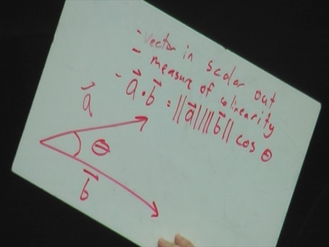
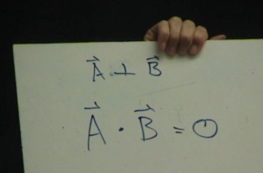
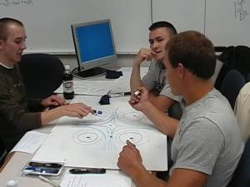
Pedagogy
Small whiteboard questions
Small group problem solving
Whole class discussions on sense-making strategies
Metacognitive prompting
  What are you doing? (precisely)
  Why are you doing it? (fit in solution)
  How is it useful? (do with result)
  (Schoenfeld, Handbook for Research on Mathematical Teaching and Learning, 1992)
Sense-making-enhanced HW
Computer visualization with Mathematica

Slide 8
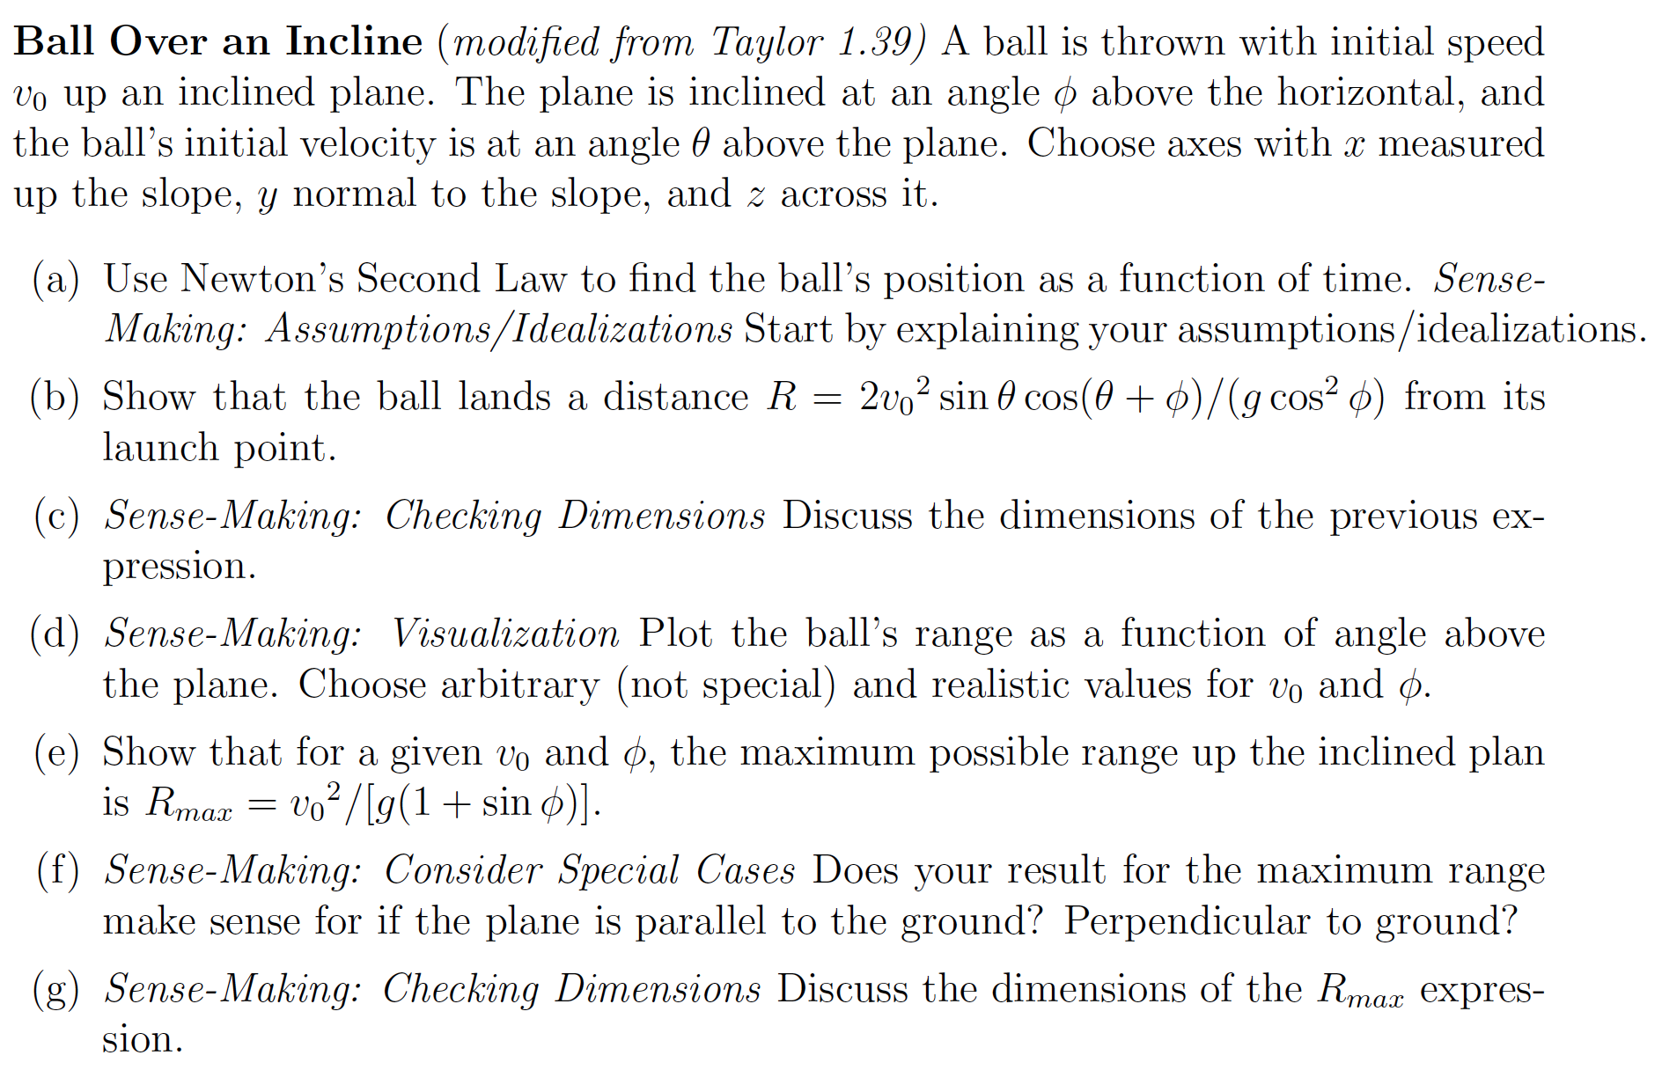
Enhanced HW

Slide 9
Evidence
Homework & Exams (Hahn, et al., PERC 2017)
  Most common strategies chosen:
  Units/Dimensions Checking
  Special Case Analysis (productive cases?)
Case-Study Interviews (Lenz, et al., PERC 2017)
  Started with informal knowledge of strategies
  Increased use of strategies in other math/physics courses
  Checking units/dimensions at (unprompted) intermediate steps
Sense-Making Assessment (in alpha)
  Increased performance in pre/post test.
  Many students use a variety of strategies within a question

Slide 10
Challenges
Beginning vs. End of the problem
How to do it vs. What strategies are productive?

Slide 11
Summary
New course that prioritizes supporting many aspects of physics sense-making
Intermediate classical mechanics and relativity turns out to be a good context for supporting various sense-making strategies
Some evidence of increased sense-making activity, increased proficiency

Slide 12





Acknowledgments
Paradigms 2.0 Team
  Corinne Manogue
  Emily van Zee
  David Roundy
  Ethan Minot
  Elizabeth Gire
Mechanics Team
  Kelby Hahn
  Paul Emigh
  MacKenzie Lenz
NSF DUE1323800

