Slide 1
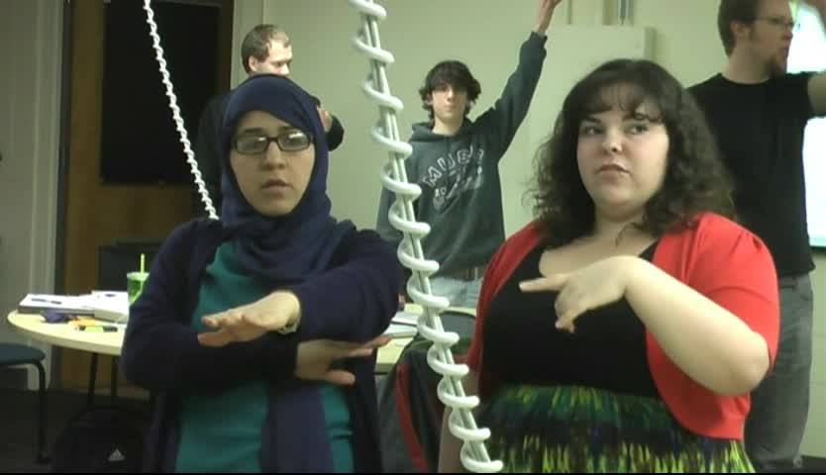
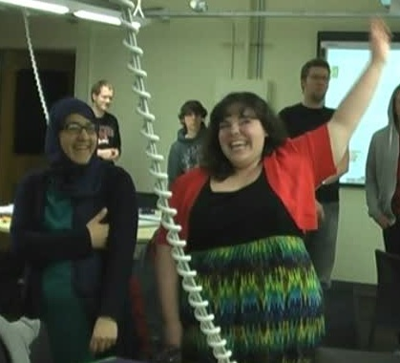

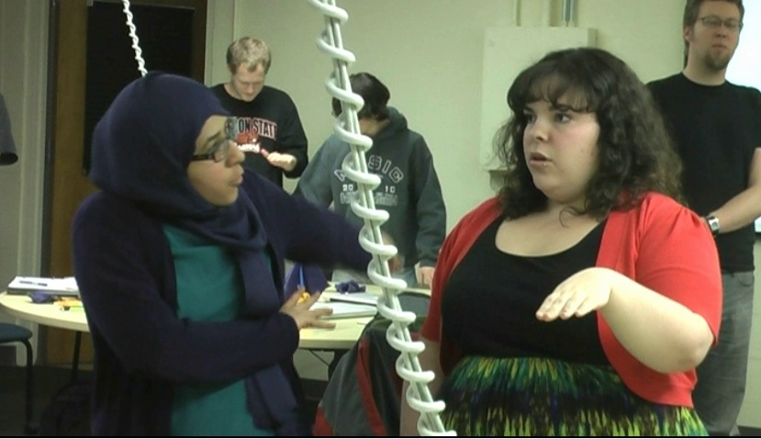


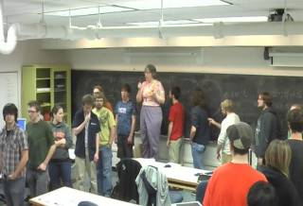
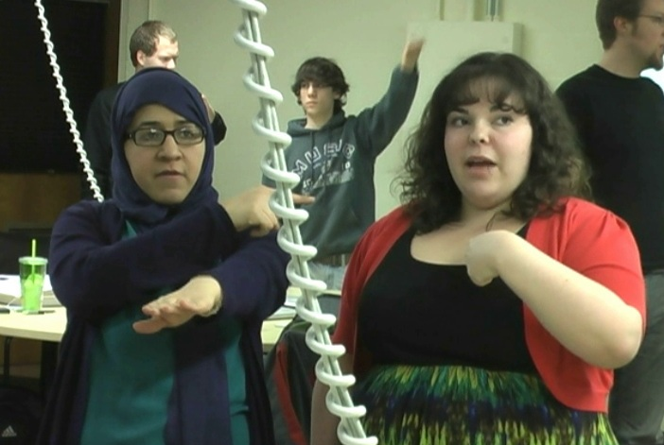
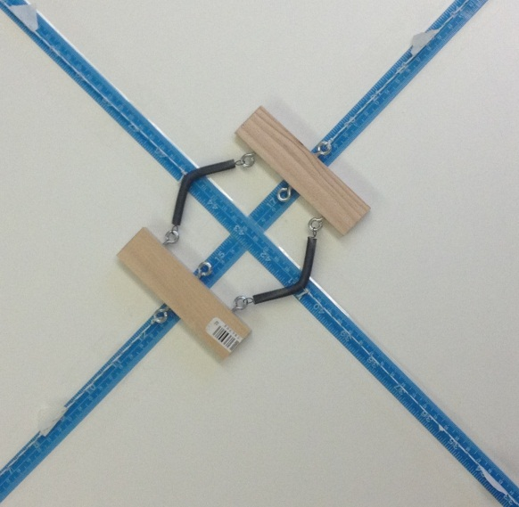
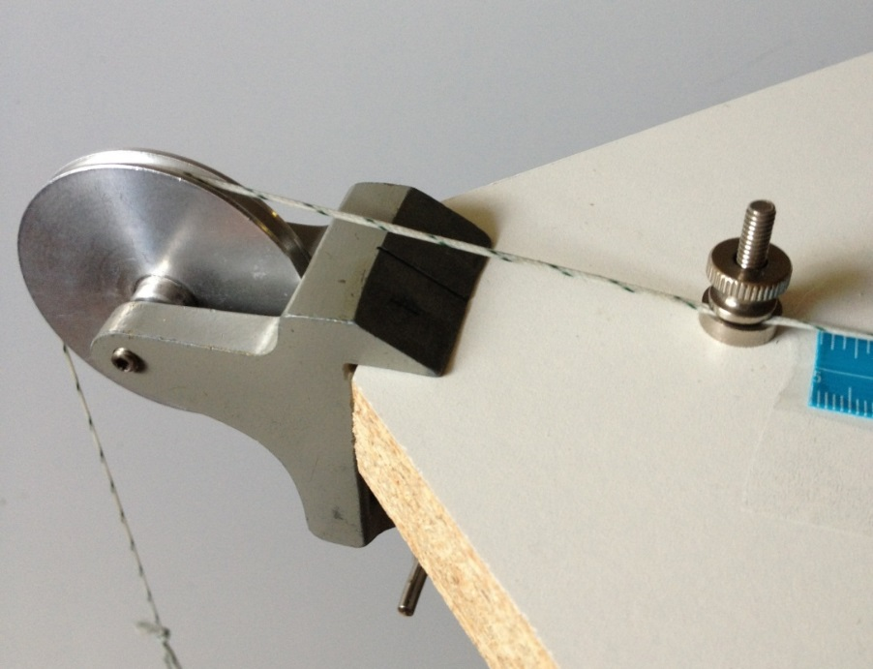
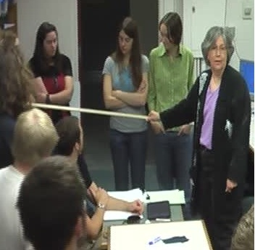
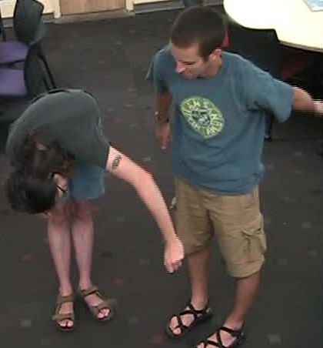
Upper-division physics requires students to use abstract mathematical objects to model measurable properties of physical entities. We have developed activities that engage students in using their own bodies or simple home-built apparatus as metaphors for novel (to the students) types of mathematical objects. These tangible metaphors are chosen to be rich, robust, and flexible so that students can explore several properties of the mathematical objects over an extended period of time. The collaborative nature of the activities and inherent silliness of “dancing” out the behavior of currents or spin ½ quantum systems certainly increases the fun in the classroom and may also decrease students' fear of learning about these mathematical objects. We include examples from the electromagnetism, quantum mechanics, and thermodynamics content in the Paradigms in Physics program at Oregon State University.
Characteristics
Tangible: capable of being perceived especially by the sense of touch.
Metaphor: a comparison between two unrelated things.
Natural: students should get the point with little coaching.
Extend over time: used on multiple days.
Require cooperation & conversation.
Use geometry: to mediate the metaphor.
Robust and Flexible: several features of the metaphor must be comparable.
Failure of the metaphor: is a learning /discussion opportunity.
Tangible Metaphors
References
Multiple Representations: M. J. Zandieh, A theoretical framework for analyzing student understanding of the concept of derivative. CBMS Issues in Mathematics Education, 8, 103-127 (2000).
Concept Image: D. Tall and S. Vinner, Educational Studies in Mathematics, 12, 151-169 (1981).
Conceptual Metaphors/Embodied Cognition: G. Lakoff & M. Johnson, Philosophy in the flesh: The
embodied mind and its challenge to Western thought, New York, NY, Basic Books (1999).
Conceptual Blending: G. Fauconnier & M. Turner, The Way We Think, New York, Basic Books, (2003).
Material Anchors: E. Hutchins, (2000) Material anchors for conceptual blends, Journal of Pragmatics 37, 1555-1577 (2005) .
Corinne Manogue*, Elizabeth Gire†, David Roundy*
^{*Oregon State University} ^{†University of Memphis}
From Fear
To Fun
Acknowledgments
Details of the activities can be found at:
http://www.physics.oregonstate.edu/portfolioswiki/
This work was
supported by NSF DUE-1023120.
Charge and Current Densities
Description: Students, using their bodies to represent charges, act out various charge and current densities.
Prompts:
First Day: Make a constant linear charge density.
A few minutes later: Does it need to be straight?
Several days later: Make a constant linear current density.
A few minutes later: How would we measure this?
Features:
Idealization: discrete charges->linear charge density is explicit.
Can model measurement.
Language for current densities can be discussed.
Complex-Valued Spin ½ States
Description: Students, in pairs, use their left arms to represent the two complex numbers in a spin ½ state.
Prompts:
First Day: Represent the state
A few minutes later: Show all the combinations that represent the same state.
Several days later: Represent the time-dependence of the state if it is placed in a magnetic field oriented in the z-direction.
Features:
Easy to model independence of overall phase.
Time dependence can be made explicit.
Obvious when students miss features of the representation!!
Partial Derivative Machine
Description: Students use a mechanical system of springs and weights to represent different ways of getting energy into and out of a thermodynamic system.
Prompts:
First Day: How many properties can you control?
A few minutes later: How many properties are independent?
A few minutes later: Measure
10 minutes later: Are these two derivatives the same?
The next day: Find the internal energy.
Features:
Model thermodynamics problems with a mechanical system.
Students feel the consequences of holding variables constant.
Connect mathematics to experiment.

