Slide 1



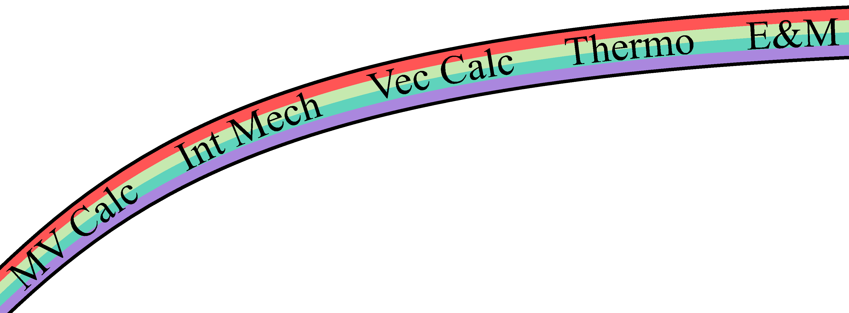
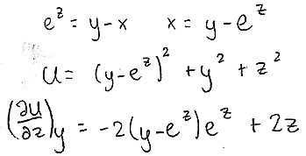
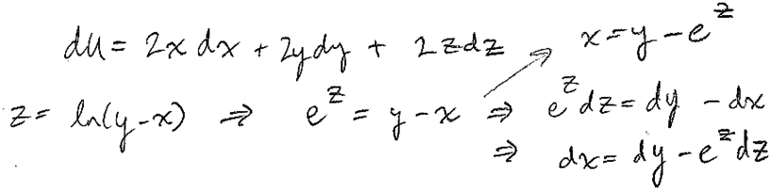
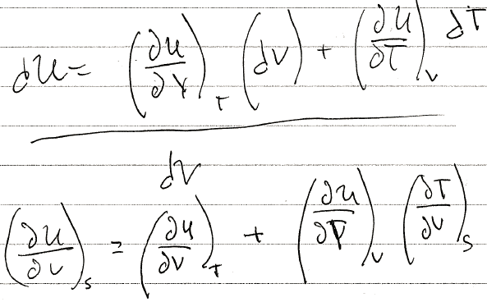
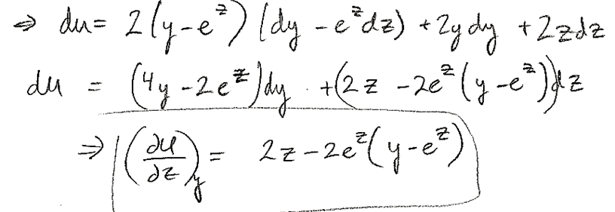
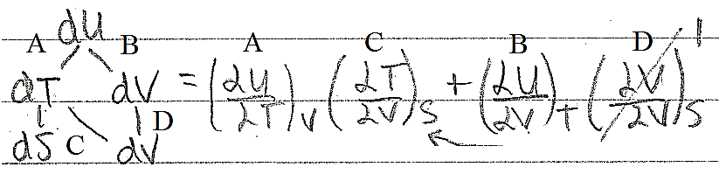


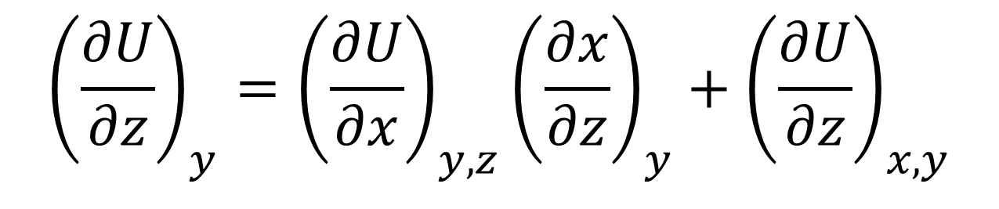
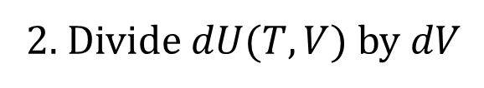
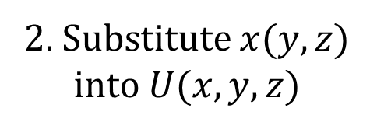
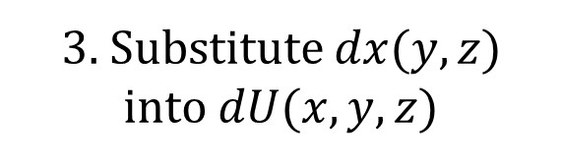
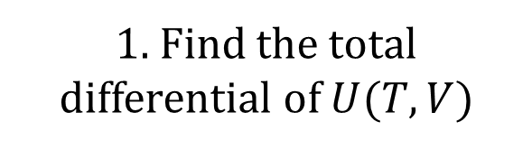
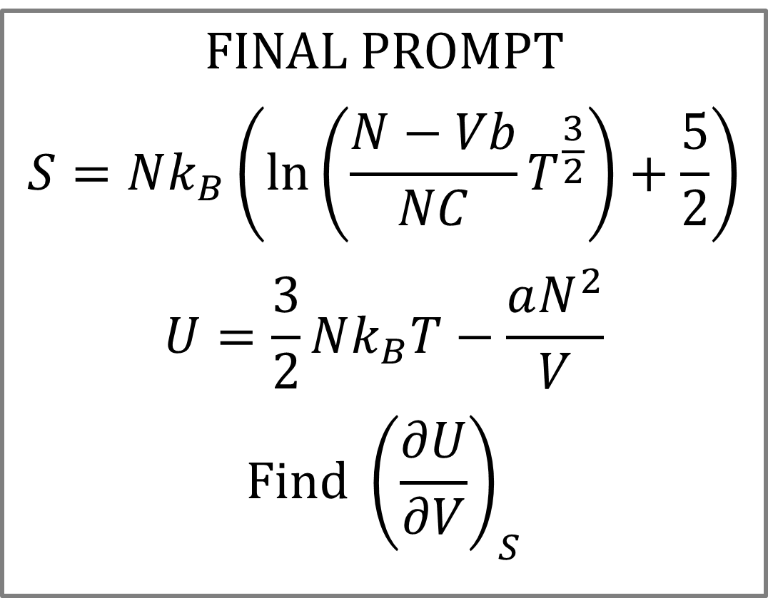
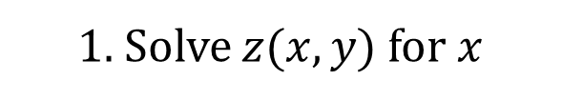
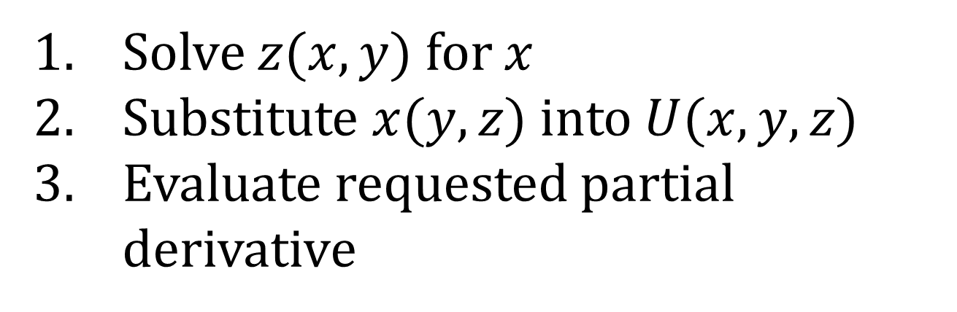
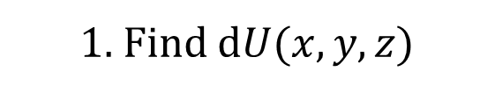
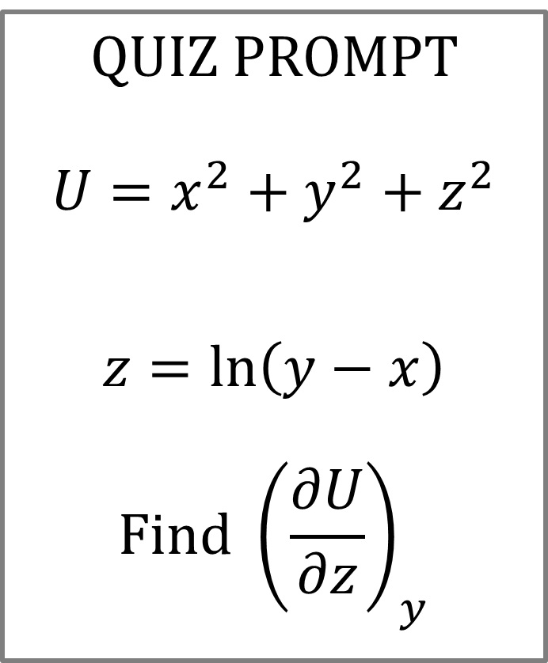
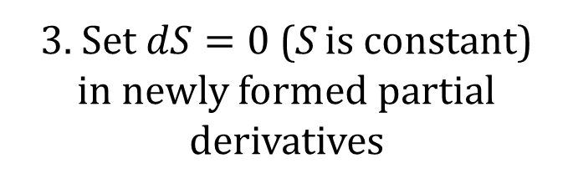
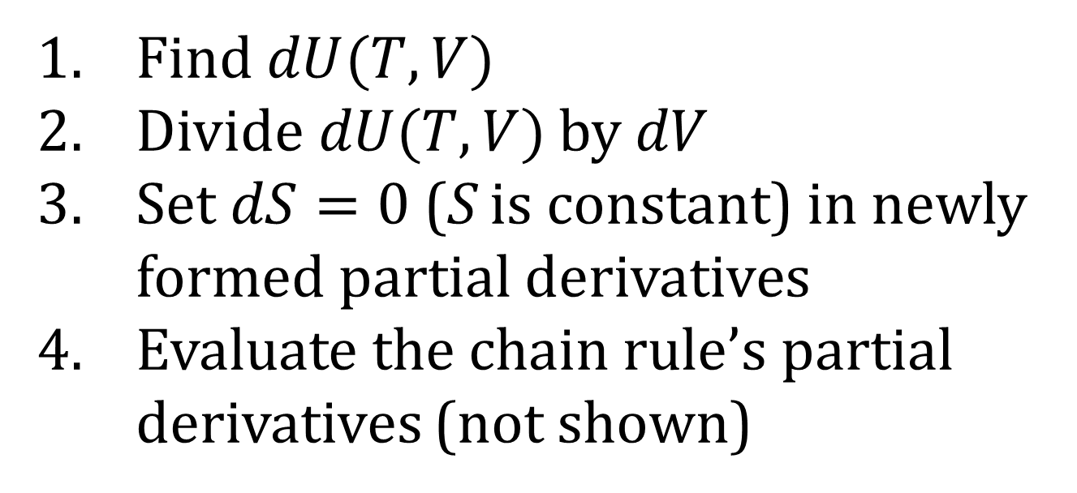
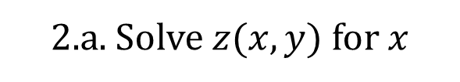
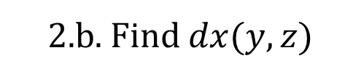
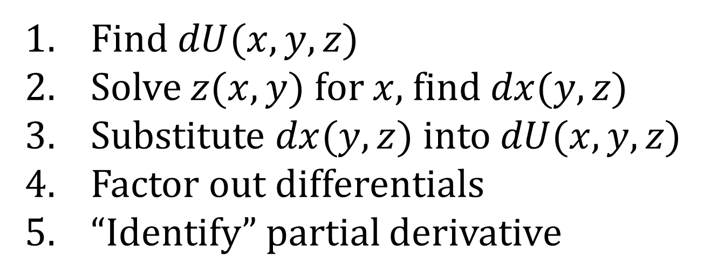
Student Responses to Chain Rule Problems in Thermodynamics
Ian W. Founds, Paul J. Emigh, and Corinne A. Manogue
INTRODUCTION
What methods do students use to evaluate partial derivatives that “require” a multivariable chain rule?
We studied student responses to 2 chain rule problems:
  Quiz prompt (no thermodynamics context)
  Final prompt (implicit thermodynamics context)
We identified 5 solution methods using emergent coding.
Student errors were also identified and categorized.
Part of an expansive study [1] to describe a broad learning progression for partial derivatives across advanced courses in physics and mathematics:
THE PROMPTS
Given the definitions, evaluate the requested partial derivative.
QUIZ PROMPT
$$U=x^{2}+y^{2}+z^{2}$$
$$z=\ln\left(y−x\right)$$
$$Find {\left(\frac{∂U}{∂z}\right)}_{y}$$
FINAL PROMPT
$$S=Nk_{B}\left(\ln\left(\frac{N−Vb}{NC}T^{\frac{3}{2}}\right)+\frac{5}{2}\right)$$
$$U=\frac{3}{2}Nk_{B}T−\frac{aN^{2}}{V}$$
$$Find {\left(\frac{∂U}{∂V}\right)}_{S}$$
Learning Progression for Partial Derivatives
Energy and Entropy
Junior-level thermodynamics in OSU’s Paradigms in Physics [2-3]
(left column in table)
Assigned on last class day – Friday
(right column in table)
Assigned on final exam – Monday
VARIABLE SUBSTITUTION
DIFFERENTIAL SUBSTITUTION
IMPLICIT DIFFERENTIATION
DIFFERENTIAL DIVISION
CHAIN RULE DIAGRAM
Solve $z(x,y)$ for $x$
Substitute $x(y,z)$ into $U(x,y,z)$
Evaluate requested partial derivative
Find $dU(x,y,z)$
Solve $z(x,y)$ for $x$, find $dx(y,z)$
Substitute $dx(y,z)$ into $dU(x,y,z)$
Factor out differentials
“Identify” partial derivative
Without intermediate written work, write the chain rule for the requested partial derivative
Evaluate the chain rule’s partial derivatives (not shown)
Find $dU(T,V)$
Divide$dU(T,V)$ by $dV$
Set$dS=0$(S is constant) in newly formed partial derivatives
Evaluate the chain rule’s partial derivatives (not shown)
Build chain rule tree diagram for the requested partial derivative
Associate all branches with a partial derivative
Construct the chain rule by following all paths from dU to dV
Evaluate the chain rule’s partial derivatives (not shown)
1. Solve $z(x,y)$ for $x$
2. Substitute $x(y,z)$ into $U(x,y,z)$
1. Without intermediate written work, write the chain rule (for the requested partial derivative).
1. Find d$U(x,y,z)$
2.a. Solve $z(x,y)$ for $x$
1. Find the total differential of $U(T,V)$
$${\left(\frac{∂U}{∂z}\right)}_{y}={\left(\frac{∂U}{∂x}\right)}_{y, z}{\left(\frac{∂x}{∂z}\right)}_{y}+{\left(\frac{∂U}{∂z}\right)}_{x,y}$$
3. Substitute $dx(y,z)$ into $dU(x,y,z)$
1.a. Requested partial derivative’s numerator differential
2. Each link of each path from numerator to denominator represents a unique partial derivative
2.b. Find $dx(y,z)$
3. Evaluate requested partial derivative
1.b. Requested partial derivative’s denominator differential
3. Multiply the partial derivatives along each path and sum the results to produce the chain rule for the requested partial derivative
5. “Identify” requested partial derivative
4. Factor out differentials
2. Divide $dU(T,V)$by $dV$
3. Set$dS=0$(S is constant)
in newly formed partial derivatives
ERROR TYPE | ERROR DESCRIPTION | ERROR CONCLUSIONS
Conceptual Error | Errors during manipulation of derivatives, differentials, or chain rule diagrams. These errors provide insight into students’ lack of conceptual understanding of the solution methods. | Students often “mis-identified” partial derivatives from total differentials. Students often did not correctly hold variables constant while evaluating partial derivatives. Several students mis-built or mis-read chain rule diagrams on the Quiz.
Math Error | Algebraic errors, sign errors, inadvertently dropped terms, etc. | Math errors were prevalent on the Final prompt but conceptual errors were not.
No Error | No errors were made. | Every student who made no error on the Final used differential substitution or chain rule diagrams.
METHOD CONCLUSIONS
Students used a variety of solution methods but favored different methods on the Quiz than on the Final.
Variable substitution was less common on the Final, where the algebra is more difficult.
Differential substitution was more common on the Final.
Students who used a chain rule diagram improved from Quiz to Final.
REFERENCES
[1] See Manogue’s poster, number
[2] C. A. Manogue et al., Am. J. Phys., 69 (2001)
[3] C. A. Manogue et al., Phys. Today, 56 (2003)
ACKNOWLEDGEMENTS
We thank David Roundy, Guenter Schneider, MacKenzie Lenz, Mike Vignal, the rest of the OSU PER group, and the students who participated! This work was supported in part by NSF grant DUE-1323800.

