Slide 1


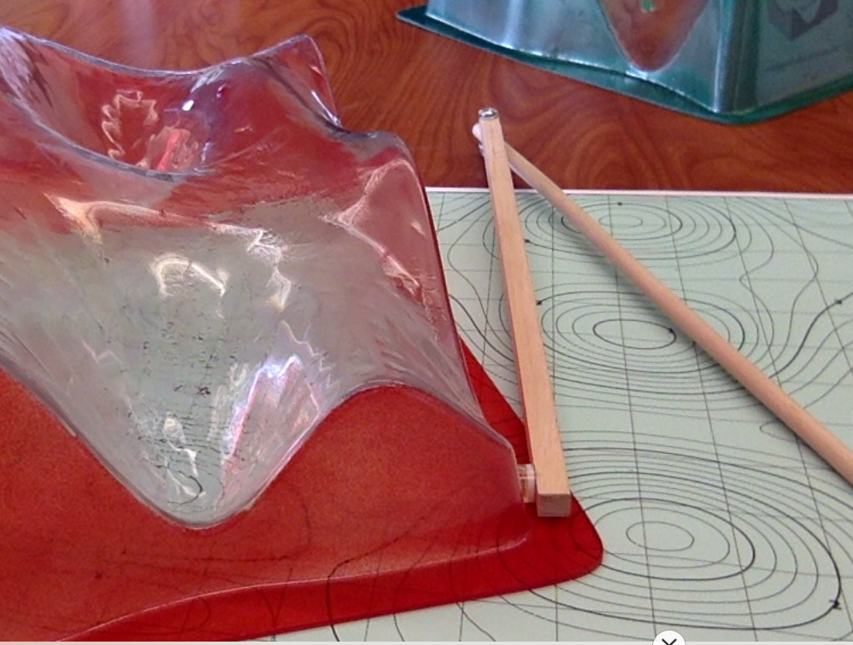
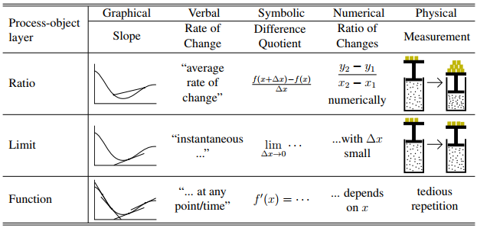
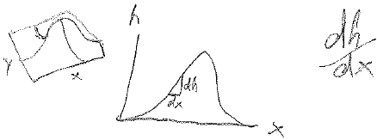


Student Interpretations of Partial Derivatives
Paul J. Emigh
Corinne A. Manogue
Background
We are developing a learning progression [1] for partial derivatives; one aspect is taking research “snapshots” at different points along the progression, such as:
How do student ideas about derivatives and partial derivatives evolve as they progress through undergraduate math and physics?
(3-question survey given in three courses)
Question 1
For a function h, the derivative of h with respect to x is sometimes known as a rate of change. Explain the meaning of rate of change in this context.
Question 2
During a previous class period, you were provided with a plastic surface, which is a representation of a function h(x, y). Explain the meaning of the derivative of h with respect to x in this context.
Question 3
The contour graph also represents a function h(x, y). Explain the meaning of the derivative of h with respect to x in this context.
[2]
“Rate of change is the slope of the function at any point along line h.”
 | Q1 | Q2 | Q3
MC | 53% | 42% | 42%
EM | 17% | 27% | 17%
CF | 28% | 20% | 20%
More prevalent among math than physics students.
Only about half of these students drew a graph in support of their answer.
Few drew or discussed a tangent line.
Slope
CF (N=29)
End of the Paradigms
“The rate of change expresses how much h changes as x changes.”
“The derivative of a function captures the instantaneous change of the function.”
 | Q1 | Q2 | Q3
MC | 37% | 37% | 37%
EM | 70% | 60% | 47%
CF | 82% | 60% | 66%
More prevalent among physics than math students.
Students commonly used the phrase “how much” the function changes across all questions.
Few students discussed the derivative as a ratio.
EM (N=30) Start of the Paradigms
Cha
nge
MC (N=19) Multivariable calculus
Theoretical perspective – Concept image [3-4]
What to hold constant
Cro
ss-
Hold y constant
On
In a direction
ly
x
t
change
sec
ion
“How much the distance between contour lines changes as x (and only x) is changed by a given amount.”
“How quickly and in what direction the value of h would change if you moved only in the x-direction.”
“How does h change as x is wiggled and y is constant.”
Common language like “hold y constant” was prevalent, especially on Question 2.
Students who talked about moving in a direction may be thinking graphically, but rarely drew graphs.
A surprising number of physics students did not discuss this idea at all!
 | Question 2 |  |  |  | Question 3
 | MC | EM | CF |  | MC | EM | CF
Hold y constant | 16% | 33% | 41% |  | 5% | 3% | 24%
Only change x | 0% | 7% | 7% |  | 11% | 3% | 7%
In a direction | 32% | 43% | 38% |  | 11% | 53% | 48%
Cross-section | 11% | 3% | 3% |  | 16% | 10% | 0%
Did not discuss | 26% | 17% | 21% |  | 47% | 20% | 10%
Conclusions from comparing student work to theoretical perspective
Student interpretations tended to be verbal or symbolic in nature.
Few students discussed the derivative as a ratio – many students wrote dh/dx, but this seemed to be common notation rather than division.
Almost no students discussed the derivative as an explicit limit – but 30-40% of physics students did use words like “small” or “instantaneous.”
Few used language that distinguished between the derivative at a point vs. as a function.
Our results are only indicative of students’ first-level interpretations – further research is necessary to explore the concept image of these student populations.
Conclusions from open-coding analysis of student work
Math students favor slope while physics students favor change.
Students’ interpretations at the end of a year of junior physics are mostly the same as at the start of the year.
The “how much h changes” language was incredibly common (~50% of physics students); while it is not present in physics or calculus textbooks, it may be common language among physics experts.
Students were not more likely to interpret the derivative graphically in graphical contexts.
Discussions of what to hold constant were somewhat different given the two graphical contexts, but student language tended to be symbolic rather than graphical.
Refs: [1] See Manogue’s poster, number [2] raisingcalculus.winona.edu
[3] M.J. Zandieh, CBMS Issues in Math. Ed. 8 (2000). [4] D. Roundy et al., in RUME Conf. Proceedings (2015).
Acknowledgements: We thank the Paradigms research project, especially Tevian Dray, Elizabeth Gire, and David Roundy, and the students who participated! This work was supported in part by NSF grant DUE-1323800.

