Slide 1
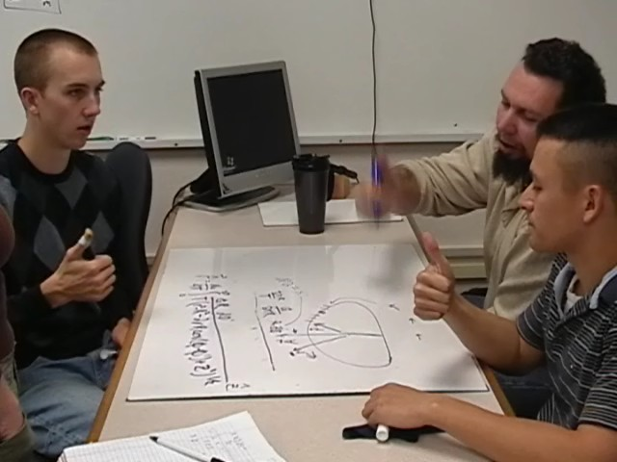



Context
Students find the magnetic vector potential due to a spinning ring of charge as part of a sequence of 5 activities in a junior-level E&M course.
In this sequence students are asked to find:
Successful Sense Making vs Accepting Nonsense:
Geometric Reasoning in Middle Division E&M
Len Cerny and Corinne Manogue
1
The electric potential V on an axis due to 2 point charges using
Accepting Nonsense:
Relying on Un-Examined “Plastic” Resources
Successful Sense Making:
Connecting to “Solid” Geometric Resources
2
The electric potential V in all space
due to a charged ring
GROUP 4 : Kevin, Robert & Stan
ACCEPTING THE RIGHT-HAND RULE
GROUP 5: Shawn, Devin & Biff
CHALLENGING THE RIGHT-HAND RULE
Students in Group 4 all agreed that the “right-hand rule” applied to finding the direction of the magnetic vector potential.
Students were using incomplete or “plastic” understanding of magnetic vector potential, magnetic field, and the right-hand rule
This prevented them from seeing the challenging aspects of finding the direction of magnetic vector potential
DIALOG
Biff, "Say by the right hand rule, it's in this direction." [gestures right hand rule with thumb up]
Shawn, "But if you're, like, way up here at some weird point..." [points to a place on board away from the ring and off-axis]
Devin, "Yeah, but right-hand rule is kind of a sketch. You still have to have an exact [inaudible].”
Shawn, "Like if you're way up here,
[draws an external point ],
like, which,…I mean which way
is it going to point?“
DISCUSSION
Shawn initially accepts his partner’s suggestion to use the right-hand rule, but quickly shows that it would not easily show the direction of the magnetic vector potential at “some weird point” (a point off axis)
Shawn connects to something he geometrically understands, which prevents him from accepting an incorrect solution.
3
The electric field in all space
due to a charged ring
4
The magnetic vector potential, in all space,
due to a spinning charged ring
●
GROUP 2: Bob, Nick & Tanya
ANGULAR CONFUSION
GROUP 6: Rob, Ryan & Derek
ANGULAR CLARITY
Radius = R
Charge = Q
Period = T
Nick, points to ω = 2π/T on the whiteboard, "OK, but we just we need to add an R to this because that is not the correct units. Angular velocity is...meters per second, so it needs to be R in here." [writes an R to get ω = 2πR/T]
Bob, "Well this,...this is radians." [points at the equal sign in ω = 2πR/T]
Nick, "2πR, that's, that's radians."
Bob, "Right."
Nick, "Yeah."
Tanya, "Yeah, that's, that's angular velocity."
Derek, points to 2πR/T and says, "This is angular velocity, right?"
Ryan, "Wait, this is a velocity, because there's distance per time."
Rob, "Right, but it's angular velocity..."
Ryan, "The units still don't work out though."
Derek, points to 2πR/T and says, "This is tangential velocity. It would have to be divided by 2π to be ω, right?"
Ryan, "Divided by R, because you want, like, radians per second."
Derek, "Yes." (nods)
Ryan, "The 2π/T would get us ω."
Students confuse angular and linear velocity and misunderstand radians
Students check for meaning and use understanding of units to correct an error
The students are given the general equation for the magnetic vector potential due to a volume current
Theoretical Framework:
Resource “Plasticity”
Conclusion
Instructional Implications
where denotes the position in space at which the magnetic vector potential is measured and denotes the position of the current segment), but were expected to generalize this expression to a line current. Ideally, students would eventually reach a solution in the form
When looking at student learning in physics, Hammer¹ proposed using an analogy from the language of computer programmers. “Resources” in computer programming refer to chunks of code that are taken unaltered and can be transferred as a single piece to a new situation, without needing to think about any of its sub-pieces. Since then, a resources perspective has become a staple of physics education research.
Sayre and Wittmann² subsequently modified the definition of “resources” to consider a continuum of understanding and subsequently applied this new definition in the context of upper-division physics. Specifically they consider the degree to which student resources are “solid” versus “plastic.” Solid resources tend to be older, readily available, easy to use, well consolidated and well connected to other resources. Plastic resources tend to require more effort to use, are open to re-evaluation and are often reliant on justifications from more solid resources.
D. Hammer, “Student resources for learning introductory physics,” PER Supplement to the Am. J. Phys 68, S52-S59 (2000).
E. C. Sayre and M. C. Wittmann, Phys. Rev. ST Phys. Educ. Res. 4, 020105 (2008).
Accepting Nonsense
Students who settled on errant final results used unexamined “plastic” resources in their problem solving
Successful Sense Making
Students who consistently connected to “solid” geometric resources, did not settle on incorrect answers, even when unable to achieve a correct answer
Many students make some attempt to interpret and understand their results, but are often willing to accept weak or partial understanding. Only a few students consistently insisted on a much firmer footing for their sense-making.
When instructors encourage students to quickly acquire new understandings and connect them to incomplete older understandings, they may inadvertently encourage students to be satisfied with a poor understanding. Students may learn to see “sense-making” as connecting any new thing to any old thing, even if both are poorly understood.
5
The magnetic field ,
in all space,
due to a spinning charged ring
Acknowledgements
We would like to thank members of the Paradigms team, especially
Elizabeth Gire, Emily van Zee, and
Janet Tate
This work is part of the Paradigms in Physics project at Oregon State University. More information, including instructor’s guides for many of our activities, are available on our website:
http://physics.oregonstate.edu/portfolioswiki
This material is based upon work supported by the National Science Foundation under DUE Grant Nos. 9653250, 0088901, 0231032, 0231194, 0618877.
Any opinions, findings and conclusions or recommendations expressed in this material are those of the authors and do not necessarily reflect the views of the National Science Foundation (NSF)

