Slide 1



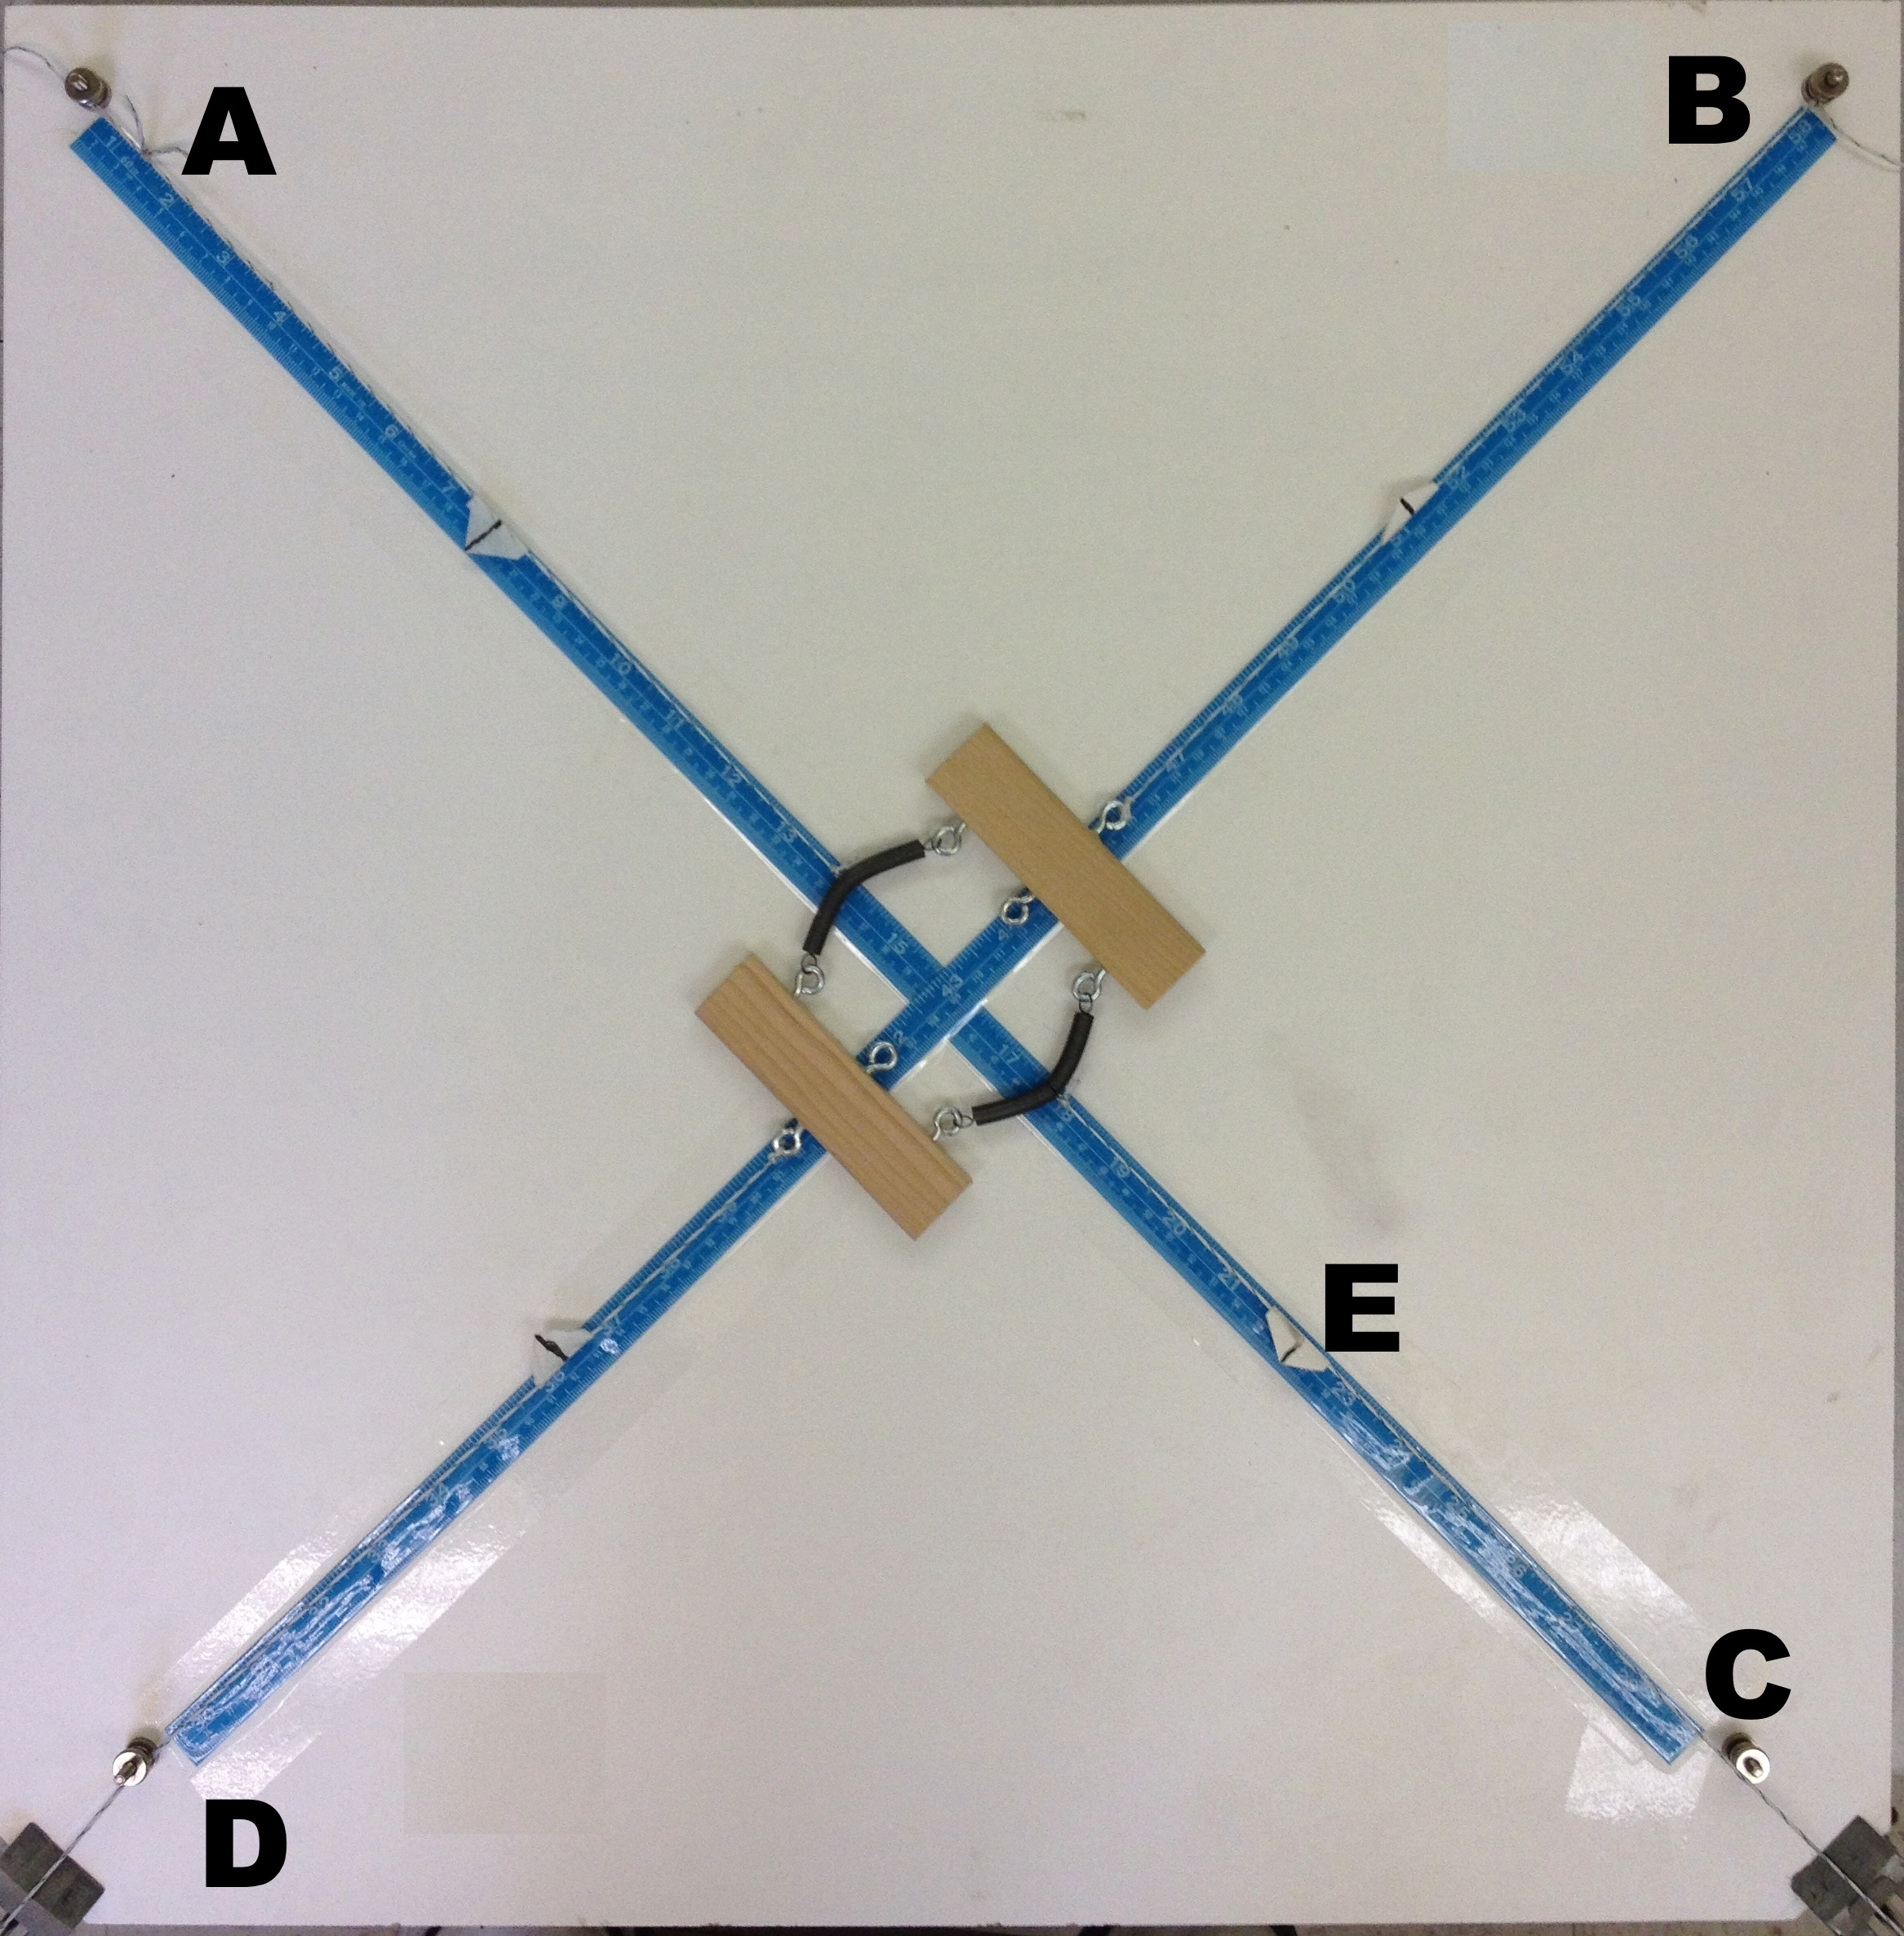
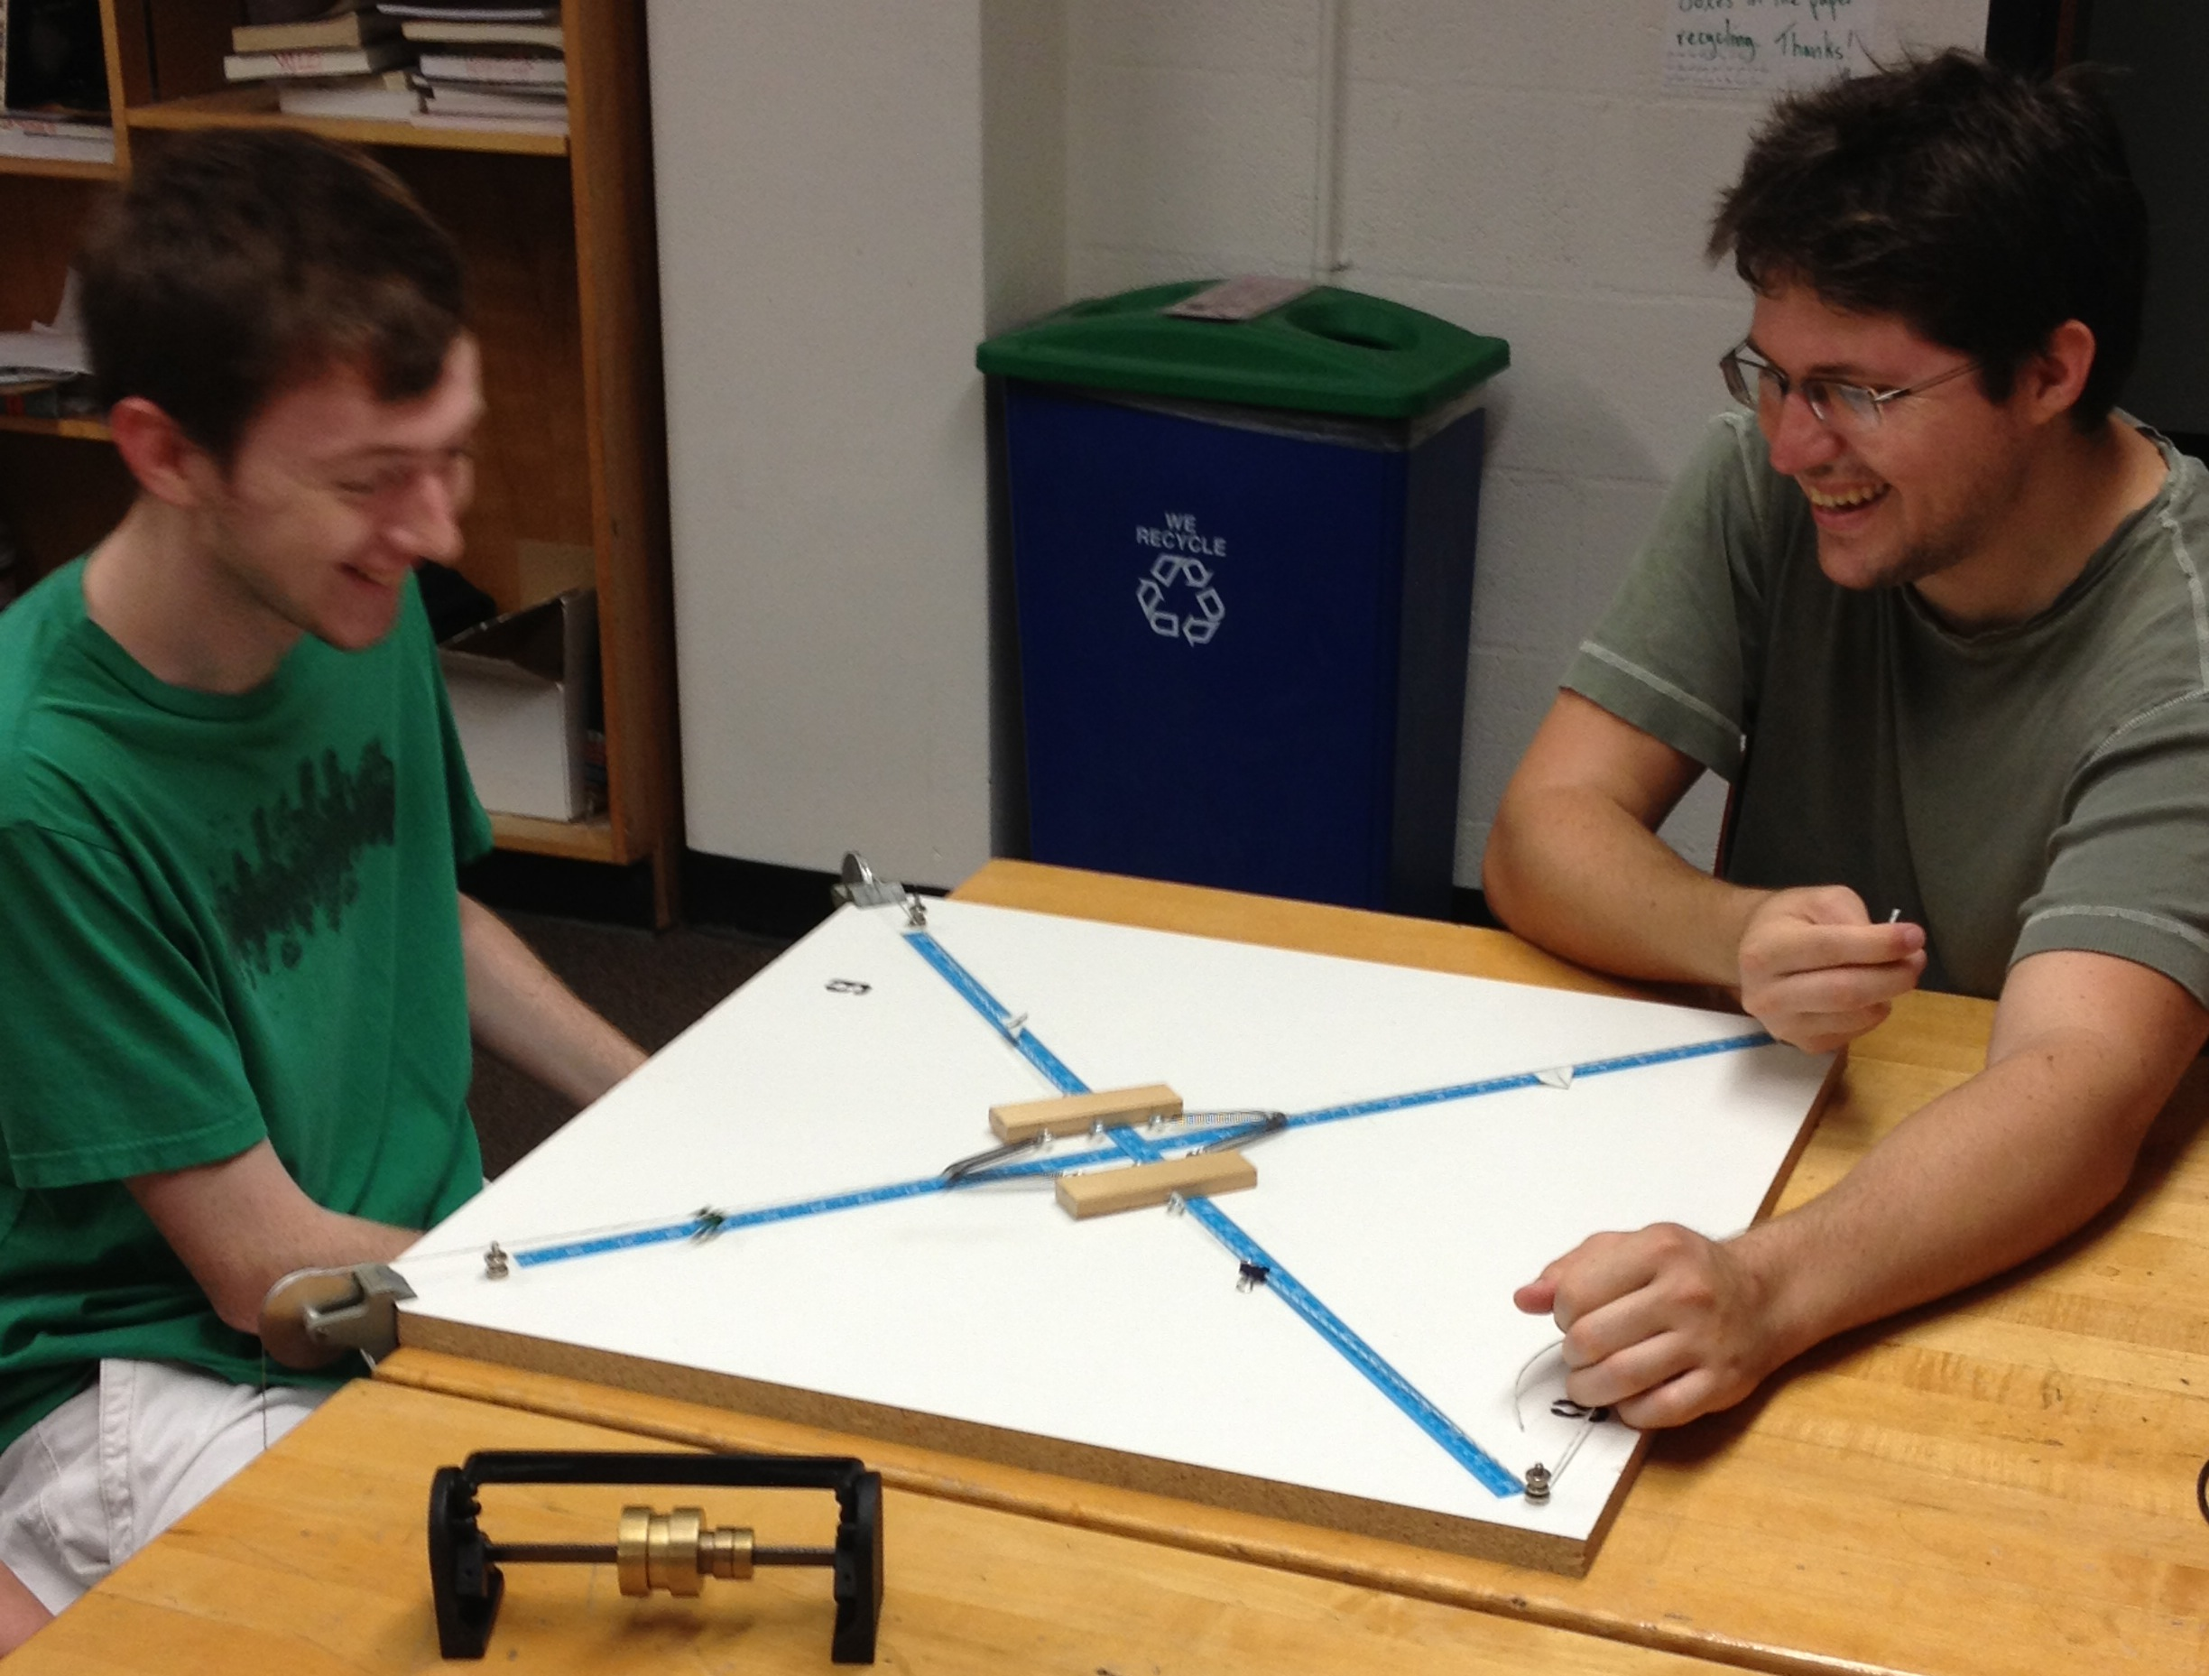
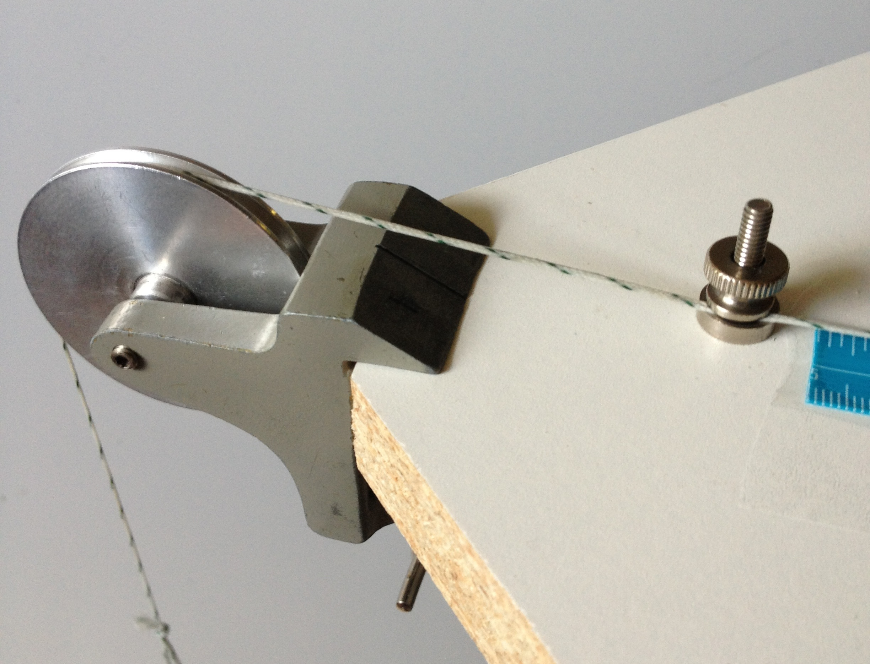
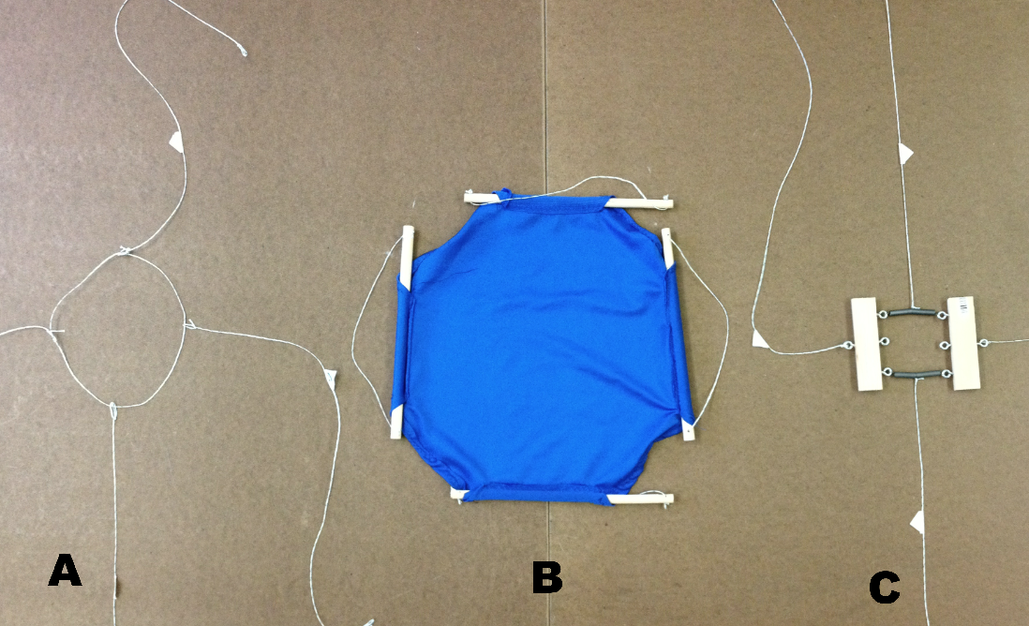
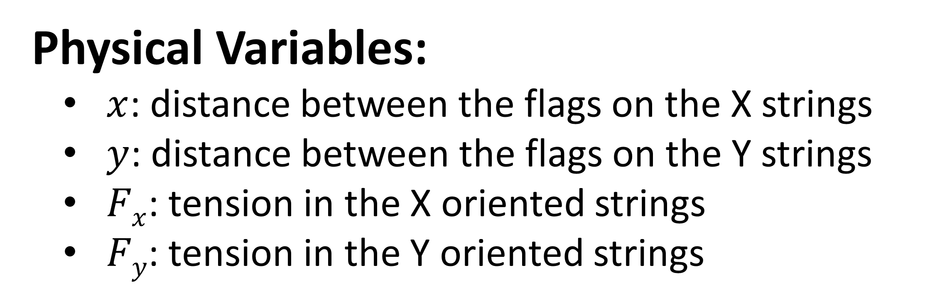
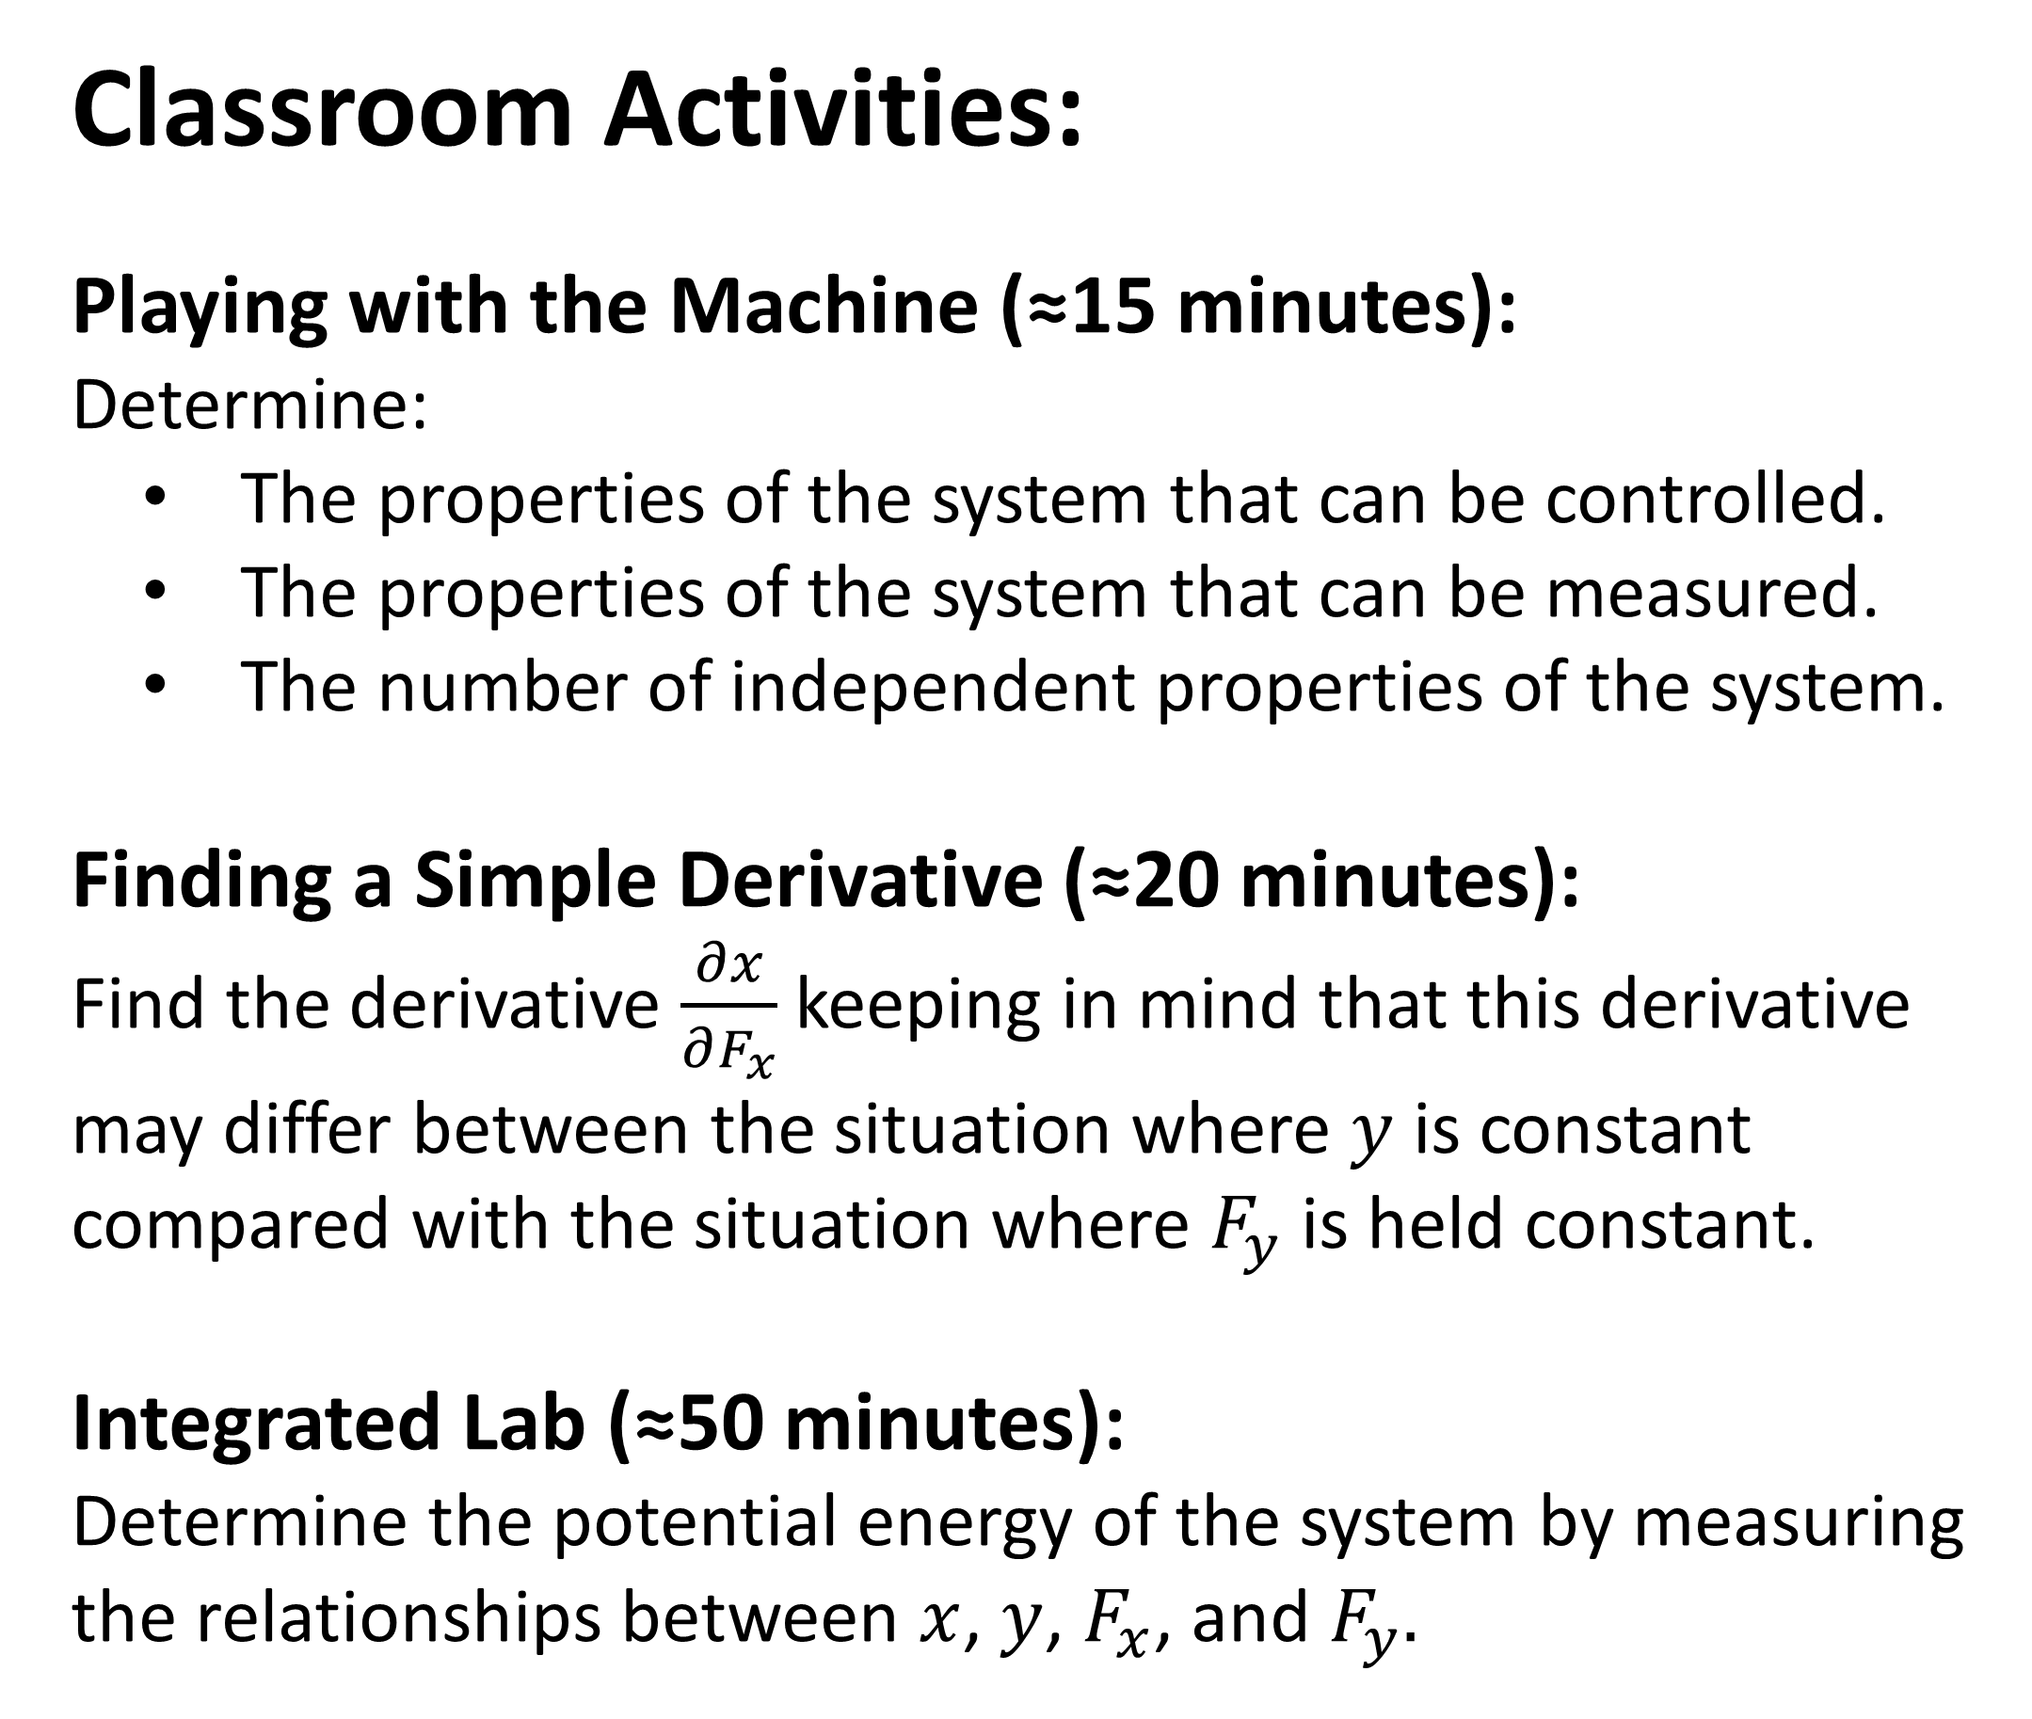
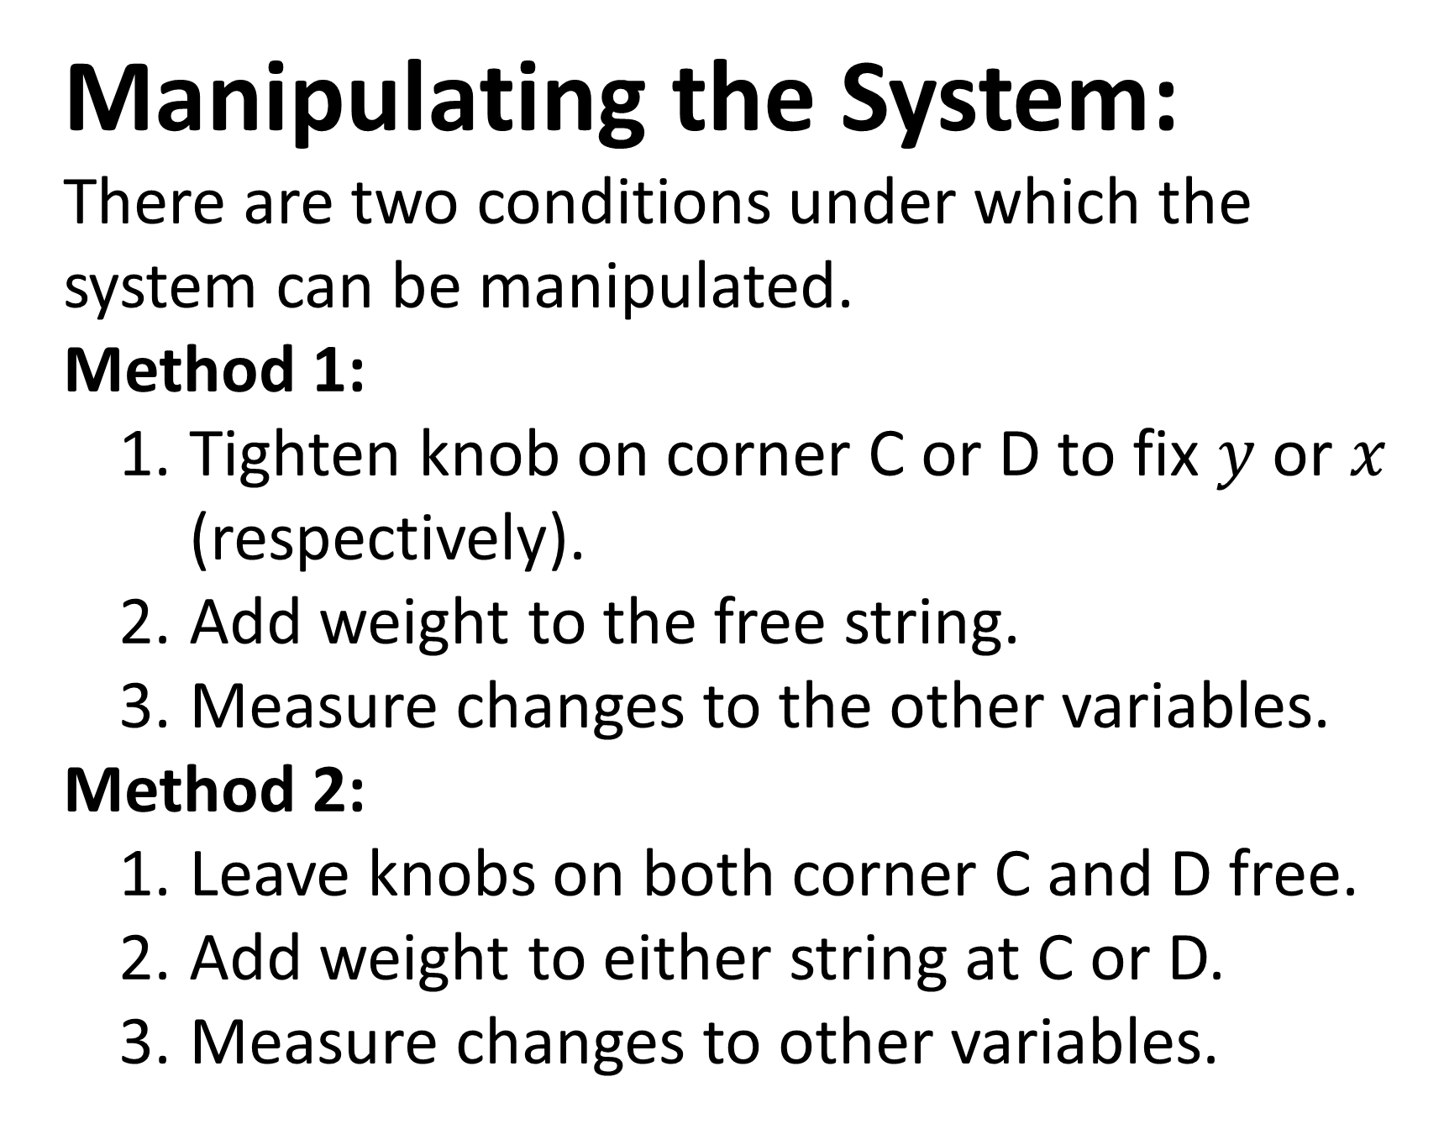
Abstract
Research has shown that students struggle to understand the use of partial derivatives in thermodynamics. We have designed an apparatus, which we have called a Partial Derivative Machine, that serves as a mechanical analogue of a thermodynamic system. Using this device, students have a tangible way to wrestle with issues related to partial derivatives and thermodynamics, such as which variables are held fixed, how many variables are independent, and how energy can be added to a system. In this paper, we present a description of the apparatus, an introduction to the associated activities, and an overview of how this apparatus can be connected to thermodynamic systems.
The Partial Derivative Machine
Grant Sherer, Mary Bridget Kustusch, Corinne A. Manogue, and David Roundy
Oregon State University
PERC 2013, Portland, OR
Paradigms in Physics
Acknowledgments
http://www.physics.oregonstate.edu/portfolioswiki
This work was supported by NSF DUE-1023120.
A Mechanical Analog for Thermodynamics
Manipulating the System:
There are two conditions under which the system can be manipulated.
Method 1:
Tighten knob on corner C or D to fix $y$ or $x$ (respectively).
Add weight to the free string.
Measure changes to the other variables.
Method 2:
Leave knobs on both corner C and D free.
Add weight to either string at C or D.
Measure changes to other variables.
The Partial Derivative Machine can be used to teach various mathematical techniques such as:
Total Differentials
Maxwell Relations
Partial Derivative Manipulations
Cyclic Chain Rule
Legendre Transforms
What is a Partial Derivative Machine?
The Partial Derivative Machine is an apparatus consisting of a central spring system that can be stretched via four strings extending outward. This central system is on a large piece of particle board which features a pulley on two adjacent corners (Corners C and D), and a knob on all four corners. The system is held in place using the knobs at A and B. Adding weight to the strings at C and D causes the system to stretch, and this stretching can be measured using the flags on the strings (Example labeled E).
Classroom Activities:
Playing with the Machine (≈15 minutes):
Determine:
The properties of the system that can be controlled.
The properties of the system that can be measured.
The number of independent properties of the system.
Finding a Simple Derivative (≈20 minutes):
Find the derivative $\frac{∂x}{∂F_{x}}$keeping in mind that this derivative may differ between the situation where $y$ is constant compared with the situation where $F_{y}$ is held constant.
Integrated Lab (≈50 minutes):
Determine the potential energy of the system by measuring the relationships between $x$, $y$, $F_{x}$, and $F_{y}.$
Alternative Central Systems:
“X-Axis”: Corner B to Corner D
“Y-axis”: Corner A to Corner C
Physical Variables:
$x$: distance between the flags on the X strings
$y$: distance between the flags on the Y strings
$Fx$: tension in the X oriented strings
$Fy$: tension in the Y oriented strings
By using central systems such as a loop of string (A), a piece of spandex (B), and different spring systems, students can experience various relationships between the properties of the system.

