Slide 1
Paradigms 2.0:
Supporting Collaborative Departmental Change
Corinne Manogue, Emily van Zee
and the Whole Paradigms 2.0 Team
July 24, 2017
ADD QR code

Slide 2






Support
National Science Foundation
  DUE-9653250, 0231194, 0618877
  DUE-0088901, 0231032, 0837829
  DUE-1023120, 1323800
Oregon State University
Oregon Collaborative for Excellence in the Preparation of Teachers
Grinnell College
Mount Holyoke College
Utah State University

Slide 3
Organizational Change Model
Investigate reality
Set goals based on principles
Learn from the experiences of others
Align desired change with goals
Assemble resources
Plan for Institutionalization
Implement new curriculum and pedagogical strategies
Study and reflect on results
ITERATE
Share with others

Slide 4
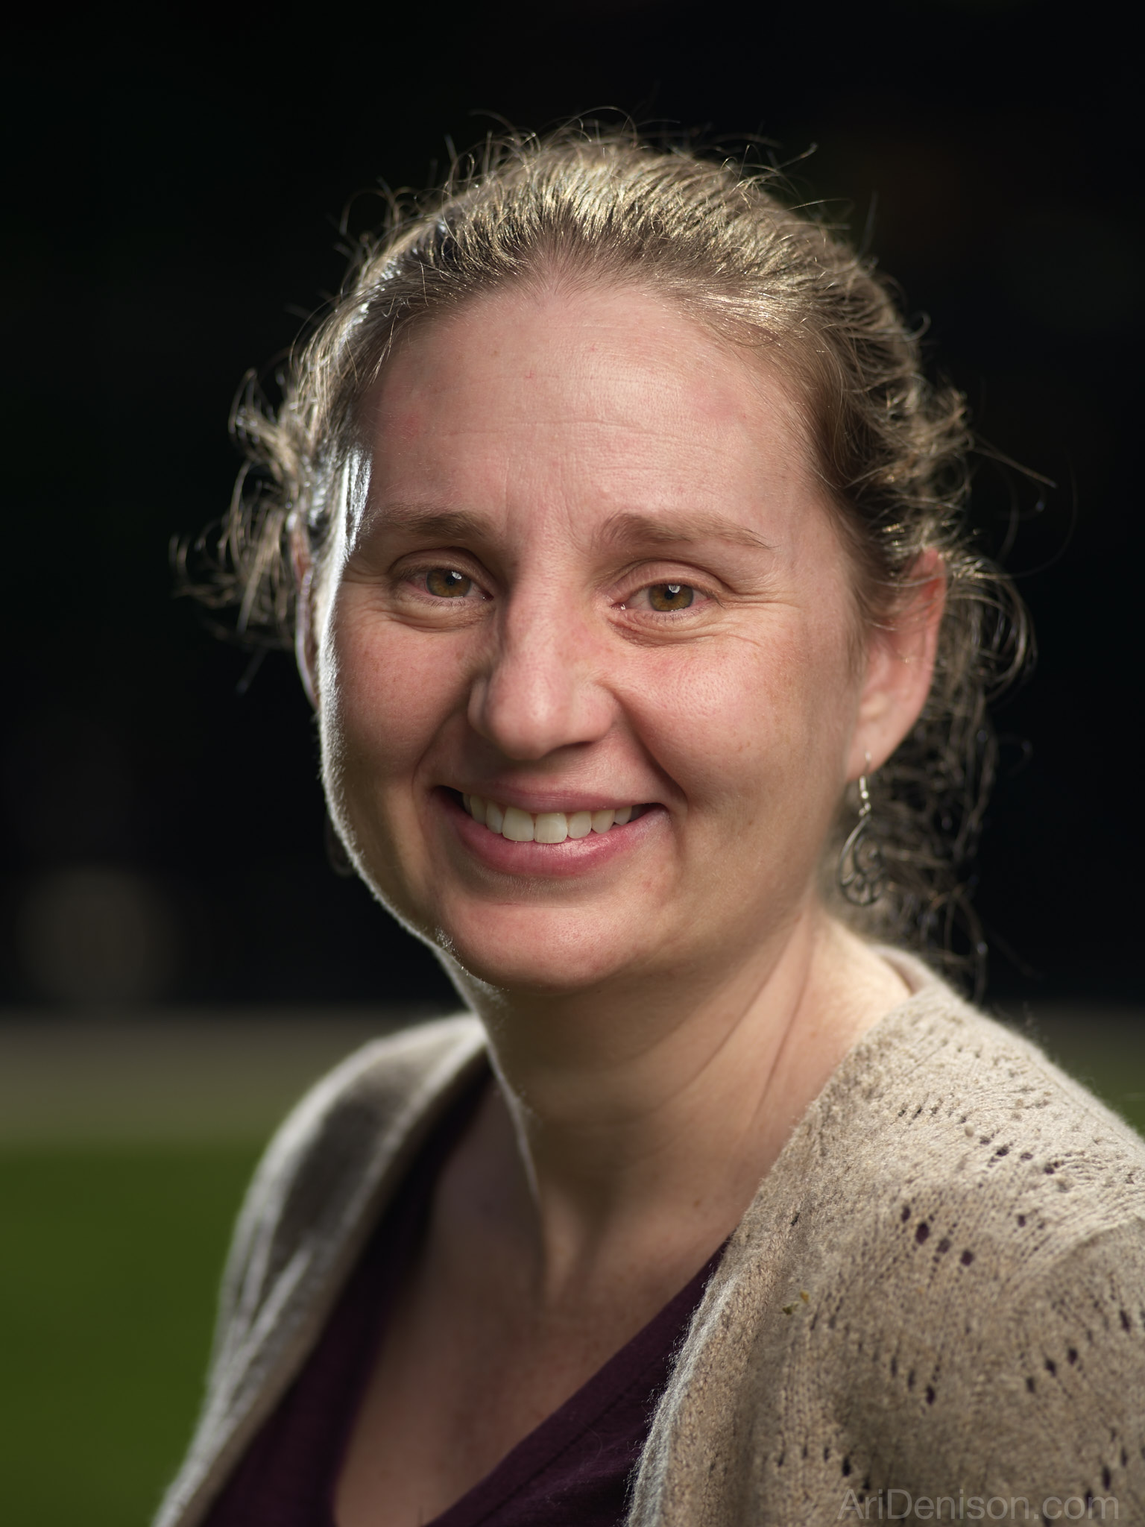
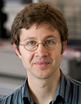
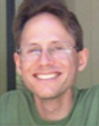
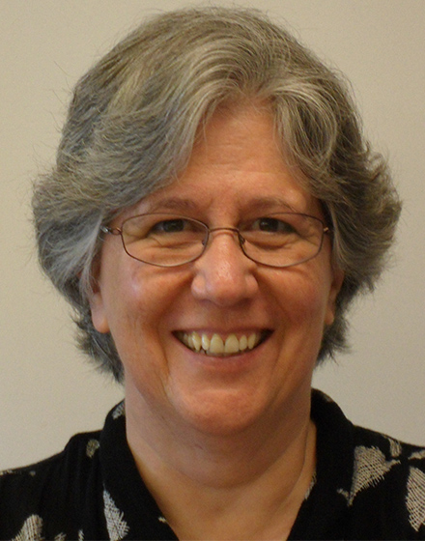
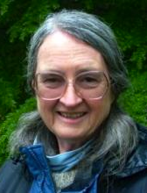
Paradigms 2.0 at OSU
Focus on Process:
  Narrative by Emily van Zee
  Ethnography/Institutional Change
  physics.oregonstate.edu/portfolioswiki/toolkit:start
  Add QR code

Slide 5
Essential Features
Collaborative ownership of the curriculum
Reorganization of the subject matter
Appropriate interactive engagement

Slide 6
Collaborative Ownership
Assemble resources
Consult everyone
Plan for institutionalization

Slide 7
Assemble Resources
Who will do the work? How can you gain their commitment? Desirable vs. not.
Do you have spaces that will allow the work you want to do?
What are the institutional constraints—registrar, calendar, teaching loads.
Collaborative Ownership

Slide 8
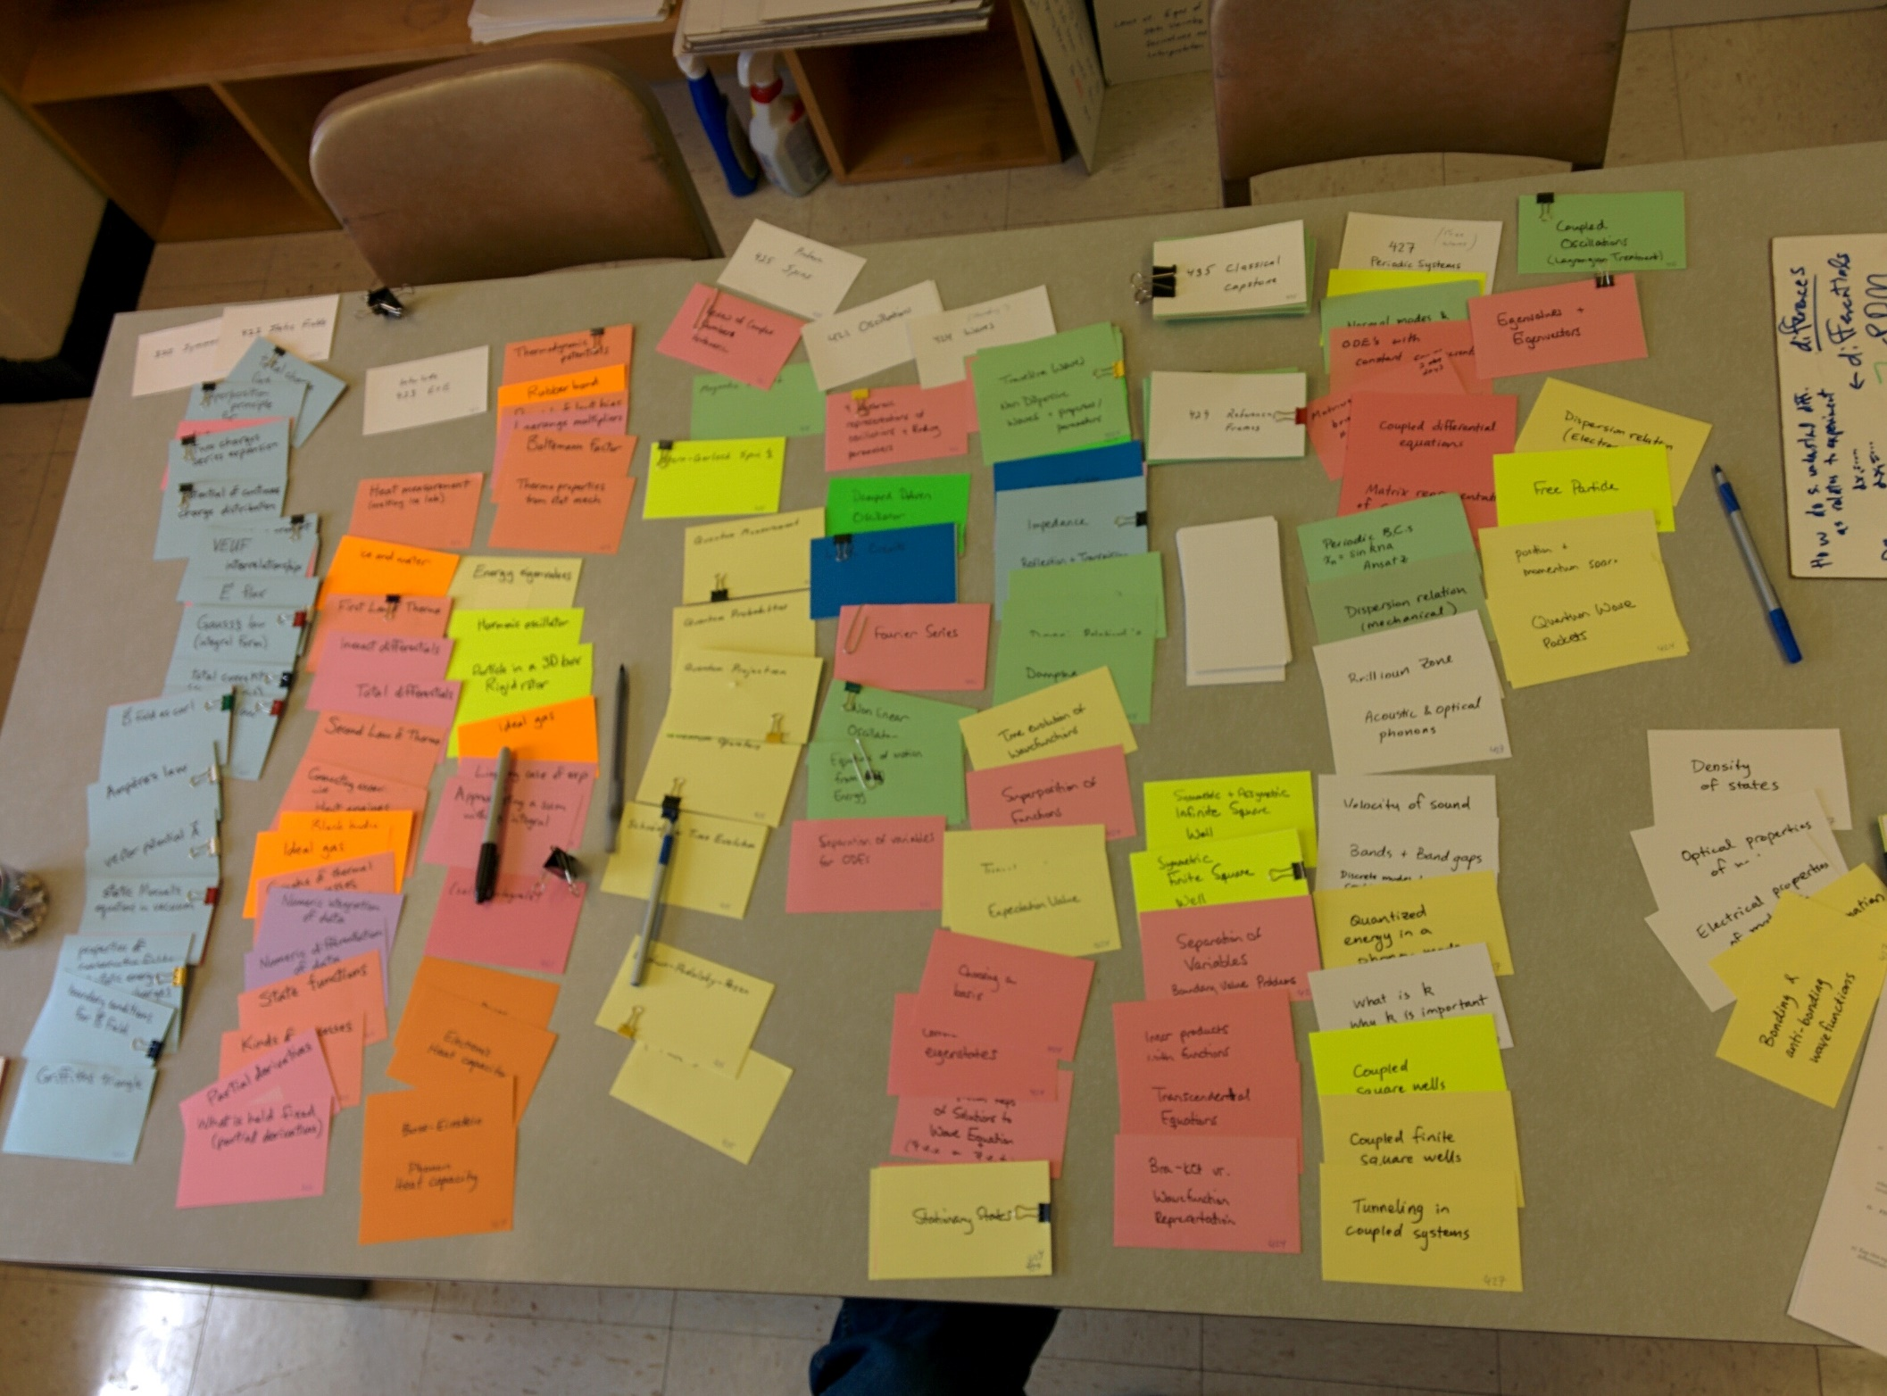
Consult Everyone
Collaborative Ownership

Slide 9
Plan for Institutionalization
Confirm & maintain support of Chair and administration—this is not a fad!!
Hold regular curriculum meetings
New faculty shadow experienced teachers:
  PCK
  Classroom management
TAs and students give feedback
Collaborative Ownership

Slide 10
Success?
How much are our faculty actually invested in this shared curriculum?
How much do we understand the shared curriculum?
Do we get value out of curriculum meetings?
Do the upper-division meetings have substantive conversations in them?
Do faculty make suggestions for changing their courses?
Do faculty volunteer to take over some responsibilities in their own courses for issues students are having problems with or things that don't work in another course?
Collaborative Ownership

Slide 11
Reorganization of Content
Common themes
Common mathematical methods
Careful sequencing (learning progressions)
Use the results of PER
Content Reorganization

Slide 12
Common Themes
Central Forces:
  Energy
  Angular momentum
Common Mathematics
Static Fields:
  Electrostatics
  Gravity
Content Reorganization

Slide 13
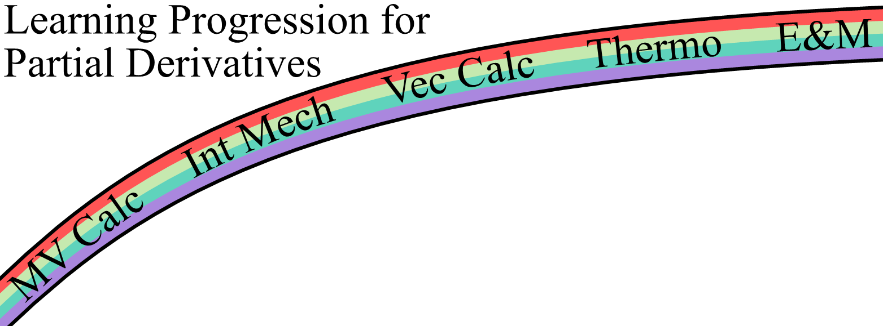
Careful Sequencing
Add QR code
Content Reorganization

Slide 14
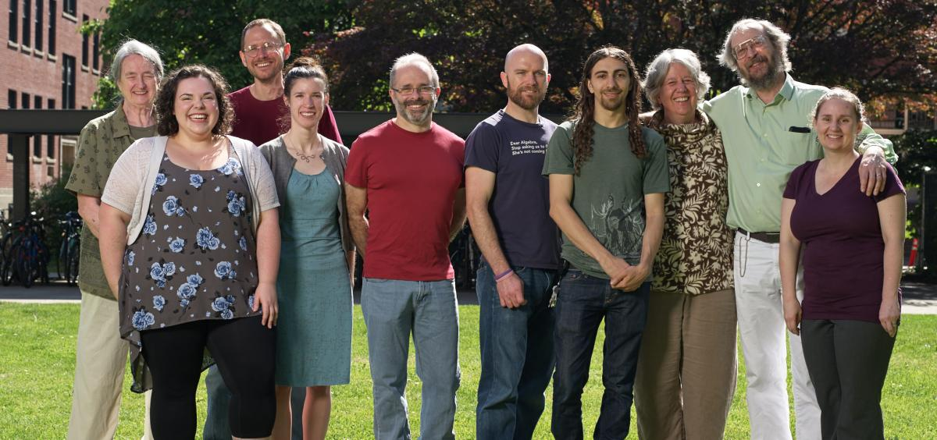
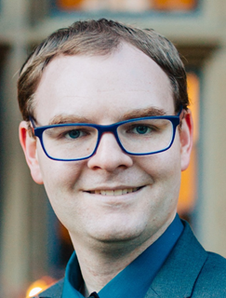
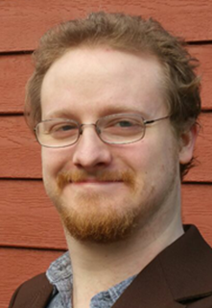
PER at OSU
Paul Emigh
Ian Founds
Content Reorganization

Slide 15
Success?
There is NO WAY to judge the effectiveness of your curriculum as a whole. There are LOTS of ways to judge pieces of the curriculum. Qualitative ways may be more valuable than quantitative.
Content Reorganization

Slide 16
Success?
How can we best sequence the content so that physics concepts develop in a natural way?
How can we best sequence the content so that mathematical skills develop in time of applications?
Are we continually increasing our understanding about which parts of the curriculum are hard for students? are easier for students?
Are we designing or adopting new curricular materials that would help address these issues?
Content Reorganization

Slide 17
Interactive Engagement
Use strategies that increase communication, especially from students to faculty
Use a variety of active engagement strategies that support different types of learning and different learners
Use representations that scaffold learning
Make sure your spaces/classrooms are welcoming and comfortable for all students

Slide 18
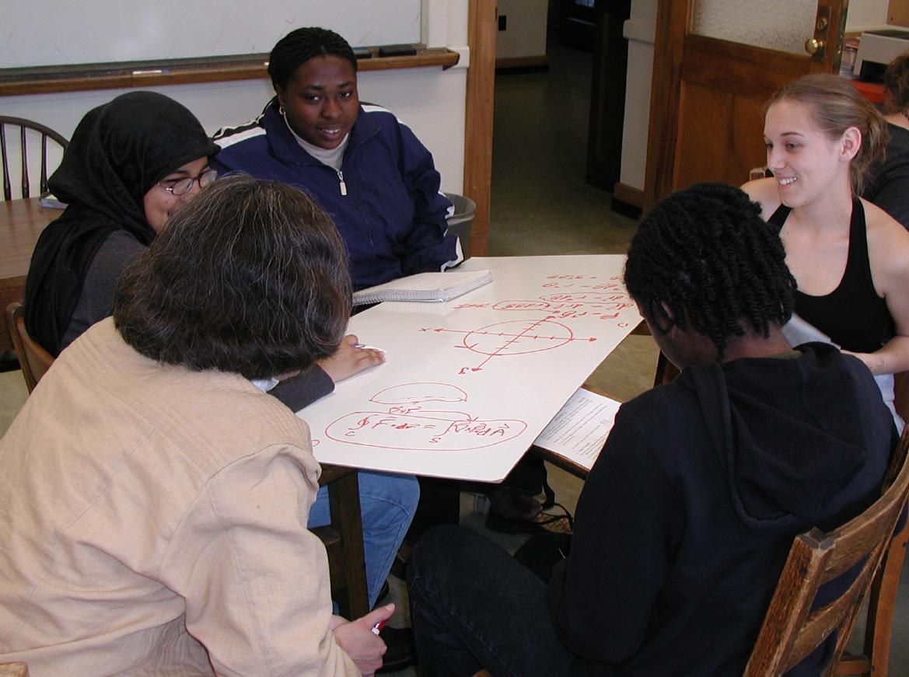
Increase Communication
All effective active-engagement strategies increase communication from the students to the faculty member.
Active Engagement

Slide 19
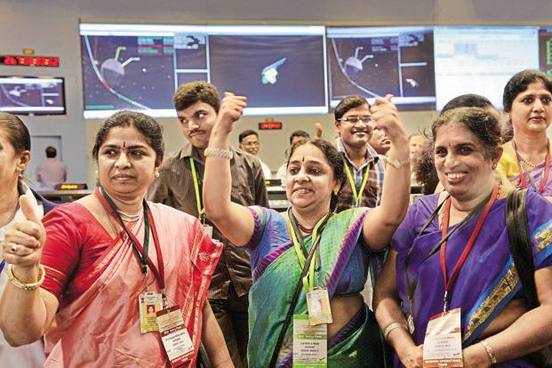
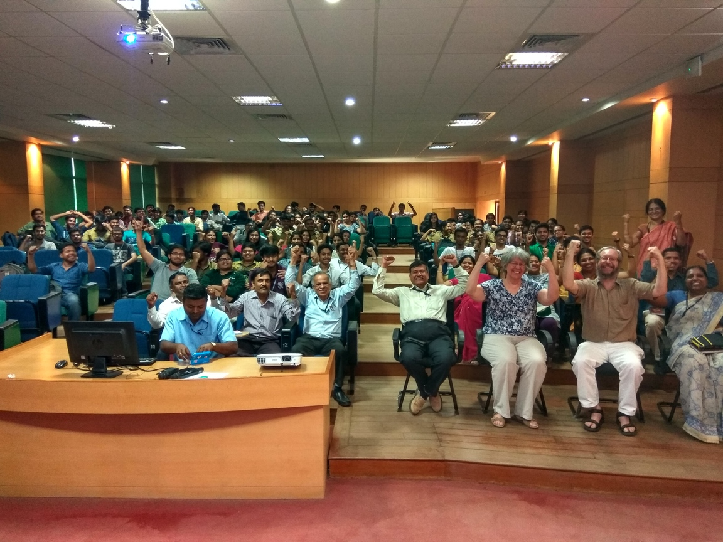
Increase Agency
Active Engagement

Slide 20
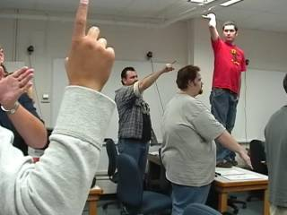
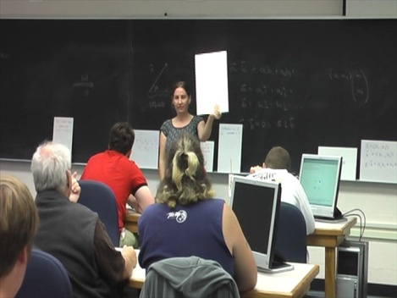
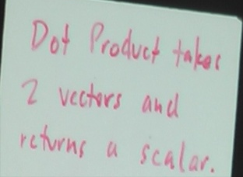
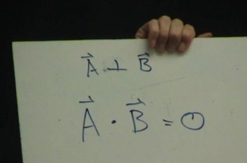
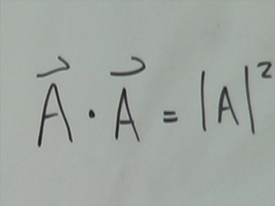
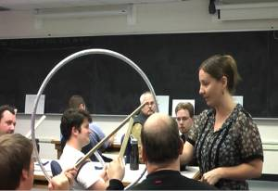
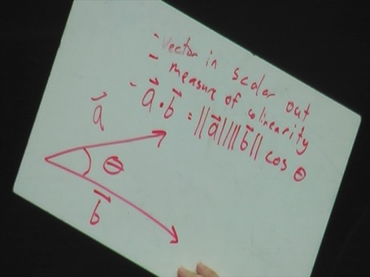
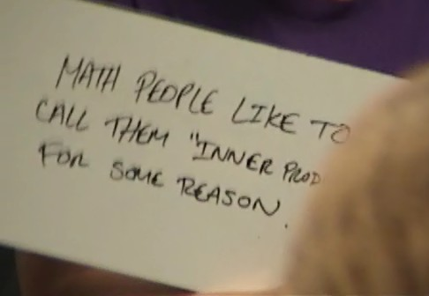
A Variety of Activity Types
Small Whiteboard Questions
Kinesthetic Activities
Active Engagement

Slide 21
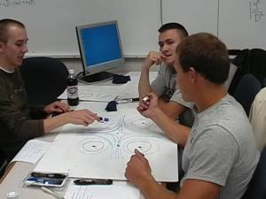
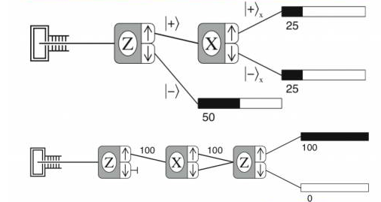
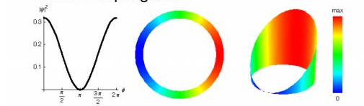
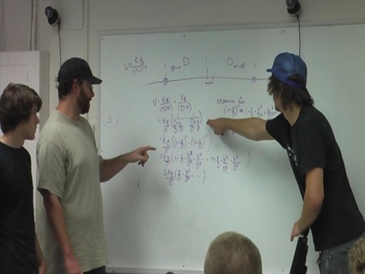
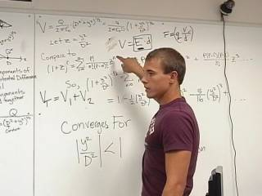
Small Group Activities
Compare & Contrast
Computer Visualization
Active Engagement

Slide 22
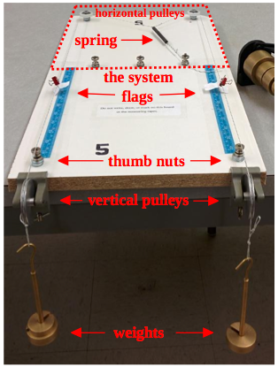
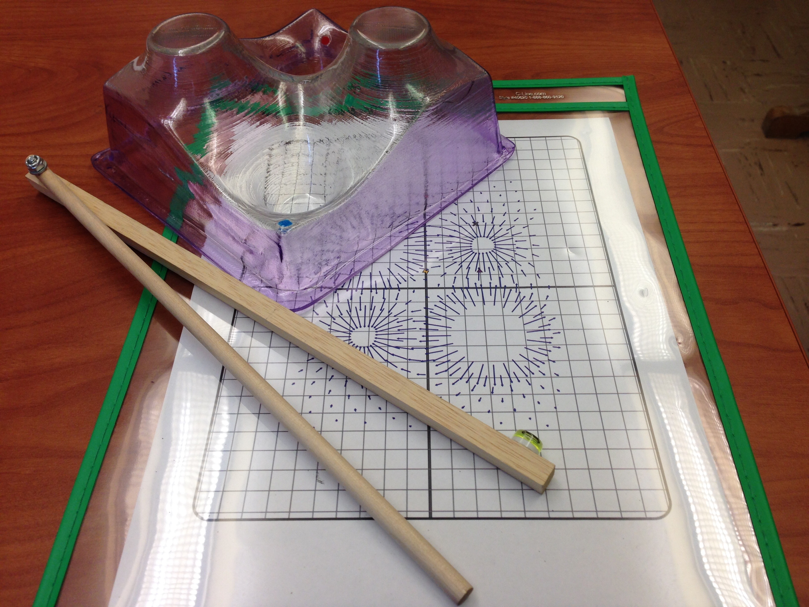
Representations Scaffold Learning
Physical Manipulatives
Active Engagement

Slide 23
Lecture vs. Activities
The Instructor:
  Paints big picture.
  Inspires.
  Covers lots fast.
  Models speaking.
  Models problem-solving.
  Controls questions.
  Makes connections
The Students:
  Focus on subtleties.
  Experience delight.
  Slow, but in depth.
  Practice speaking.
  Practice problem-solving.
  Control questions.
  Make connections.
Active Engagement

Slide 24
Success?
Are we using a variety of strategies in the classroom?
Are the strategies that we use appropriate for what we want the students to be learning?
Are the students buying into using the active engagement?
Do all students feel welcome in department spaces, including classrooms.
Do students feel safe to take intellectual risks in the classroom?

Slide 25
TRU: The Five Dimensions of Powerful classrooms
The Content | Cognitive Demand | Equitable Access to Content | Agency, Authority and Identity | Formative Assessment
The extent to which classroom activity structures provide opportunities for students to become knowledgeable, flexible, and resourceful disciplinary thinkers… | The extent to which students have opportunities to grapple with and make sense of important disciplinary ideas and their use… | The extent to which classroom activity structures invite and support the active engagement of all of the students in the classroom with the core disciplinary content being addressed by the class… | The extent to which students are provided opportunities to … build on others’ ideas and have others build on theirs – in ways that contribute to their development …development of positive identities as thinkers and learners. | The extent to which classroom activities elicit student thinking and subsequent interactions respond to those ideas, building on productive beginnings and addressing emerging misunderstandings…
Alan Schoenfeld
http://map.mathshell.org/trumath.php

