Slide 1
Single-sheet inorganic colloidal dispersions are common and easily prepared
Ion exchange: (fixed charge density)
  smectite clays Na_{x+y}Al_{2-y}Mg_{y}Si_{4-x}Al_{x}O₁₀(OH)₂
  layered double hydroxides Mg₃Al(OH)₈Cl
  layered oxides Cs_{x}Ti_{2-x/4x/4}O₄
  metal phosphorous sulfides K_{0.4}Mn_{0.80.2}PS₃
Redox reaction: (variable charge density)
  metal dichalocogenides Li_{x}MoS₂
  layered oxides Li_{x}CoO₂ , Na_{x}MoO₃

Slide 2
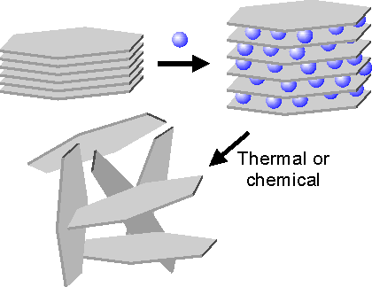
Intercalation/exfoliation
Graphite exfoliation
Layered chalcogenide exfoliation
Can we make colloidal [graphenium]⁺ or [graphide]⁻ sheets

Slide 3
…if you have the correct sheet charge density and an appropriate polar solvent
Intercalation compound Swollen Colloidal
No solvation solvent in galleries solvated ions/sheets
ΔΗ_{L} > ΔΗ_{solv}
ΔΗ_{solv} > ΔΗ_{L}
higher surface charge density
lower surface charge density

Slide 4
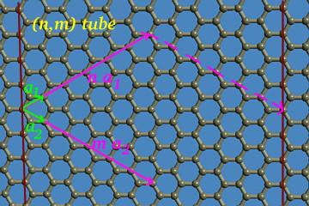
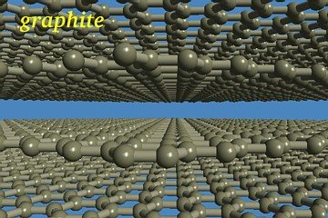
Graphite structure
C-C in-plane = 1.42 Å
Usually (AB)_{n} hexgonal stacking
Interlayer distance
= 3.354 Å
Graphite is a semi-metal, chemically stable, light, strong
A
B
http://www.ccs.uky.edu/~ernst/
A

Slide 5
Graphite Lithiation
Expands about
10% along z
Graphite lithiation: approx 0.2-0.3 V vs Li⁺/Li
Theoretical capacity:
Li metal > 1000 mAh/g
C₆Li 370
Actual C₆Li formation: 320 – 340 mAh/g reversible;
20 – 40 irreversible

Slide 6
Li arrangement in C₆Li
Li⁺ occupies hexagon centers of non-adjacent hexagons
Theoretical capacity:
Li metal > 1000 mAh/g
C₆Li 370
Typical C₆Li formation: 320 – 340 reversible;
20 – 40 irreversible

Slide 7
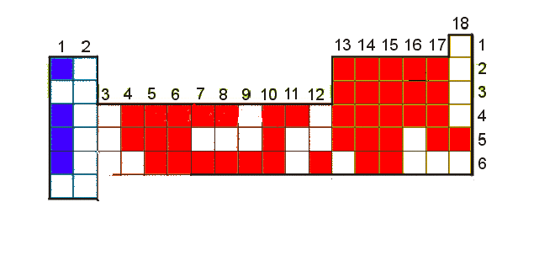
GIC’s
Reduction M⁺C_{x}⁻
Group 1 except Na
Oxidation C_{x}⁺An⁻
F, Br₃⁻, O (OH)
  BF₄⁻, P → BiF₆⁻ , GeF₆²⁻ to PbF₆²⁻, MoF₆⁻, NiF₆²⁻, TaF₆⁻, Re → PtF₆⁻
  SO₄⁻, NO₃⁻, ClO₄⁻, IO₃⁻, VO₄³⁻, CrO₄²⁻
  AlCl₄⁻, GaCl₄⁻,FeCl₄⁻, ZrCl₆⁻,TaCl₆⁻

Slide 8
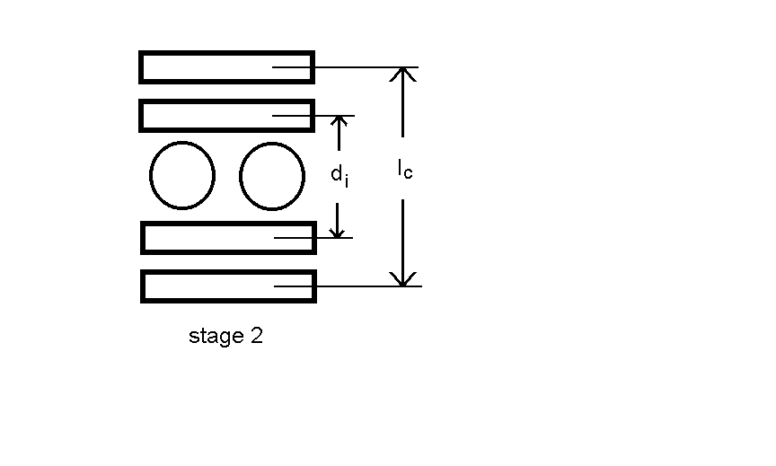
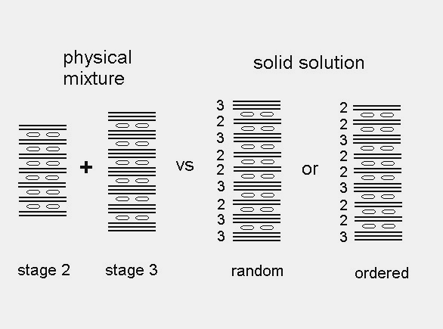
Staging and dimensions
I_{c} = d_{i} + (n - 1) (3.354 Å)
For fluoro, oxometallates d_{i} ≈ 8 A,
for chlorometallates d_{i} ≈ 9-10 A

Slide 9
Graphite oxidation potentials
H₂O oxidation potential vs Hammett acidity
Colored regions show the electrochemical potential for GIC stages.
49% hydrofluoric acid
All GICs are unstable in ambient atmosphere , they oxidize H₂O

Slide 10
New syntheses: chemical method
1,2
C_{x} + K₂MnF₆ + LiN(SO₂CF₃)₂ C_{x}N(SO₂CF₃)₂ + K₂LiMnF₆
oxidant anion source GIC
1. 48% hydrofluoric acid, ambient conditions
2. hexane, air dry
O
O
CF₃
F₃C
S
S
N
..
O
O
Oxidant and anion source are separate and changeable. Surprising stability in 50% aqueous acid.

Slide 11
C_{x}N(SO₂CF₃)₂ chem prepn

Slide 12
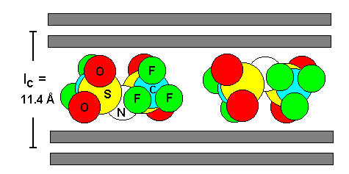
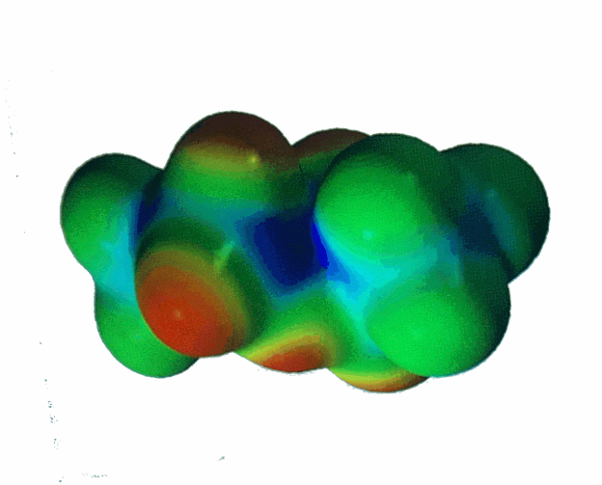
New syntheses: N(SO₂CF₃)₂ orientation
F
F
F
F

Slide 13
Increasing F anion co-intercalate with reaction time
C_{x}N(SO₂CF₃)₂· δF
Katinonkul, Lerner
Carbon (2007)

Slide 14
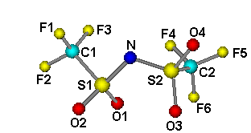
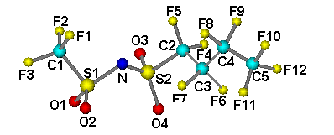
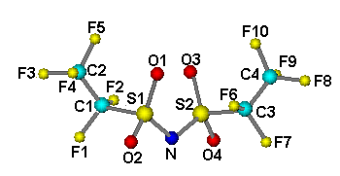
New syntheses: imide intercalates
Anion mw d_{i} / nm
1. N(SO₂CF₃)₂ 280 0.81
2. N(SO₂C₂F₅)₂ 380 0.82
3. N(SO₂CF₃)(SO₂C₄F₉) 430 0.83
1
3
2

Slide 15
C_{x}N(SO₂CF₃)₂ echem prepn
2 → 1
3 → 2

Slide 16
C_{x}N(SO₂CF₃)₂ - echem prepn
C_{x}PFOS
C_{x}N(SO₂CF₃)₂

Slide 17
Imide (NR₂⁻) intercalates
Anion MW d_{i} / Å
N(SO₂CF₃)₂ 280 8.1
N(SO₂C₂F₅)₂ 380 8.2
N(SO₂CF₃) 430 8.3
(SO₂C₄F₉)

Slide 18
C_{x}PFOS - preparation
C_{x}+ K₂Mn(IV)F₆ + KSO₃C₈F₁₇
→ C_{x}SO₃C₈F₁₇ + K₃Mn(III)F₆
(C_{x}PFOS)
Solvent = aqueous HF
3.35 A

Slide 19
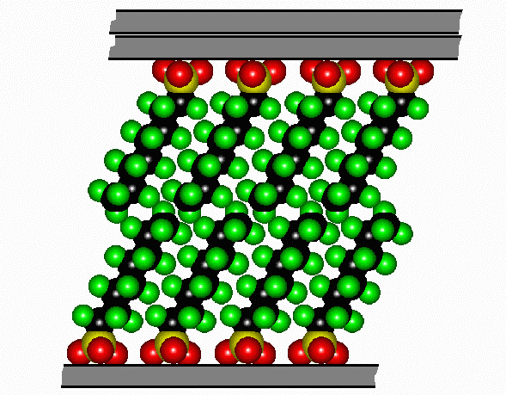
C_{x}PFOS intercalate structure
Anions self-assemble as bilayers within graphite galleries

Slide 20
New syntheses: C_{x}SO₃C₈F₁₇
Domains are 10-20 sheets along stacking direction

Slide 21
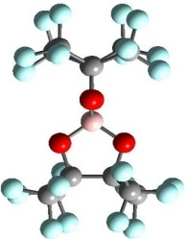
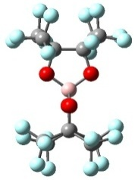
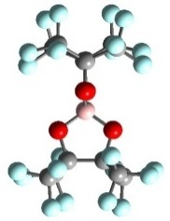
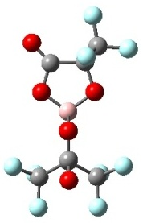
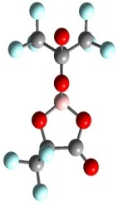
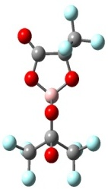
Borate chelate GIC’s
C_{x}B(O₂C₂(CF₃)₄)₂
Stage 1
1.13
0.85 nm
Blue: obs
Pink: calc
C_{x}B(O₂C₂O(CF₃)₂)₂
1.12
Stage 2
0.78 nm
T
Unexpected anion orientation - long axis to sheets

Slide 22

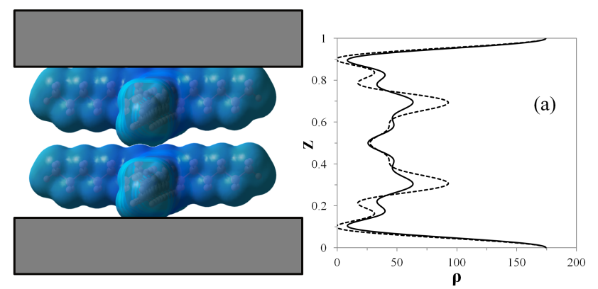
GIC with alkylammonium cations
e.g. C₄₁[(C₄H₉)₄N]
Small R₄N-intercalates; flattened monolayer
Large R₄N-intercalates; flattened bilayer
e.g. C₆₃[(C₇H₁₅)₄N]
1D electron density maps of the flattened bilayer vs. expanded monolayer of (C₇H₁₅)₄N-GIC.

