Slide 1
OSU Faculty Research Presentation
Professor Michael Lerner
Oct 14, 2011

Slide 2
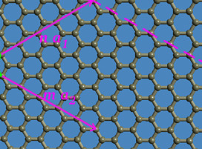
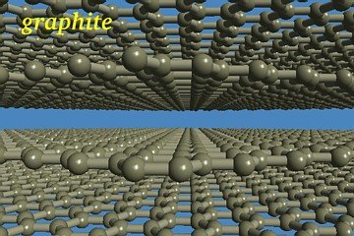
Graphite’s fundamental properties
Graphite / graphene sheets are:
Thin (0.34 nm)
Strong (C-C covalent bonding)
Thermally and chemically stable
Conducting and electroactive
Light-weight
Cheap and non-toxic
Image from www.ccs.uky.edu/~ernst

Slide 3
New syntheses: C_{x}N(SO₂CF₃)₂
Yan, Lerner, J Electrochem Soc 2001

Slide 4
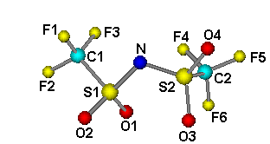
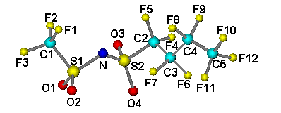
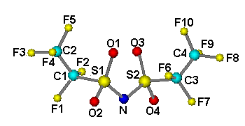
New syntheses: imide intercalates
Anion mw d_{i} / nm
1. N(SO₂CF₃)₂ 280 0.81
2. N(SO₂C₂F₅)₂ 380 0.82
3. N(SO₂CF₃)(SO₂C₄F₉) 430 0.83
1
3
2

Slide 5
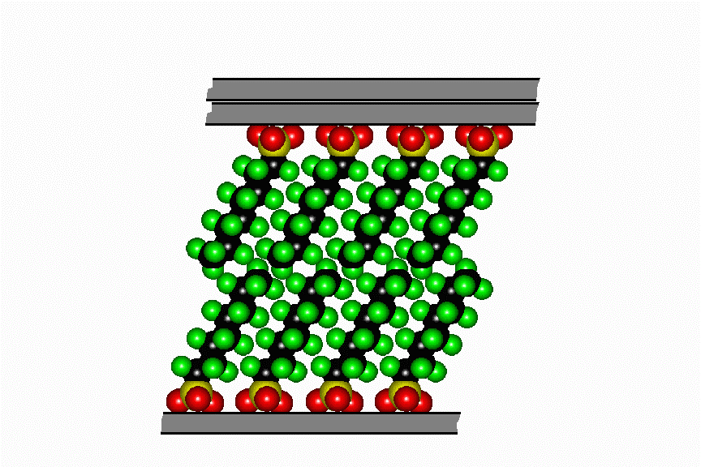
New syntheses: C_{x}SO₃C₈F₁₇
Anions self-assemble as bilayers within graphite galleries

Slide 6
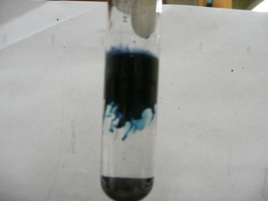
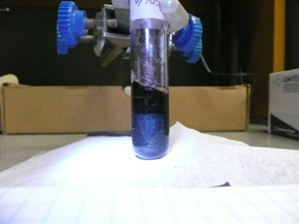
Synthesis of amine GICs

Slide 7
Synthesis of amine GICs
A comparative structural study of ternary graphite intercalation compounds containing alkali metals and linear or branched amines Tosapol Maluangnont, Weekit Sirisaksoontorn and Michael M. Lerner , Carbon 2011

Slide 8
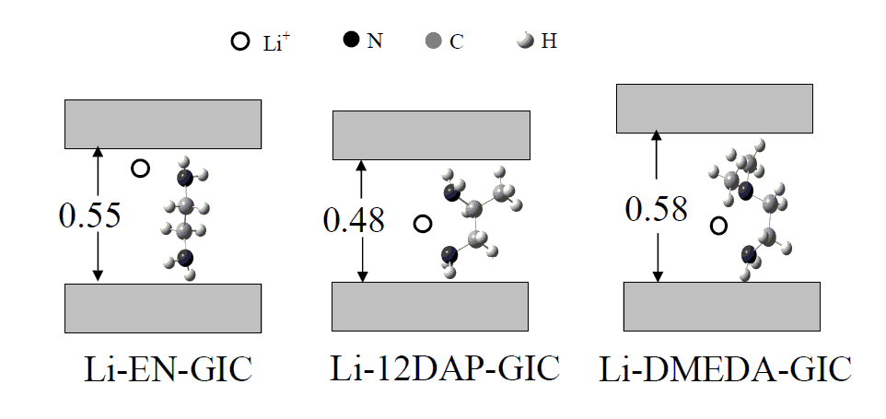
Synthesis of diamines
Synthesis of Ternary and Quaternary Graphite Intercalation Compounds containing Alkali Metal Cations and Diamines Tosapol Maluangnont and Michael M. Lerner Inorganic Chemistry 2011, in press

Slide 9
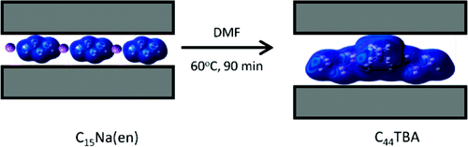
Synthesis of alkylammonium GICs
Weekit Sirisaksoontorn, Adeniyi A. Adenuga, Vincent T. Remcho, and Michael M. Lerner J. Am. Chem. Soc., 2011

Slide 10
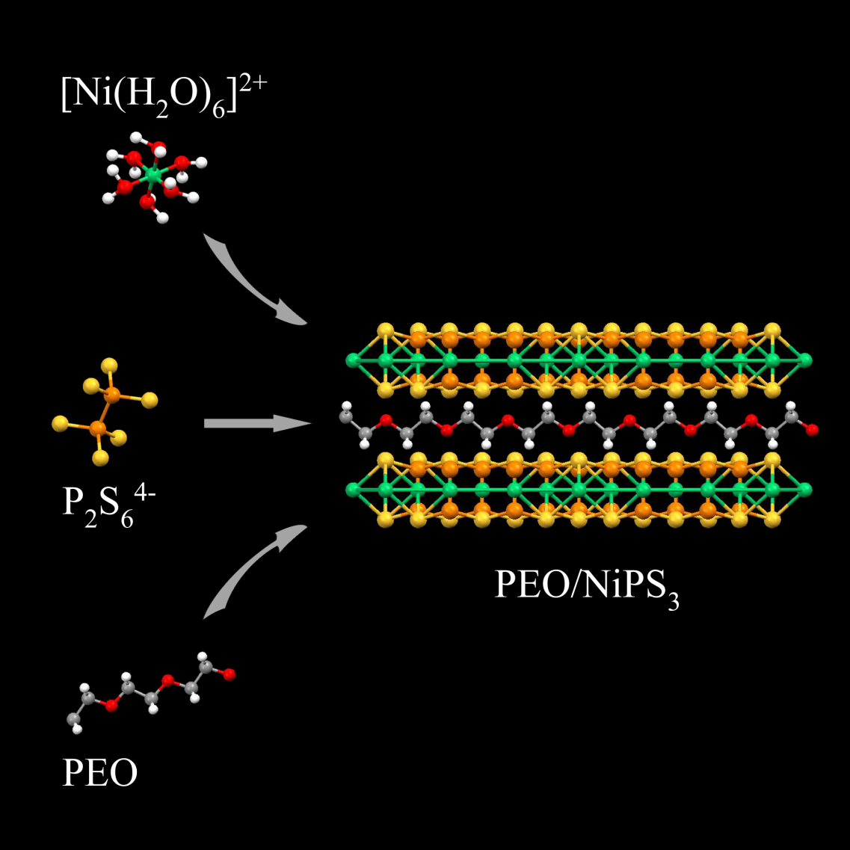
Template Syntheses
Template Preparation of NiPS₃ Polymer Nanocomposites Amila Udayanga Liyanage and Michael M. Lerner RSC Advances 2011, in press

